Slide 1

Compensation, Career Development, and Job Satisfaction as the Antecedent of Nurse Turnover Intention
Hidayah1, Hana Rizka Ananda2
1,2Master of Hospital Management, Postgraduate Program, Universitas Muhammadiyah Yogyakarta, Indonesia
1nurhidayah@umy.ac.id, 2hanarizkananda@gmail.com

Slide 2
Introduction
Shortage of professional nurse in a hospital is threaten service quality and patient safety.
Inadequate compensation, no career development, and dissatisfaction can increase turnover intention. Increasing the resilience of professional nurses better than recruiting new nurses from an economic perspective.

Slide 3
Research Purpose and Method
The research analyzed the effect of compensation and carrier development on job satisfaction and the impact on turnover intention of nurses in a private hospital in Yogyakarta, Indonesia.
A quantitative research design with cross sectional approach used. The sampling technique was simple random sampling. The samples consisted of 47 nurses who made a self-reported by filling out the questionnaire. Data analysis used Partial Least Square.

Slide 4
Gender
Education
Category | Frequency |  | Presentage
Man | 5 | 10.6
Women | 42 | 89.4
Total | 47 | 100.0
Category | Frequency | Presentage
D3 | 33 | 70.2
S1 | 14 | 29.8
Total | 47 | 100.0
Age
Employment Status
Category | Frequency | Presentage
< 25 Years | 4 | 8.5
25-30 Years | 23 | 48.9
31-35 Years | 8 | 17.0
> 35 Years | 12 | 25.5
Total | 47 | 100.0
Category | Frequency | Presentage
Contract | 8 | 17.0
Permanent | 39 | 83.0
Total | 47 | 100.0

Slide 5
Validity and Reliability Test
 | Cronbach's Alpha | rho_A | Composite Reliability | Average Variance Extracted (AVE)
Career Dev | 0,997 | 0,997 | 0,998 | 0,978
Financial Comp | 0,977 | 0,985 | 0,982 | 0,917
Job Satis | 1,000 | 1,000 | 1,000 | 0,993
Turnover Int | 0,864 | 0,892 | 0,918 | 0,791
 | R Square | R Square Adjusted
Job Satis | 0,964 | 0,963
Turnover Int | 0,739 | 0,721

Slide 6
PATH COEFFIENTS
 | Original Sample (O) | Sample Mean (M) | Standard Deviation (STDEV) | T Statistics (|O/STDEV|) | P Values
Career -> Job Satis | 1,127 | 0,855 | 0,444 | 2,538 | 0,011
Career -> Turnover Int | -1,431 | -1,132 | 0,712 | 2,011 | 0,045
Financial Comp -> Job Satis | -0,157 | -0,113 | 0,229 | 0,686 | 0,493
Financial Comp -> Turnover Int | -0,317 | -0,284 | 0,194 | 1,628 | 0,104
Job Satis -> Turnover Int | 2,454 | 1,863 | 1,088 | 2,256 | 0,024

Slide 7
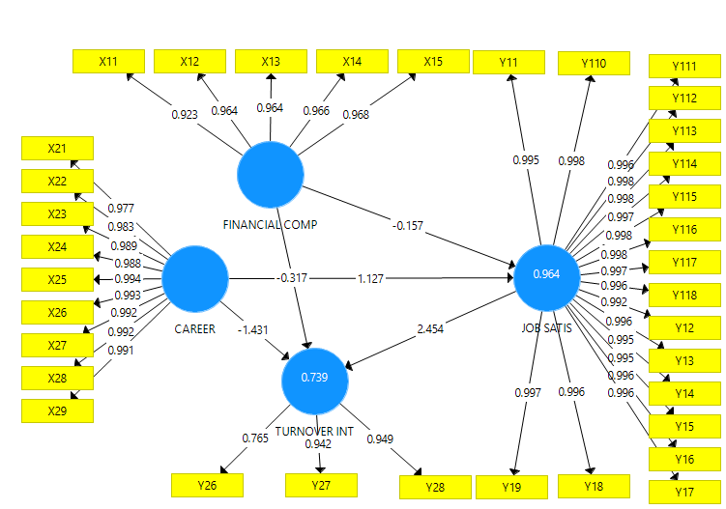

Slide 8
Discussion1
In light of protected workforce shortage that still continuous, turnover is crucial issue in the world. Turnovers have strong correlation with patient outcomes particularly patient safety (falls, infections), poor job satisfactions and quality of patient care (Lu, et al., 2017) (Roche et al., 2015).
Job satisfaction influence turnover intention (Arianto and Syihabudhin, 2018), (Omar et al., 2018), (Lu, et al., 2017), (Oktizulvia et al., 2017), (Parry, 2008)
Turnover intention also had correlation with financial rewards. So, to reduce turnover intention, the management should be pay attention seriously to financial rewards (Azeez, 2016). Financial reward and career development influence turnover intention (Omar et al., 2018), (Ghafoor et al., 2017).

Slide 9
Discussion2
Career development is essential for every professional of nurse. To maintain nurse competencies needed continuing career development. A study found that continuing professional development have positive correlation with nurse satisfaction (Hariyati et al, 2017).
Inadequate compensation, unclear career development, and dissatisfaction can increase turnover intention. Increasing the resilience of professional nurses better than recruiting new nurses from an economic perspective. The cost of turnover is very high. Employee are essential assets and the building blocks of an organization.
Researchers and practitioners stated that an organization should satisfy and retain key performers (Abid and Hassan Butt, 2017) or the will lost much money to train and develop a new employee. So, raising turnover of workforce becomes a serious organizational problem.

Slide 10
Concusion
Financial compensation has negative effect on job satisfaction. So, not supported by the theory.
Financial compensation has negative and significant effect on turnover intention
Career development has positive and significant effect on job satisfaction
Career development has negative significant effect on turnover intention
Job satisfaction has positive

