Slide 1

INTEREST AND READING ABILITY OF ISLAMIC EDUCATION STUDENT IN INCREASING TEACHER CANDIDATES COMPETENCE
By. Anisa dwi makrufi
Department of Islamic Education
Faculty of Islamic Studies
Universitas Muhammadiyah Yogyakarta, Indonesia
Email: anisadwimakrufi@fai.umy.ac.id

Slide 2
PROLOGUE
READING POWER AND INTEREST
FACTORS AFFECTING
TEACHER
COMPETENCES
SOLUTION
Research Methodology:
Type of Research -> library research, qualitative descriptive
Research Approach -> psychological paedagogy
Research Subjects -> 40 students of UMY's fourth semester Islamic Education Study Program.

Slide 3
RESULT (Interest)
Reading is a requirement = 45% is very appropriate
Look at reading as a task = 40% sometimes
Nice to read books = 65% sometimes
As prospective educators prefer to read academic reading = 60% sometimes, 15% accordingly
Benefit by reading in the form of information, knowledge, and new vocabulary = 47.5% accordingly
Set aside a portion of pocket money to buy books = 52.5% sometimes
Use your free time to read = 62.5% sometimes
Prefer to read printed books rather than e-books = 37.5% accordingly
Prefer to read e-books because they are more efficient = 40% do not match, 40% sometimes
Being able to held a book review forum = 47.5% is not appropriate

Slide 4
RESULT (Interest)
Reading to completion at least one book supporting lectures in each course taken = 53.8% is not appropriate
Reading is a tedious activity = 42.4% sometimes
Having a private library = 47.5% is not appropriate
Utilizing technological developments to access various information = 65% accordingly
Visiting the library at least once a week = 45% accordingly
Tends to read books about thinking = 37.5% sometimes, 35% is not appropriate
Liked the reading fiction genre rather than academics = 57.5% sometimes

Slide 5
RESULT (ABILITY)
Read word for word = 40% sometimes
Reading by pointing to reading lines (word for word) with fingers, pencils, or other tools = 40% is not appropriate
Reading with lips moves = 45% sometimes
Read with a voice = 47.5% sometimes
Determine clear goals in reading = 50% sometimes
Critical readers (don't just believe what the author says) = 65% sometimes
Different reading speeds (according to the type of reading and situation) 55% accordingly
Spending 325 words / minutes in reading = 42.5% did not match, 42.5% sometimes

Slide 6
RESULT (ABILITY)
Cannot find certain information quickly = 60% sometimes
Cannot find the main mind of reading quickly = 60% sometimes
Quickly forget the read portion = 52.5% sometimes
Feeling difficult to understand the contents of the reading = 57.5% sometimes
Difficulty concentrating at reading = 57.5% sometimes
It often stops in one section at reading = 47.5% sometimes
Often find vocabulary that is difficult to understand in a reading = 50% sometimes
Frequently repeat what you have just read = 60% sometimes

Slide 7
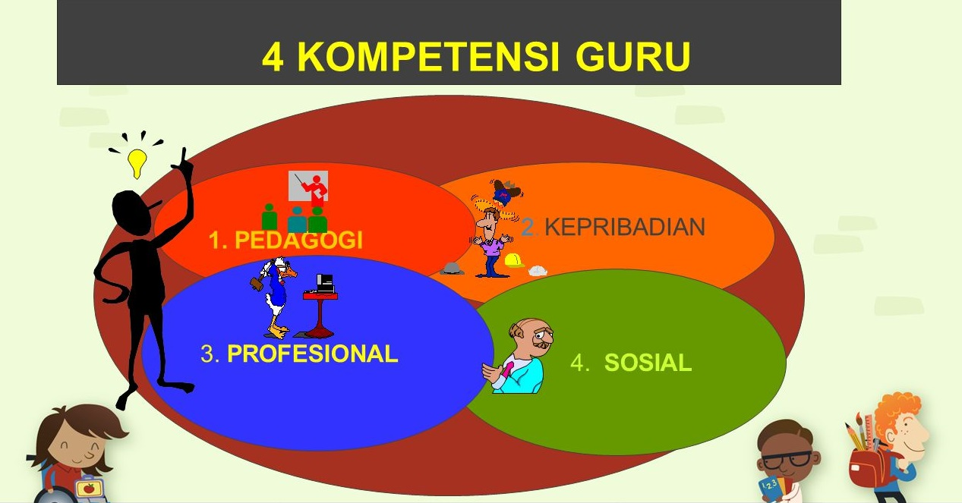

Slide 8
INTERESTS AND POWER READING STUDENTS OF TEACHERS
The reading interest of prospective Islamic education teacher students is moderate/average
The reading power of prospective Islamic education teacher students is also in the medium category
At the time of testing, there were only a few students who could thoroughly read one book
Mastery and understanding of the contents of the book when testing (book reading deposit) is classified as low
The emphasis on the reading ability test is the ability to understand information contained in reading or discourse (classified as cognitive activity)
Benjamin S. Bloom (reading comprehension ability): memory level (C1); level of understanding (C2); level of application (C3); level of analysis (C4); synthesis level (C5); level of evaluation (C6)

Slide 9
FACTORS AFFECTING INTEREST AND READING POWER
A. General inhibiting factors:
The learning system in Indonesia has not made the learners want to read more books, often dominated by the theory of teacher delivery;
Amount of television entertainment;
Many entertainment venues;
Reading culture has not been inherited from ancestors;
Parents are more preoccupied with earning a living, so reading time is lacking or very minimal (role model for children);
Books are considered expensive by the community;
Lack of adequate reading resources to foster interest in reading.
B. Personal factors: age, gender, intelligence, reading ability, attitude, psychological needs.
C. Institutional factors: availability of books, socio-economic status, influence of parents, peers and teachers.

Slide 10
SOLUTIONS TO INCREASE READING ABILITY
AND
INTEREST OF READING
Quick Reading Method (Art of Reading)
The task is to read books or journals related to the course
Reading community (book review, discussion)
Start reading books from genres that you like first
Condition the environment and special time to read
Have a target (for example, one day at least read 3 sheets)
Build self-awareness that reading is a necessity
Make a list of recommended books to be read or purchased
Facilities for reading corners in each entertainment place (certain) or public facilities
Read the ability test (type or form of discourse: prose, dialogue, poetry)

Slide 11
SOLUTIONS TO INCREASE READING ABILITY
AND
INTEREST OF READING
Art of Reading
Assignments related to reading book or journal
Reading community
Start reading with the genre you like
Conditioning the environment
Have a target
Reading is a necessity
List of recommended books to be read or purchased
Facilities for reading corners
Special time to read

Slide 12
CONCLUSION
Teacher competence shows the quality of the teacher
Students as prospective teachers should have a high interest and reading power in order to improve their competence in both pedagogical, personal, professional and social competencies.
Interest in reading someone is influenced by several factors: a. internally, such as disposition, gender, level of education, state of health, mental state and habits; b. external factors include books or reading materials, needs, and environmental factors.
To improve reading skills (reading power) the key is the habit of reading and continuing to practice (quick reading workshop)

Slide 13
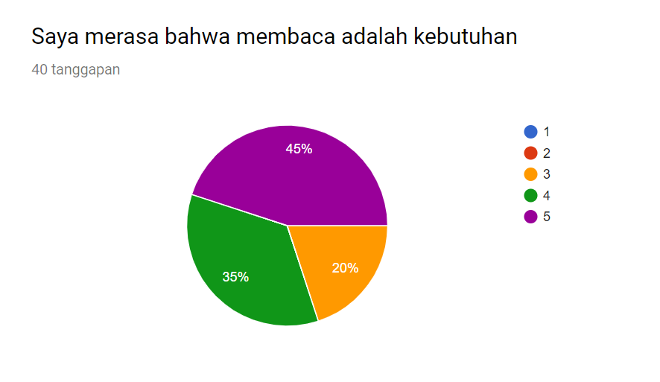
Diagram Responden
Responden penelitian ini adalah kelas PAI A 2017

Slide 14
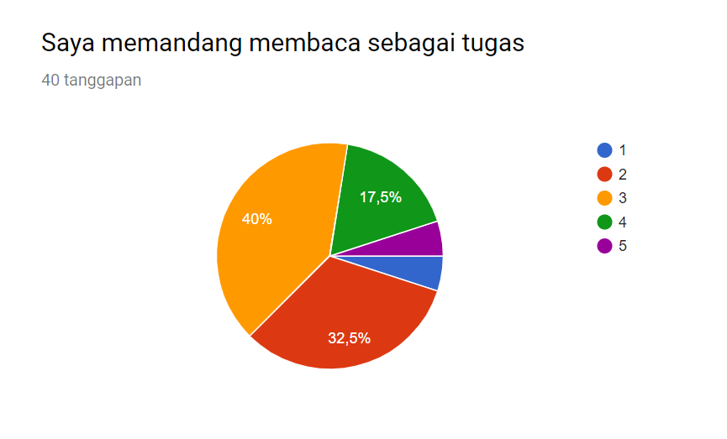
Diagram Responden
Responden penelitian ini adalah kelas PAI A 2017

Slide 15
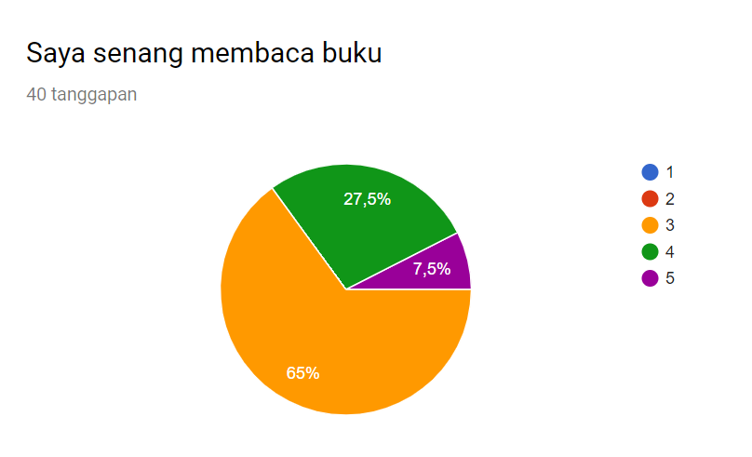
Diagram Responden
Responden penelitian ini adalah kelas PAI A 2017

Slide 16
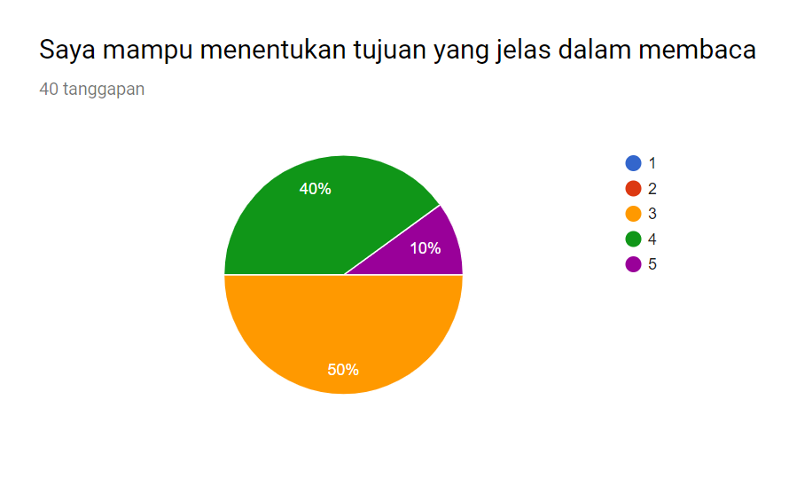
Diagram Responden
Responden penelitian ini adalah kelas PAI A 2017

Slide 17
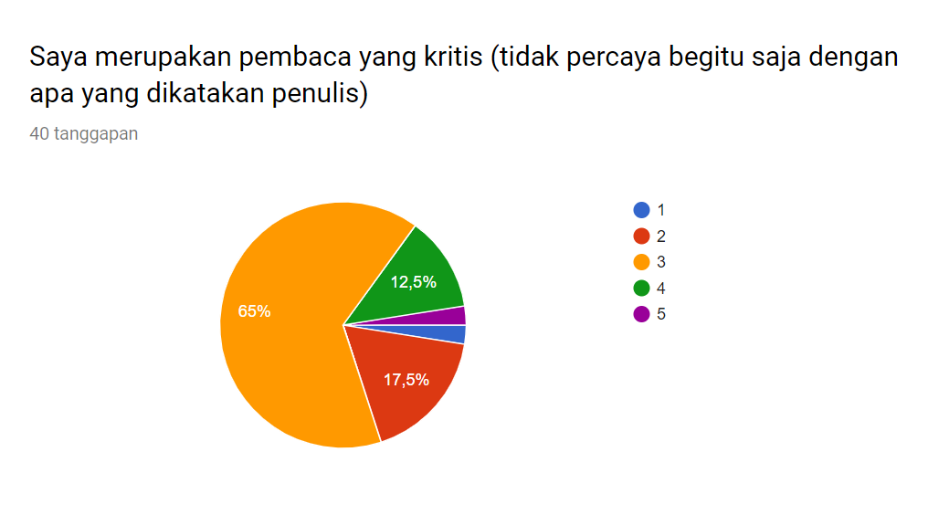
Diagram Responden
Responden penelitian ini adalah kelas PAI A 2017

Slide 18
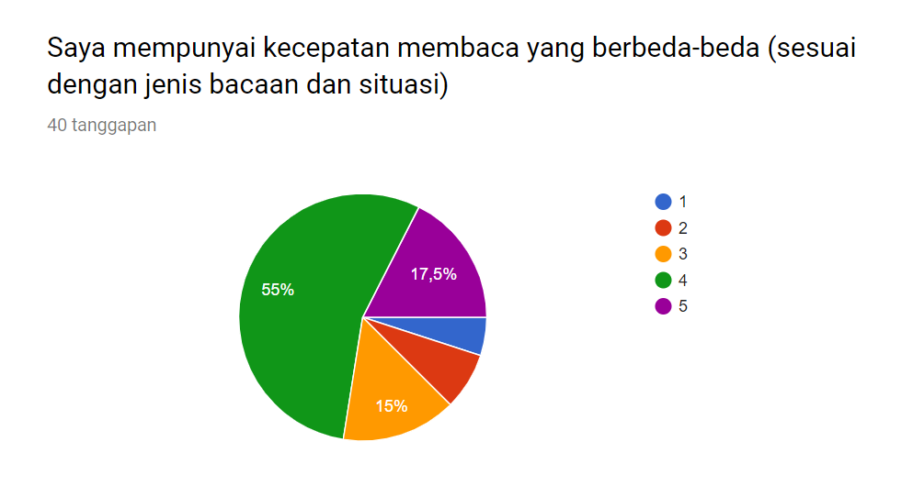
Diagram Responden
Responden penelitian ini adalah kelas PAI A 2017

Slide 19
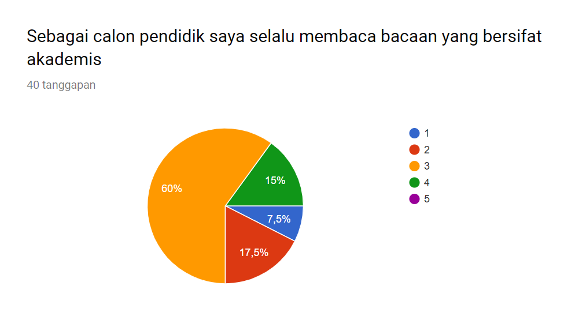
Diagram Responden
Responden penelitian ini adalah kelas PAI A 2017

Slide 20
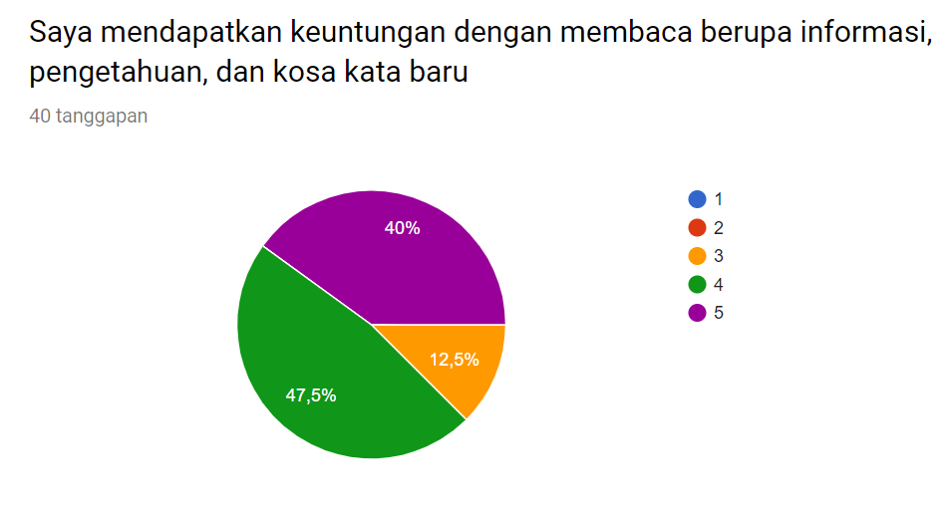
Diagram Responden
Responden penelitian ini adalah kelas PAI A 2017

Slide 21
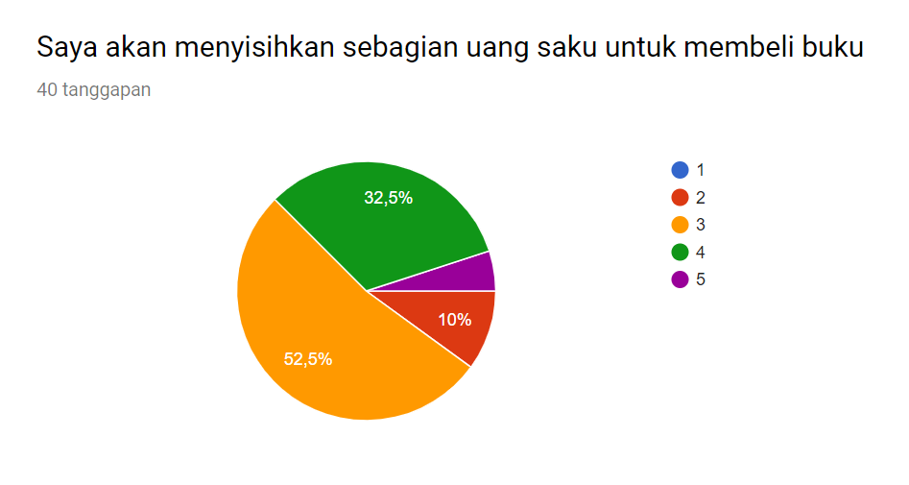
Diagram Responden
Responden penelitian ini adalah kelas PAI A 2017

Slide 22
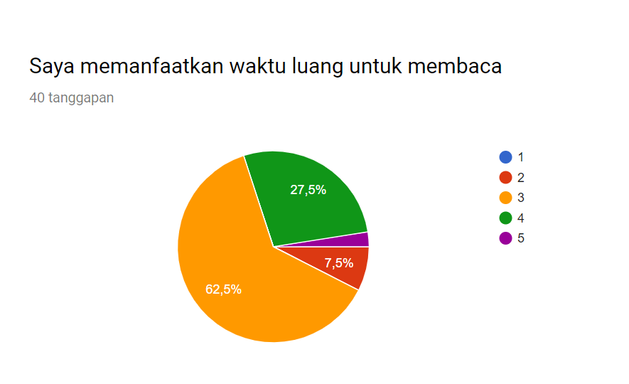
Diagram Responden
Responden penelitian ini adalah kelas PAI A 2017

Slide 23
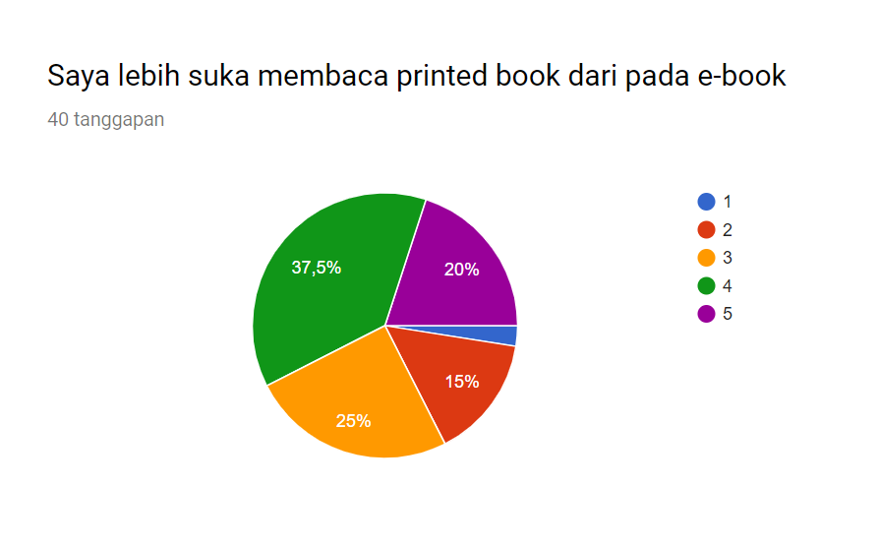
Diagram Responden
Responden penelitian ini adalah kelas PAI A 2017

Slide 24
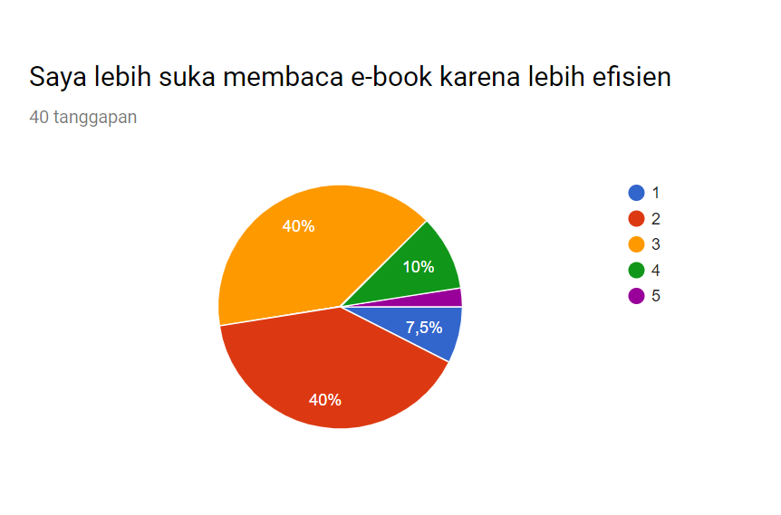
Diagram Responden
Responden penelitian ini adalah kelas PAI A 2017

Slide 25
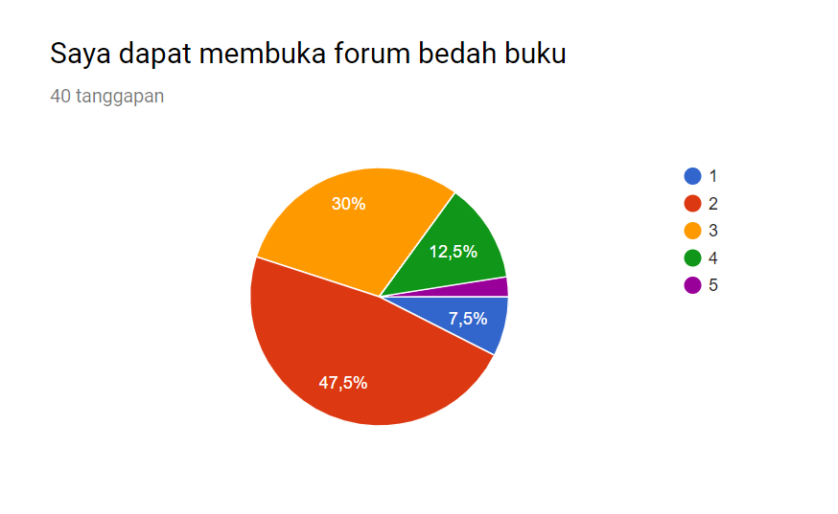
Diagram Responden
Responden penelitian ini adalah kelas PAI A 2017

Slide 26
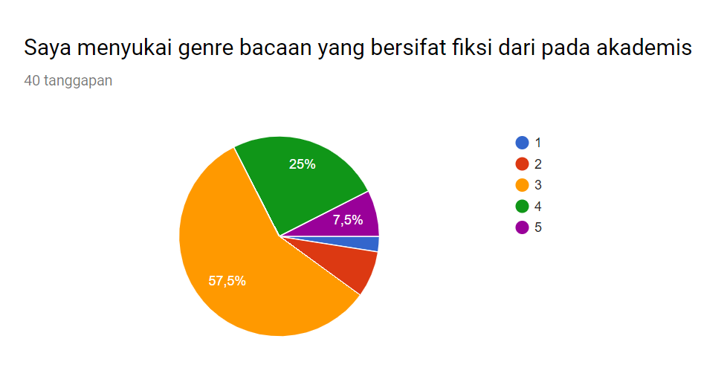
Diagram Responden
Responden penelitian ini adalah kelas PAI A 2017

Slide 27
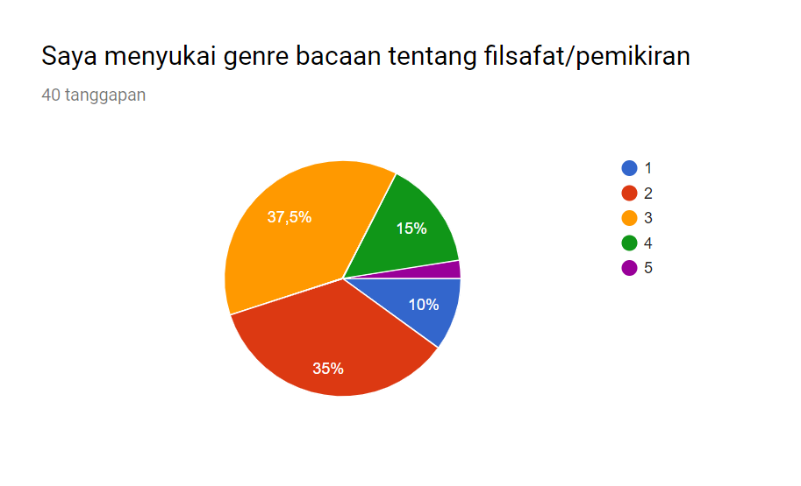
Diagram Responden
Responden penelitian ini adalah kelas PAI A 2017

Slide 28
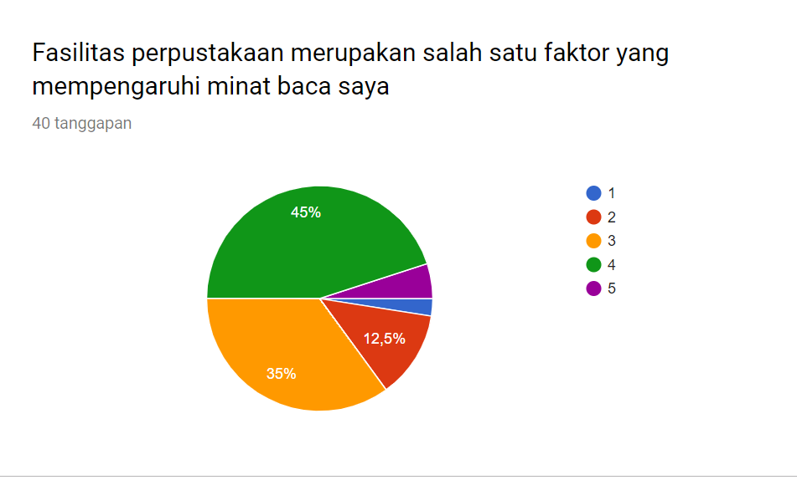
Diagram Responden
Responden penelitian ini adalah kelas PAI A 2017

Slide 29
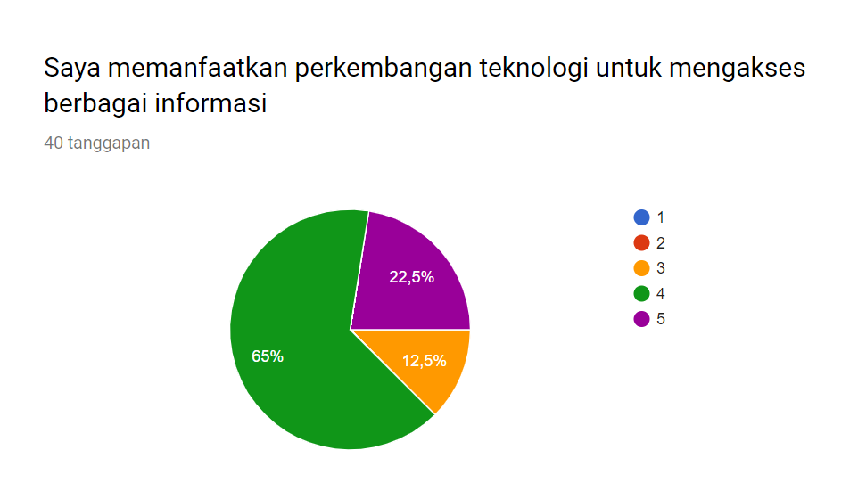
Diagram Responden
Responden penelitian ini adalah kelas PAI A 2017

Slide 30
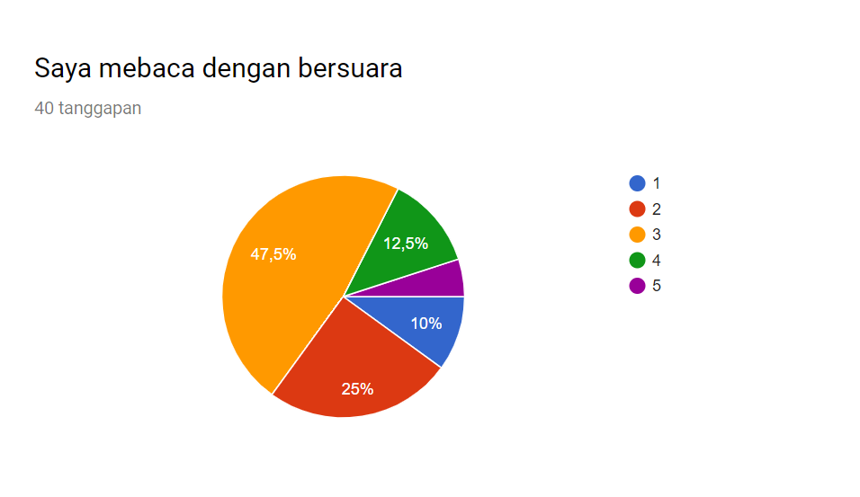
Diagram Responden
Responden penelitian ini adalah kelas PAI A 2017

Slide 31
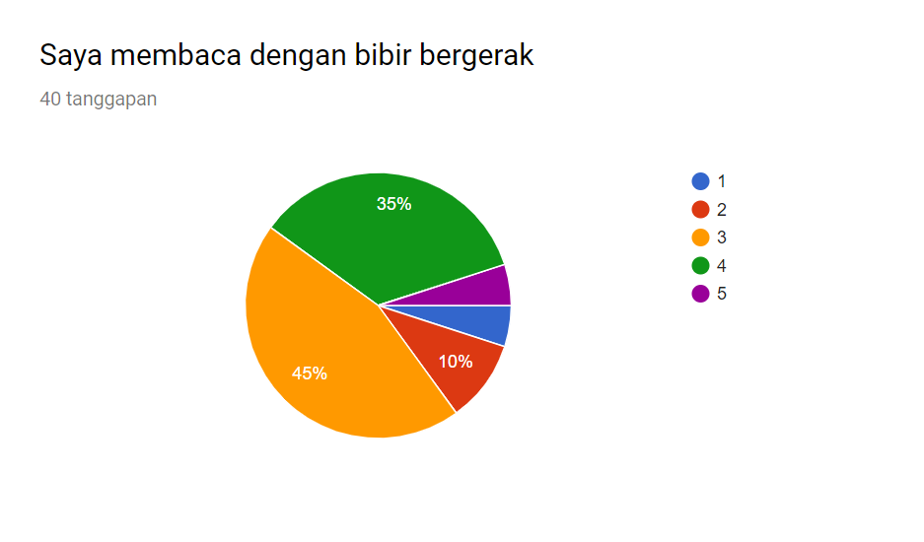
Diagram Responden
Responden penelitian ini adalah kelas PAI A 2017

Slide 32
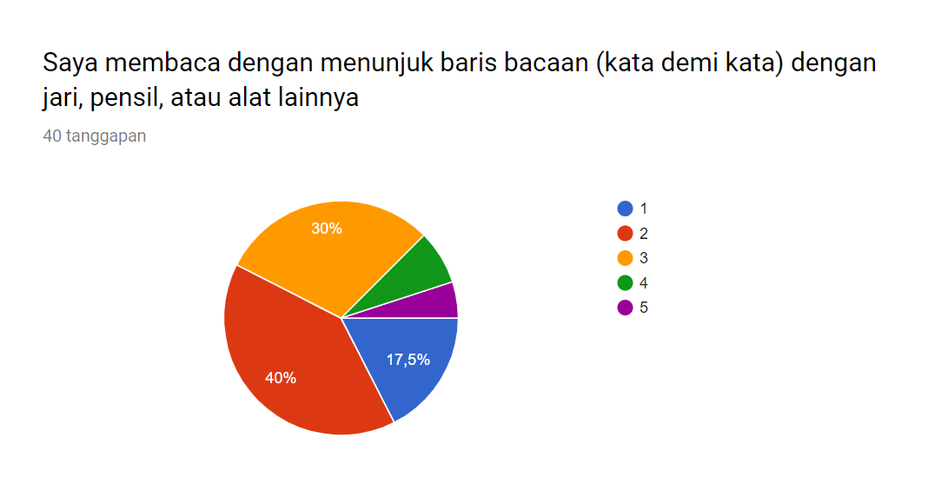
Diagram Responden
Responden penelitian ini adalah kelas PAI A 2017

Slide 33
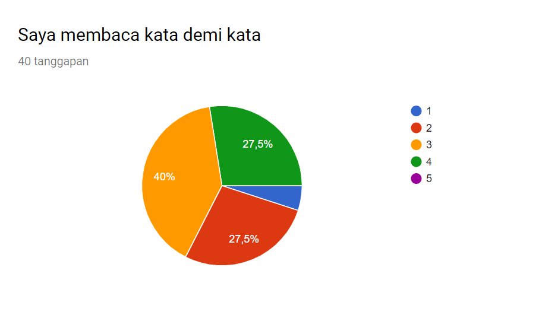
Diagram Responden
Responden penelitian ini adalah kelas PAI A 2017

Slide 34
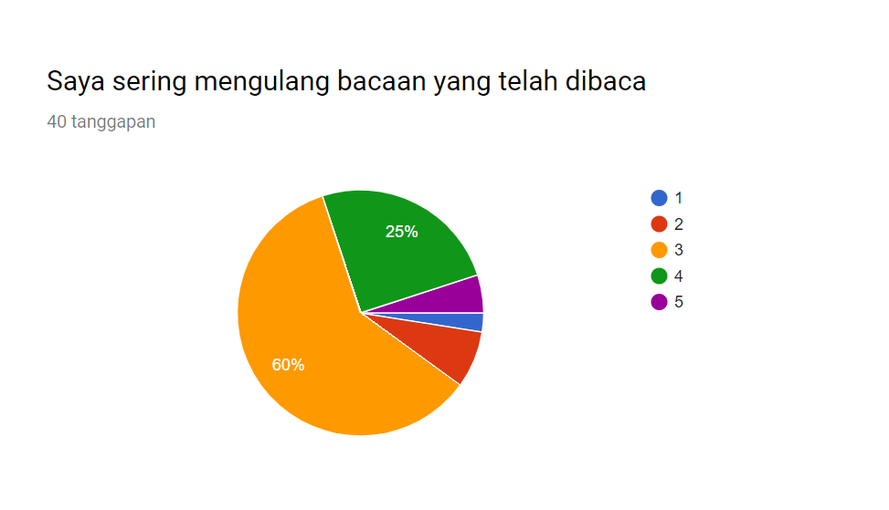
Diagram Responden
Responden penelitian ini adalah kelas PAI A 2017

Slide 35
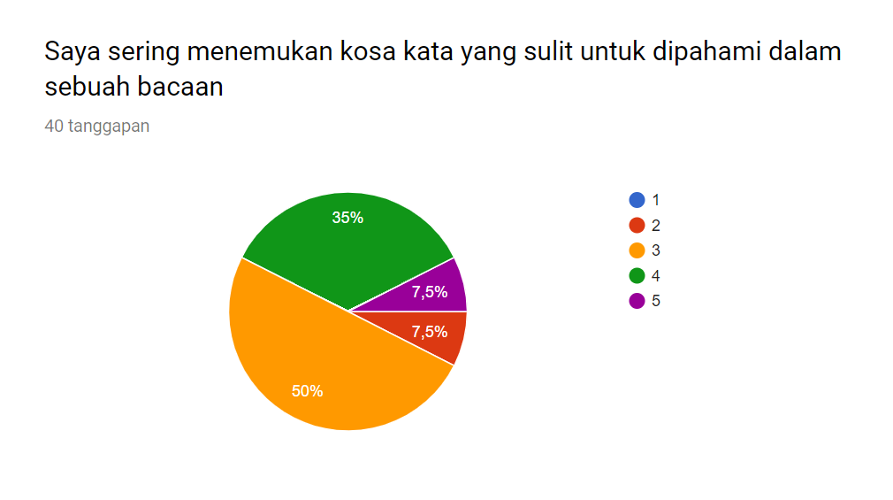
Diagram Responden
Responden penelitian ini adalah kelas PAI A 2017

Slide 36
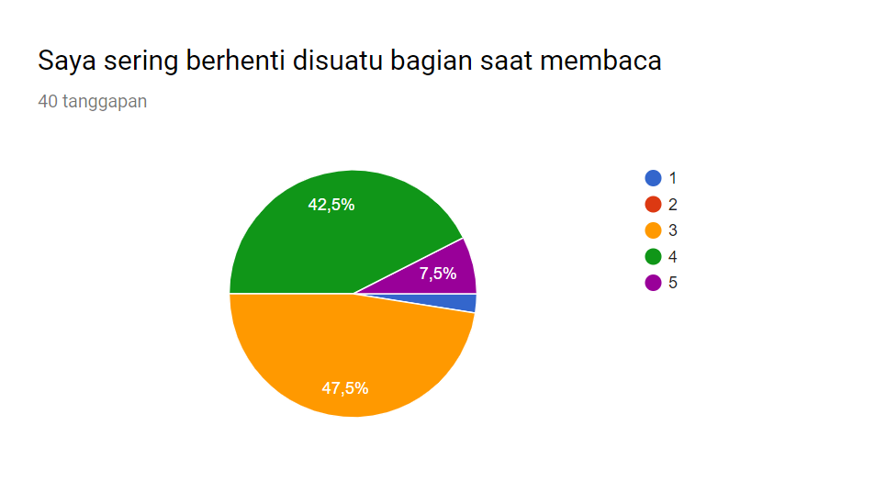
Diagram Responden
Responden penelitian ini adalah kelas PAI A 2017

Slide 37
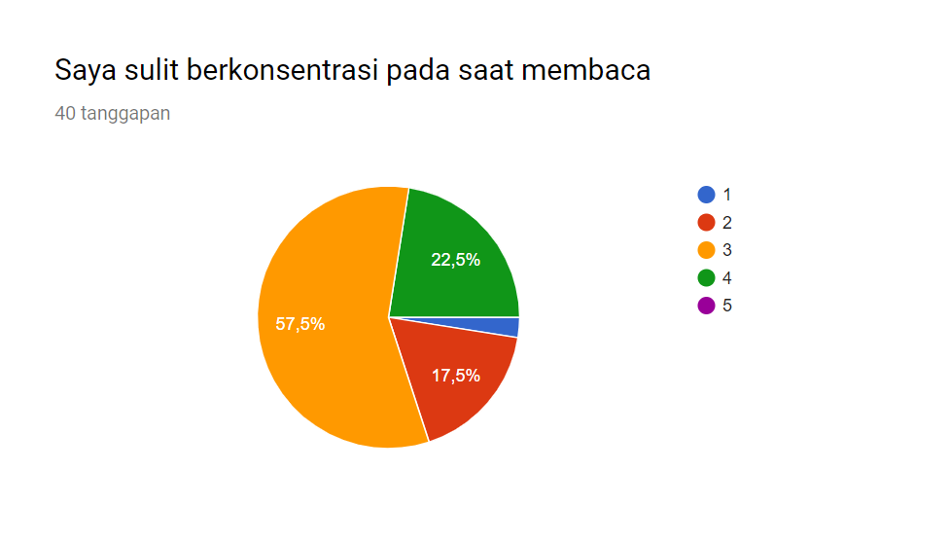
Diagram Responden
Responden penelitian ini adalah kelas PAI A 2017

Slide 38
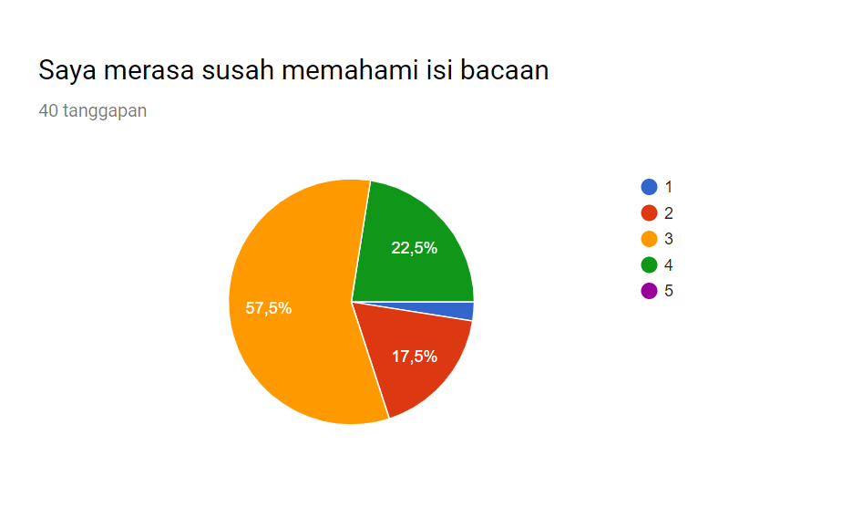
Diagram Responden
Responden penelitian ini adalah kelas PAI A 2017

Slide 39
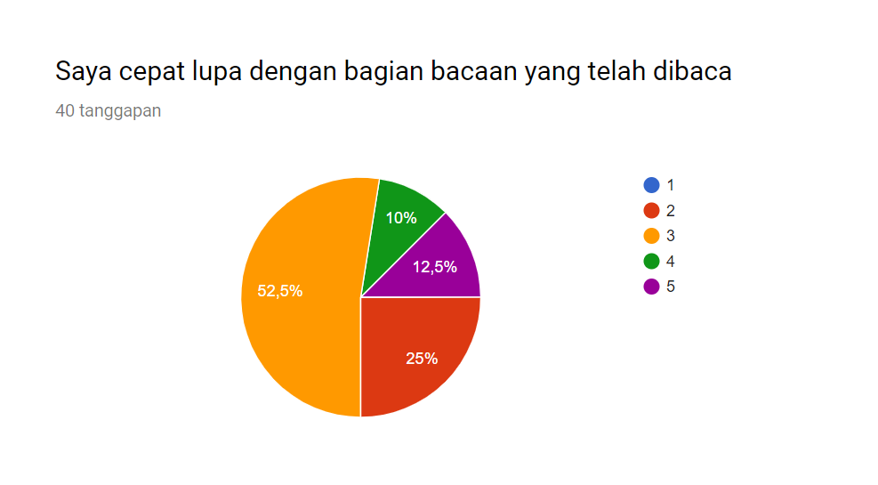
Diagram Responden
Responden penelitian ini adalah kelas PAI A 2017

Slide 40
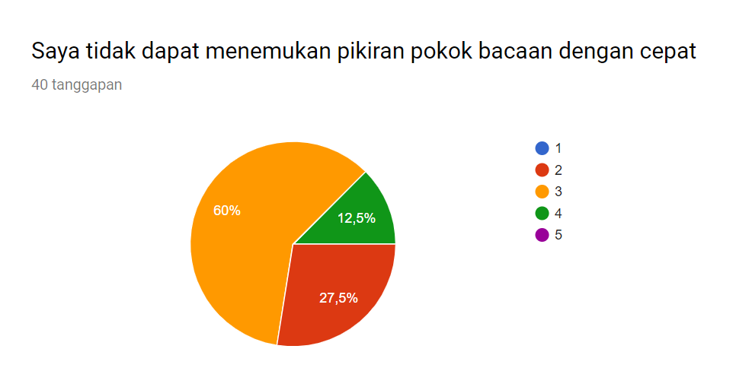
Diagram Responden
Responden penelitian ini adalah kelas PAI A 2017

Slide 41
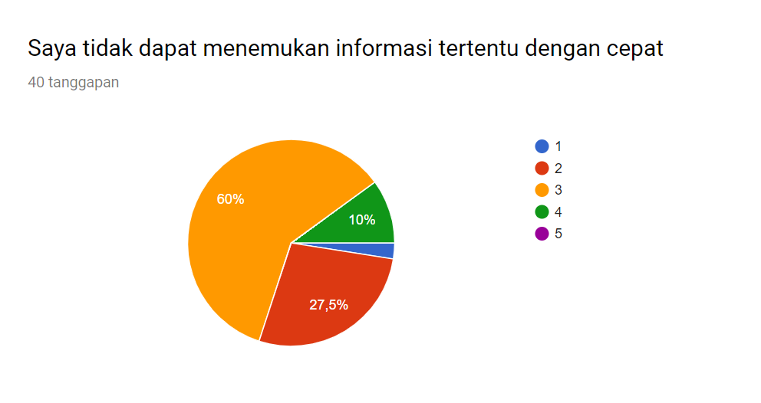
Diagram Responden
Responden penelitian ini adalah kelas PAI A 2017

Slide 42
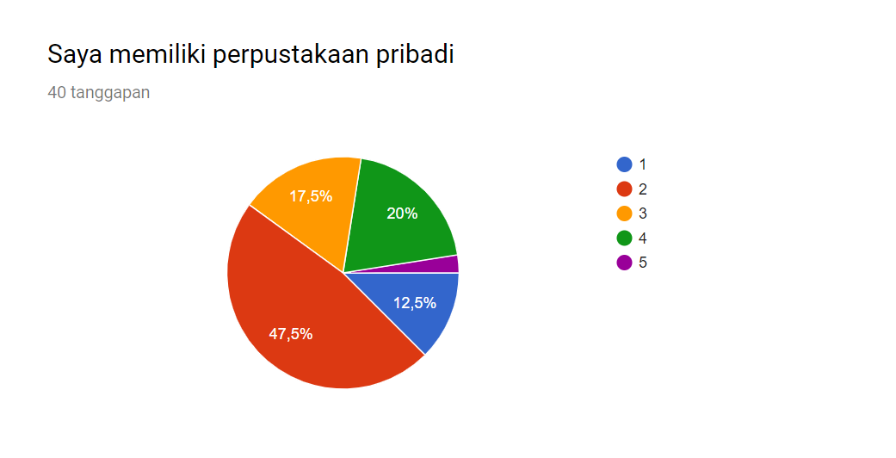
Diagram Responden
Responden penelitian ini adalah kelas PAI A 2017

Slide 43
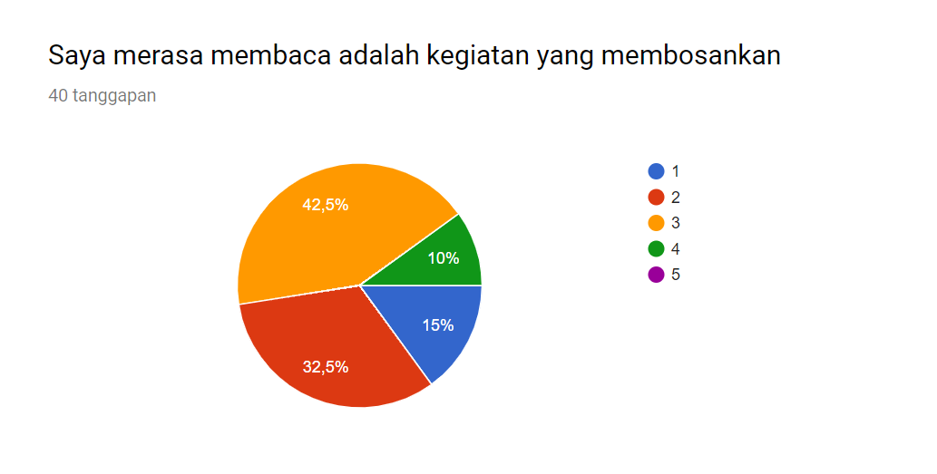
Diagram Responden
Responden penelitian ini adalah kelas PAI A 2017

Slide 44
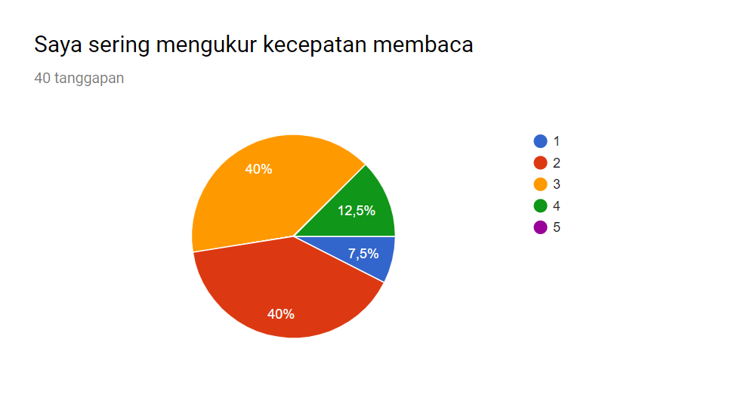
Diagram Responden
Responden penelitian ini adalah kelas PAI A 2017

Slide 45
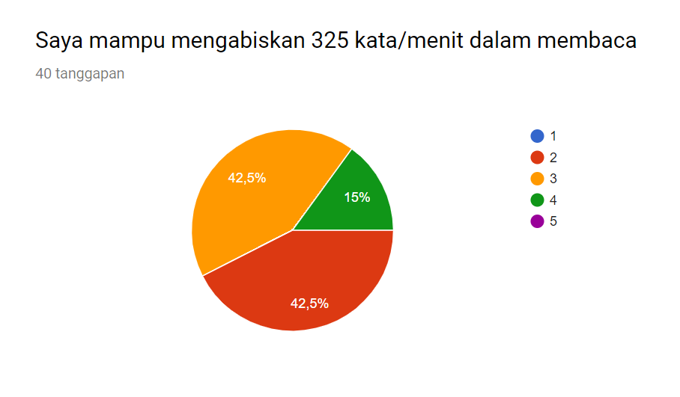
Diagram Responden
Responden penelitian ini adalah kelas PAI A 2017

Slide 46
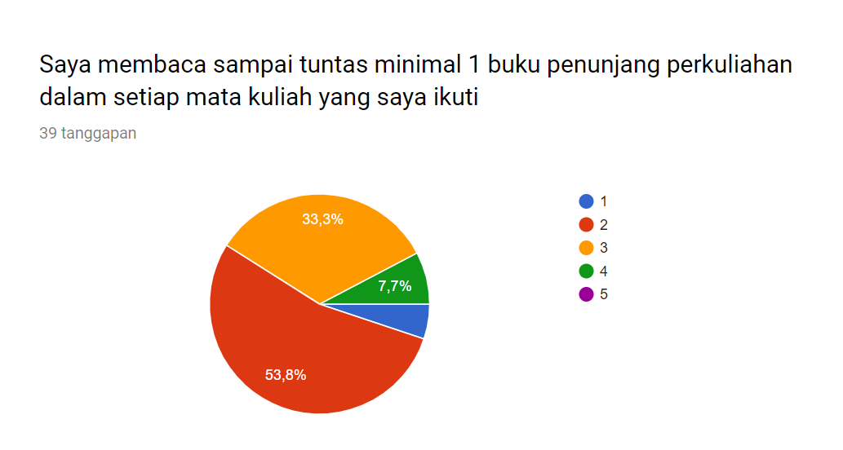
Diagram Responden
Responden penelitian ini adalah kelas PAI A 2017

