Slide 1

REFLESKSI 13 TAHUN KPK;
SIASAT KAUM MUDA MELAWAN KORUPSI
By: Imam Mahdi,S.IP.,MA
Notes:
Before we start our class to day, please switch off your phone or your iphone....and let’s pray together by saying basmallah……
Asslamulaikum Wr, Wb..
My name is Mahdi, I would like to discuss about “Iran’s Sucses as a host of 16th Non Aligned Movement in Tehran” for today’s meeting.
Talking about iran, we will remember of controversial relation, between US and Iran..okey guys, what do you thing about our topic today???? You what your name??? you don’t have any idea??, what about the other??..Okey Bambang..I know that every student here is low profile but so smart, and special.

Slide 2
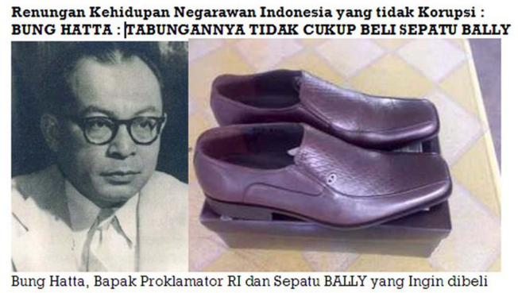
SEJARAH YANG TIDAK TERLUPAKAN
Notes:
In 1989 Iran becomes famous state in the world, this is because of Iran Revolution. Not only the vision of most people there want to make a change, or to fall down reza pahlevi rezim, but also the americans’s people terrorized by Iranian Student, after Revolution Iran and US like dogs and cats, there are always fighting each other in any field.
2006, when Iran President Ahmadinejad wanted Iran’s to be Nuclear state. This was used to make a great security and nulear can be alternative energy. but Iran Amibition faced obstacle from UN Security council. They assumed Iran want to make nuclear as mass destructive weapon,.So Iran get sanction from UN SC until now..
european union also gave a sanction toward Iran. They usually added the sunction, and hope all of member of EU will do same.
Last oppression, before Iran Held NAM conference the Israel said “they want to all of member to skip this conference, Iran is an existed evil”
This sanction, isolation, and embargo from western states did not make Iran desperated. they struggle to show, what western county said is not true.
Finally, Iran sucsess held NAM confrens,,,
Before we talk about the conference anybody knows the conference? Please share…

Slide 3

Con’t
Gusdur “Hanya ada tiga polisi jujur di negeri ini, polisi tidur, patung polisi, dan Houegeng”.
Notes:
This conference shows that the invited countries were so enthusiastic to come and the same point of view about the issues. They believe will give them benefit, especially for bilateral and multilateral affairs. Fortunately, Alhamdulillah, the oppression spread by Israel was vanishing.

Slide 4
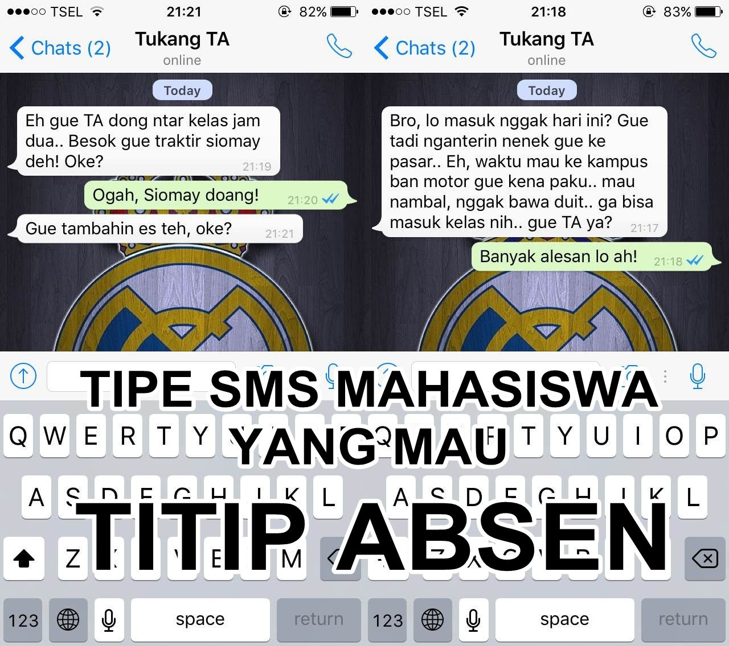
Sekarang...
Notes:
Iran successfully promoted Ahmadinejad to be highest chairman of NAM. Nevertheless he was a controversial actor in international politics.
In each host country, usually, the head of state or president of the country will be the chairman of the Non-Aligned Movement. So automatically Ahmadinejad, as Iran's president, becomes the chairman. And this is certainly a positive impact on strengthening Iran bargaining position of others.

Slide 5

Korupsi Uang Jajan
Notes:
From the beginning till the end of the conference, everything went smoothly. There are no barriers of countries that have a closeness with America. This is really exciting for NAM.
Tehran Declaration answers the criticism and anxiety over Iran's nuclear program. For in the declaration there is a point to explain that all countries have the same position in the use of nuclear energy and for healing.

Slide 6
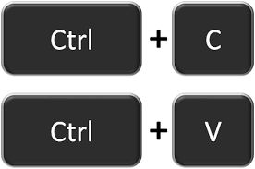
Tugas Mahasiswa

Slide 7
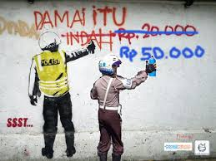
Berdamai Dengan Polisi

Slide 8
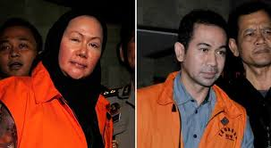
Cikal Bakal Seperti ini...
Notes:
Since becoming president, Ahmadinejad has built relationships with several countries in the world. As in Africa, although at first the existence of the Iranian is rejected, but the African countries accept Iran after realizing that the way western countries handling the economy in Africa is wrong. In addition Iran has built good relations with Latin American countries, such as venezwela, Bolivia, and Uruguay.
Iran led by Ahmadinejad also called for the independence of Palestine. Even Ahmadinejad rehashed hollocoust incident which was the source of the suffering of the Palestinian people.
As prime minister Mottaki build relationships with some developed countries Including some countries in Europe Such as German, French and Dutch

Slide 9
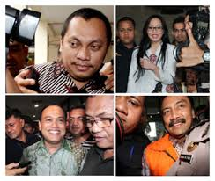
Atau Seperti ini
Notes:
Ali Khamenei as the head of state in the preamble also confirmed that Iran has not committed to make weapons of mass destruction. For those making destructive weapons means doing something unlawful.

Slide 10
Korupsi
Corruption (menyuap), Corruptore (Merusak).
S. P. Huntington: Perilaku pejabat publik yang menyimpang dari nilai dan norma yang diterima oleh masyarakat.
Josep S, Nye: “Behavior…..” tingkah laku yang menyimpang dari tugas-tugas resmi sebuah jabatan negara karena keuntungan status atau uang yang menyakngkut pribadi dan golongan...

Slide 11
Modus Korupsi
Suap dan Pemersan
Jaring-jaring antara Birokrasi, penegak hukum dan perusahaan
Jaring-jaring yang dimiliki oleh OI/Lembaga Internasional yang mempunyai otoritas dalam bidang tertentu.

Slide 12
Sudut Pandang Penanganan Korupsi
Paolo Ferreira, Pembangunan penyadaran dalam pendidikan yang kurang .
Materialistik Hume.
Habitus Para aparatur negara.
Pelanggaran HAM

Slide 13
Pola Penangangan
Elit
Middle Class
Masyarakat

Slide 14
Pola Gerakan
Penguatan Penegak Hukum (Leviathan, Hobbes).
Perubahan Habitus (Ikon Anti Korupsi)
Kosmopolitanisme Anti Korupsi

Slide 15
Alasan tetap harus ada KPK
KPK berhasil mengusut kasus-kasus korupsi di Indonesia dengan tingkat keberhasilan yang sangat tinggi. Di atas 100% menurut laporan akuntabilitas KPK tahun 2014. Namun tetap saja tingkat korupsi di Indonesia masih sangat tinggi (peringkat 88 dari 168 negara menurut CPI 2015). Artinya masih ada hal-hal yang bisa terus KPK bisa tingkatkan.

Slide 16
Indeks Persepsi Korupsi Indonesia kini ada di peringkat 88 dari 168 negara dunia. Di tahun sebelumnya, Indonesia ada di peringkat 107. Selain naik peringkat, skor Indonesia pun naik dua poin menjadi 36.
Di Asia Pasifik, skor CPI Indonesia masih tertinggal dari Malaysia (skor 50), Thailand (skor 38), dan Tiongkok (skor 37). Walau begitu Indonesia masih berada di atas Filipina (skor 35) dan Vietnam (skor 31).

Slide 17
Wassalamualaikum Wr. Wb

