Slide 1
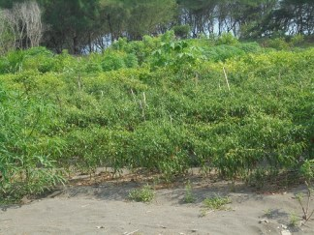
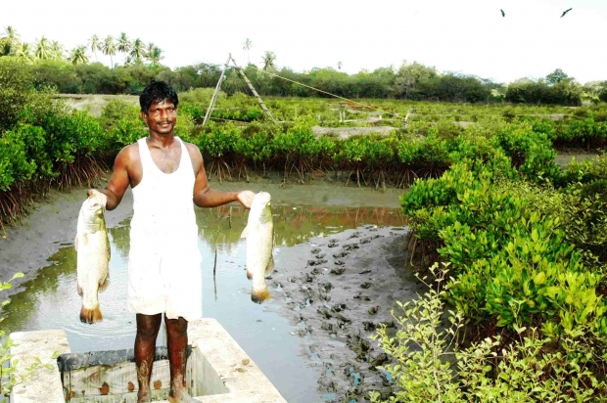
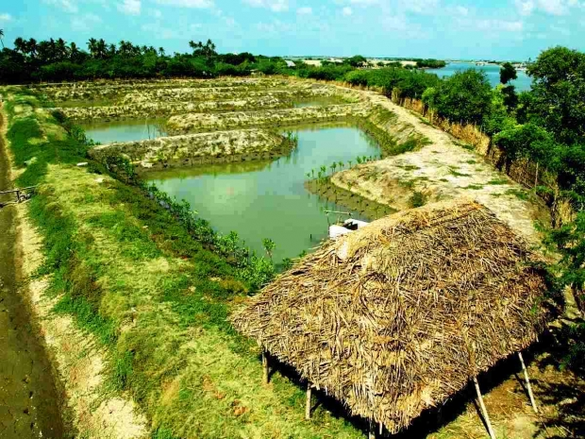
Integrated Farming System on Coastal Land
(The Case Study in Pandan Simo, Bantul, DIY)
Triwara Buddhi S, Triyono, Pujastuti S Dyah
Agribusiness Department of Agriculture Faculty
Muhammadiyah University of Yogyakarta

Slide 2
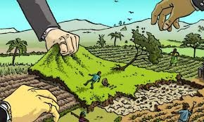
The coastal area in ​​Pandan Simo, Srandakan Sub-district, Bantul Regency, is the one of the farming areas using integrated farming system between food crops, horticulture, and livestock.
Because of the reducing agricultural land,
the diversification of land is needed
So, the marginal land has being a much-done alternative, such as farming on beach land.

Slide 3

The Purposes:
Knowing the revenue and cost of farming in coastal land.
Knowing the feasibility of farming

Slide 4
Cost and Revenue Farm
Farming in Coastal Land
Farming is an activity in agriculture that organizes the various factors of production available to bring in large and continuous incomes for farmers and their families
The cost of farming is the value of the use of factors of production, which affect the income of farmers.

Slide 5

Farming Feasibility
The feasibility of farming can be measured by looking at its productivity. In this research, feasibility will only be measured based on, because for land productivity is difficult to measure considering the land used for farming is a beach land that is basically not very suitable for food crops.

Slide 6

Basic Method
This research uses descriptive method and the technique of conducting this research was conducted by the field survey method
Sampling Technique
The object area of ​​research is taken purposively in KecamatanSrandakan, Bantul regency.
Farmer groups that manage farming in PandanSimo beach area that implement horticultural food cultivation in coastal land and join in cattle rearing with group cage system only exist in Poncosari village all used as respondent, besides also analyzed result of experiment of an Agribusiness company, 4 commodities in the coastal land of chilli,rice of rojolele, shallot and peanut.

Slide 7

Results and Findings
 | Revenue | Cost R/C
Chilli/ha | Rp 18,960,000 | Rp. 4,867,000 3,89
Rice/ha | Rp 11,340,000 | Rp. 10,216,000 1,11
Shallot/ha | Rp 60,000,000 | Rp 22,900,000 2,62
Peanut/ha | Rp 25,000,000 | Rp 22,500,000 1,12
Cattle/unit | Rp 16,600,000 | Rp 7,000,000 2,34

Slide 8
Pandan Mulyo cattle breeding livestock breeding business was established in 1994 with 134 members belonging to Madya class classification.
All farmers are the head of households who have the role of decision makers as well as managers of cow breeding business activities. Age of most breeders between 30-39 years. The average breeder has been working on cattle breeding since the cattle group started in 1994 until today.

Slide 9

Revenue of farming in coastal land of shallot is higher than another commodities,while the cost is higher too.
The R/C analysis obtained results 3.89 for chili farming in sand area , that is higher than another.
For livestock business in the form of cattle breeding stock, which has the highest capital productivity is the business of providing seedlings,

Slide 10

Based on the above conclusions, the rojolele rice, shallots and peanut farms can be developed in coastal areas by observing
1. Rice rojolele planted in the rainy season with the appropriate fertilizer with the research.
2. Onion suitable to be planted in the dry season.
3. Peanuts suitable for planting between July - October and November-March with attention to fertilization in accordance with the research.
Farmers must be good at reading market opportunities, to sell their products for a price when the harvest is stable or high.
The farmers not only make cooperation with the collecting traders to buy their products, but have to cooperate with other collectors.

