Slide 1


Slide 2

ASWIN JANUARSJAF
+62 8158143441
aswin.januarsjaf@gmail.com
PENDIDIKAN
  1986: Universitas Padjadjaran, Fakultas Psikologi
  1991: LPKIA, Application Programmer
  1993: PPM Institute of Management, Wijawiyata Manajemen
  2007: PPM Institute of Management, Magister Management
KEGIATAN SAAT INI
  Universitas YARSI, Fakultas Psikologi,
  PPM Institute of Management, HR Trainner & HR Partner
APLIKASI SOFTWARE YANG DIBUAT:
Pauli Software (1990)
EPPS Software (2003)
IST Intrepretation (2004)
DISC Software (2005)
Learning Style (2006)
Multirater Software (2007)
Workload Analysis Application (2010)
Performance Software (2013)
Fluid Intelligence Software (2014)
Automatic Report System (2014)
Organization Health Inventory (2015)
Leadership Software (2016)
eKostik (2012)
Carrier Path Application (2013)
eTIKI (2016)
Hexaco online (2016)
Applicant Tracking System (2016)
Performance Engagement Analytics (2016)

Slide 3
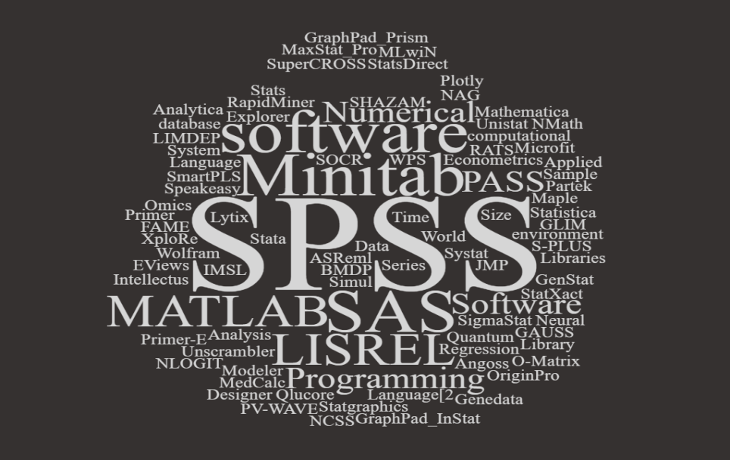

Slide 4
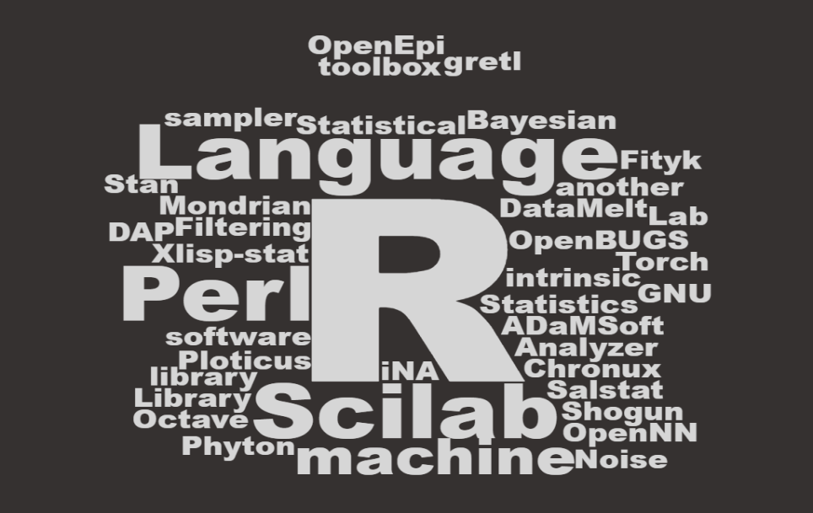

Slide 5

WHAT IS R?

Slide 6
What is R?
The R statistical programming language is a free open source package based on the S language developed by Bell Labs.
The language is very powerful for writing programs.
Many statistical functions are already built in.
Contributed packages expand the functionality to cutting edge research. Comprehensive R Archive Network (CRAN) (more than 7,801 additional packages (as of January 2016))

Slide 7

1
OPEN SOURCE
WHY We Should learn
2
CROSS PLATFORM COMPATIBLE
3
VAST COMMUNITY
4
EXTREMELY COMPREHENSIVE
5
OUTSTANDING GRAPH
Notes:
R is the leading tool for statistics, data analysis, and machine learning. It is more than a statistical package; it’s a programming language, so you can create your own objects, functions, and packages.
Speaking of packages, there are over 2,000 cutting-edge, user-contributed packages available on CRAN (A core set of packages is included with the installation of R, with more than 7,801 additional packages (as of January 2016) available at the Comprehensive R Archive Network (CRAN)t). To get an idea of what packages are out there, just take a look at these Task Views. Many packages are submitted by prominent members of their respective fields.
Like all programs, R programs explicitly document the steps of your analysis and make it easy to reproduce and/or update analysis, which means you can quickly try many ideas and/or correct issues.
You can easily use it anywhere. It’s platform-independent, so you can use it on any operating system. And it’s free, so you can use it at any employer without having to persuade your boss to purchase a license.
Not only is R free, but it’s also open-source. That means anyone can examine the source code to see exactly what it’s doing. This also means that you, or anyone, can fix bugs and/or add features, rather than waiting for the vendor to find/fix the bug and/or add the feature–at their discretion–in a future release.
R allows you to integrate with other languages (C/C++, Java, Python) and enables you to interact with many data sources: ODBC-compliant databases (Excel, Access) and other statistical packages (SAS, Stata, SPSS, Minitab).
Explicit parallelism is straightforward in R (see the High Performance Computing Task View): several packages allow you to take advantage of multiple cores, either on a single machine or across a network. You can also build R with custom BLAS.
R has a large, active, and growing community of users. The mailing lists provide access to many users and package authors who are experts in their respective fields. Additionally, there are several R conferences every year. The most prominent and general is useR. Finance-related conferences include Rmetrics Workshop on Computational Finance and Financial Engineering in Meielisalp, Switzerland and R/Finance: Applied Finance with R in Chicago, USA.

Slide 8
Advantages & Disadvantage
+
__
R is the most comprehensive statistical analysis package available
R developed by practicing statisticians and researchers
The graphical capabilities of R are outstanding
R is free and open source software
R is up-to-date
R is cross-platform
R plays well with many other tools
Many R commands give little thought to memory management
Easy to make mistakes and not know.
The quality of some packages is less than perfect
Capabilities such as security were not built into the R language,

Slide 9
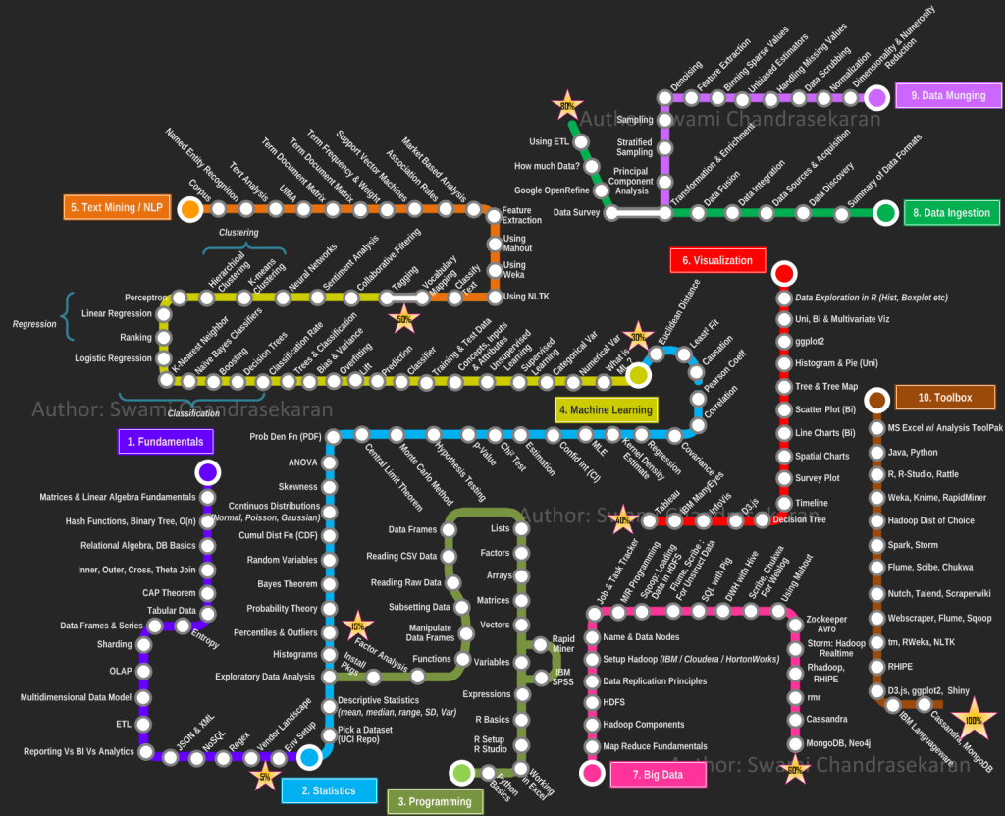

Slide 10
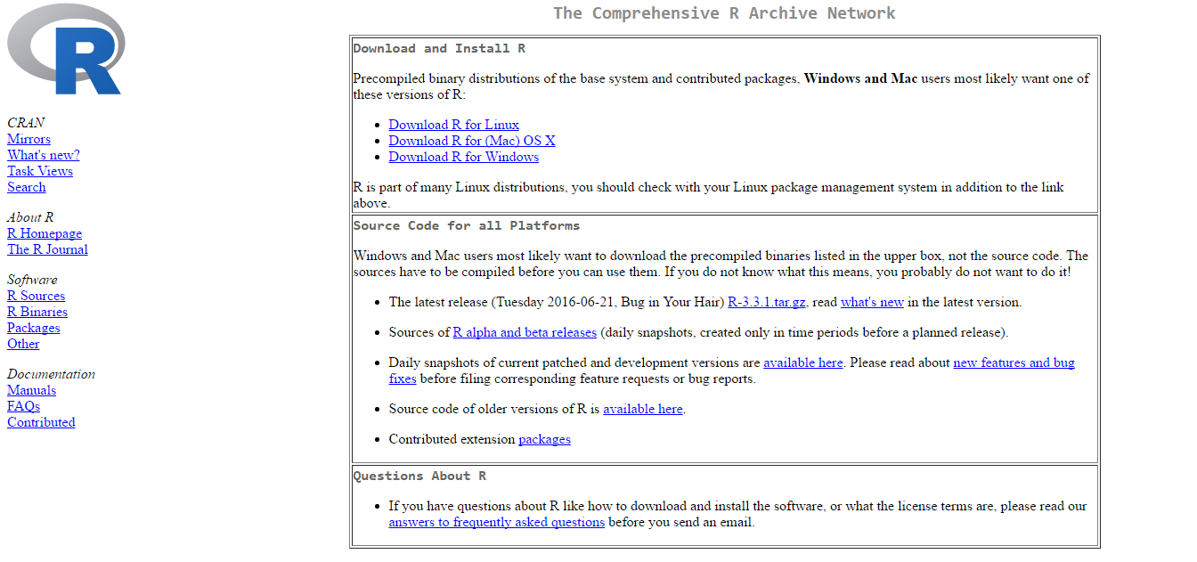
Cara Instal program R
Berikut ini langkah-langkah untuk instalasi program R:
Download program R dari Website: http://cran.r-project.org/

Slide 11

Cara instal R Studio
Download interface R menggunakan Rstudio, alamat websitenya: http://www.rstudio.org/

Slide 12
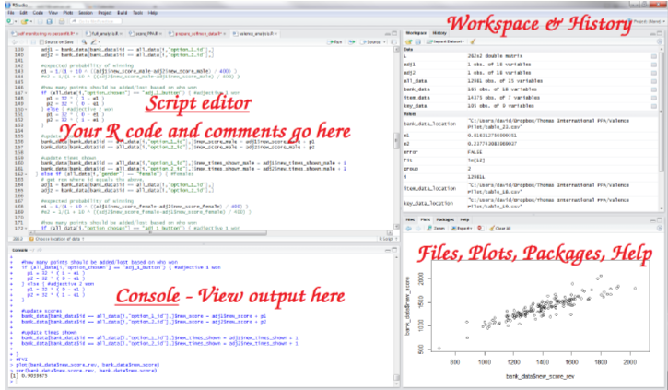

Slide 13
GENERAL INFORMATION
What is an R script ?
 | R script is “THE MAGIC WORD”
How to run R code
# | Commenting your script
> | Command prompt
+ | Incomplete statement
; | Separating multiple command
R is case sensitive

Slide 14
Google it!
Online Tutorials
Published documents, books, etc
Active user community forum
…and much more…
WHO IS THE BEST TUTOR?

Slide 15
Lets Start!

Slide 16
Penggunaan Statistik untuk menguji Hipotesis
MACAM DATA | BENTUK HIPOTESIS
 | Deskriptif (Satu Variabel) | Komparatif (dua sampel) |  | Komparatif (lebih dari dua sampel) |  | Asosiatif (Hubungan)
 |  | Related | Independen | Related | Independen
Nominal | Binomial X² One Sample | Mc Nemar | Fisher Exact Probability X² Two sample | X² for k sample Cochran Q | X² for k sample | Contingency Coefficient C
Ordinal | Run Test | Sign test Wilcoxson matched pairs | Median Test Mann-Whitney U test Kolmogorov-Smirnov Wald-Woldfowitz | Friedman Two-Way Anova | Median Extension Kruskal-Wallis One Way Anova | Spearman Rank Correlation Kendall Tau
Interval Rasio | t-test* | t-test of * Related | t-test* independent | One-Way Anova Two-Way Anova* | One Way Anova* Two Way Anova* | Pearson Product Moment* Partial Correlation* Multiple Correlation*
* Statistik Parametris

Slide 17
VALIDITAS
Mampu mengukur apa yang seharusnya diukur (Nunnally,1978, Allen & Yen, 1979:97; Kerlinger, 1986: Syaifudin Azwar, 2000:45)
Dukungan fakta empiris dan alasan teoritis terhadap interpretasi skor tes atau skor suatu instrument serta terkait dengan kecermatan pengukruan

Slide 18
TIPE VALIDITAS
Validitas
Validitas Kriteria
Validitas isi
Validitas konstruk
Prediktif
Konkuren
Notes:
Validitas kriteria, prediktif: sejauh mana tes memprediksi kemampuan peserta di masa mendatang
Validitas krriteria, konkuren: Mengestimasi kemampuan dengan alat ukur lain dengan tenggang waktu yang hamper bersamaan
Validitas isi:
sejauh mana butir-butir dalam instrument mewakili komponen-komponen dalam seluruh objek yang akan diukur dan sejauh mana butir-butir itu mencerminkan ciri perilaku yang hendak diukur (Nunnaly, 1978)
Keterwakilan pertanyaan terhadap kemampuan khusus yang harus diukur (Lawrence, 1994)
Validitas konstruk: sejauh mana suatu instrument mengungkap suatu kemampuan atau konstruk teoritis tertentu yang hendak diukur (Nunnaly, 1978; Fernandes, 1984)

Slide 19
Pembuktian Validitas
Jenis Validitas | Cara pembuktian
Validitas isi | Indeks Aiken (Face Validity)
Validitas Konstruk | Membuktikan kebermaknaan skor hasil pengukuran (meaningfulness) Explanatory Factor Analysis Confirmatory Factor Analysis
Validitas Kriteria | Kebermanfaatan dari interpretasi skor hasil pengukuran (usefulness)

Slide 20
Analisis Faktor Eksploratori
Teknik untuk mendeteksi dan mengases sumber laten dari variasi atau kovariasi dalam suatu pengukuran (Joreskog & Sorbom, 1993)
Mengeksplor data empiris untuk menemukan dan mendeteksi karakteristik dan hubungan antara variable tanpa menentukan model pada data (Stapleton, 1997)

Slide 21
RELIABILITAS
Derajat keajegan (consistency) skor hasil pengukuran pada objek yang sama, meskipun menggunakan alat ukur yang berbeda dan skala berbeda (Mehrens & Lehmann, 1973; Reynold, Livingstone & Wilson, 2010)
Reliabilitas tinggi apabila skor observasi mempunyai korelasi tinggi dengan skor sebenarnya (Allen & Yen, 1979)

Slide 22
TIPE ESTIMASI RELIABILITAS
Reliabilitas
Konsistensi Eksternal
Konsistensi Internal
Metode Tes ulang
Metode Paralel
Metode Belah dua
Reliabilitas Komposit
Reliabilitas Konstruk
Reliabilitas Interrater
Notes:
Tes ulang: dilakukan dua kali
Tes parallel: dua instrument yang memiliki kesamaan tujuan
Teknik Belah dua: dibagi dua ganjil genap
Spearman-Brown
Flanagean
Rulon
Komposit: butir-butir yang berbeda namun membentuk konstruk yang sama
Komposit merupakan gabungan dari skor butir-butir penyusun instrument
Cronbach
Koefisien KR-20
Koefisien KR-21
Reliabilitas konstruk: dapat diestimasi setelah peneliti membuktikan validitas konstruk dengan ANALISIS FAKTOR KONFIRMATORI sampai memperoleh model yang cocok, sehingga peneliti dapat memperoleh muatan factor (factor loading) tiap indicator yang menyusun instrument (λ) dan indeks kesalahan tiap factor (δ)
Reliabilitas interrater; menghitung butir atau kasus yang diskor sama oleh kedua rater

