Slide 1

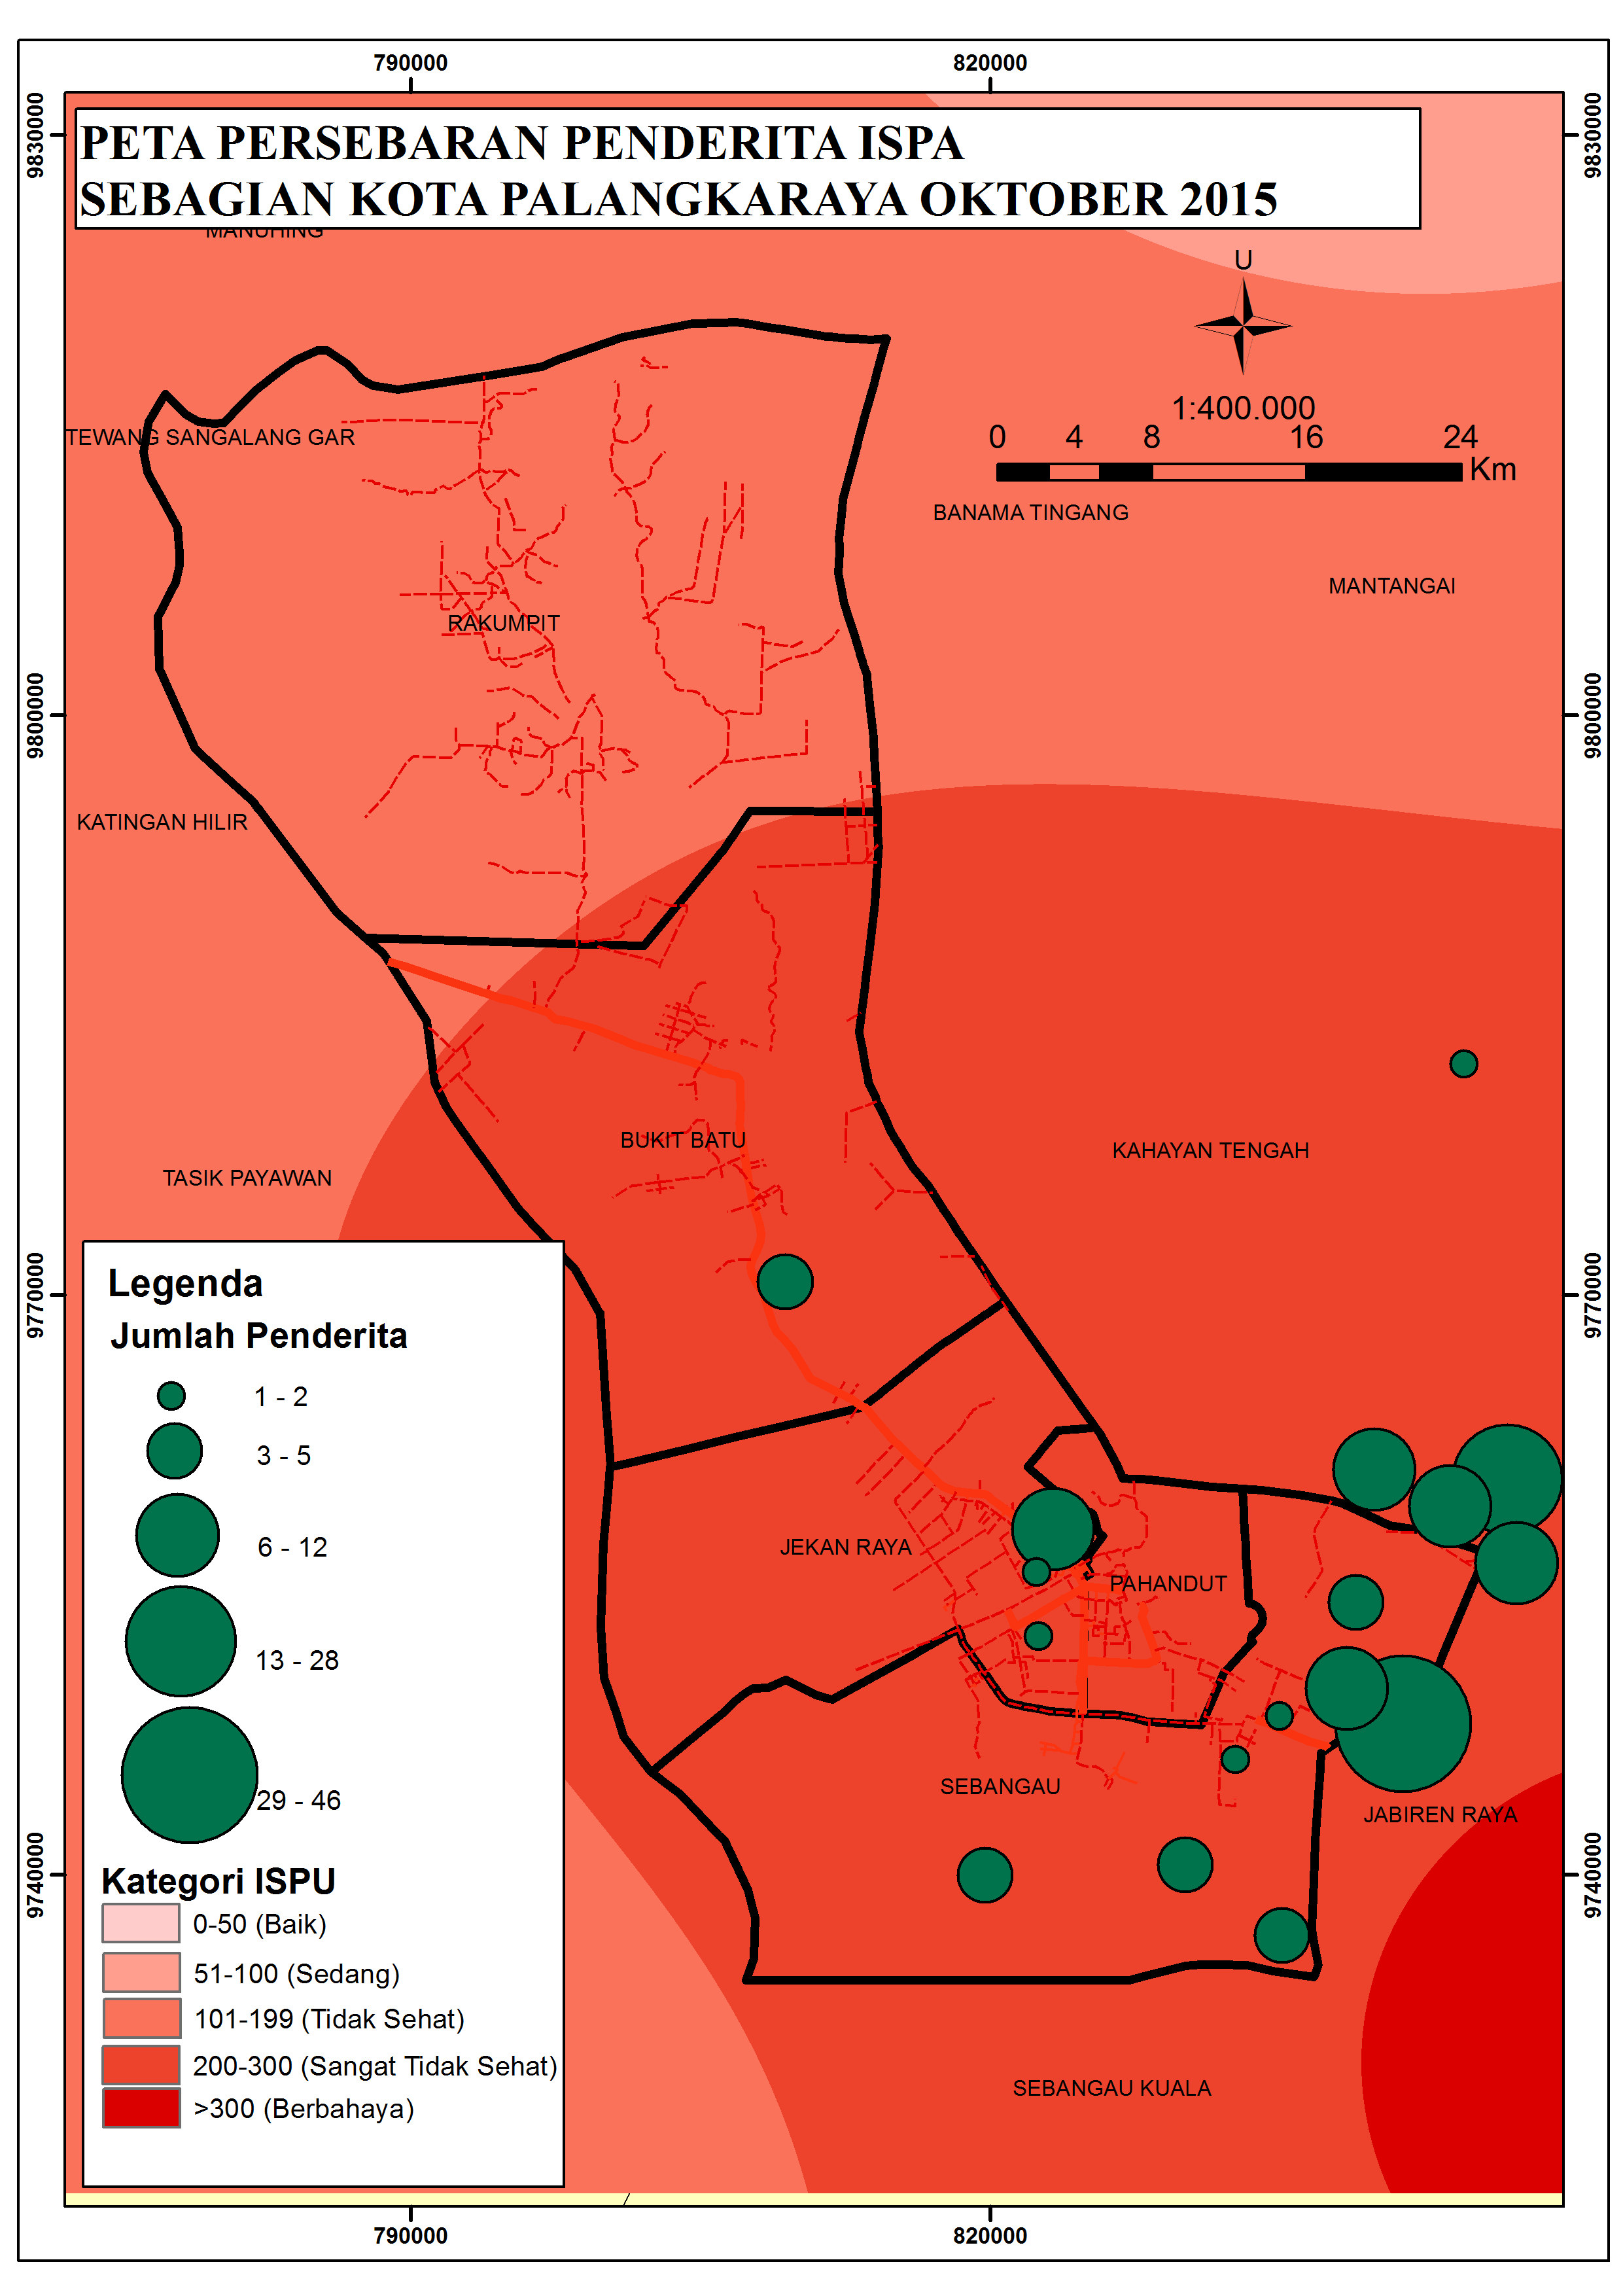
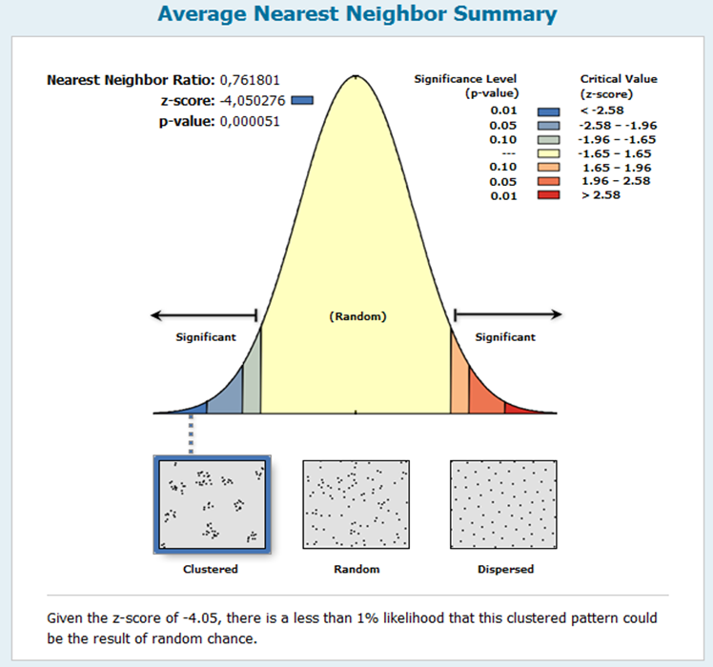
2nd International Seminar on Natural Resources Biotechnology : from Local To Global -2018
Spatial Analyze of ISPA Distribution During Fire Forest in Palangkaraya City.
Yoni Astuti
Faculty of Medicine and Health Sciences, Universitas Muhammadiyah Yogyakarta
Fire forest in Indonesia was a repeatable since 30 years ago due to open Forest area as a plantation and combine with el Nino as the effect of climate change. The following huge fire forest was in 1994 and 2015 cause of both phenomenon. Middle of Kalimantan was one of area received the impact of Haze during Fire Forest in 2015. The Haze were covered the city cause the black and dark. The haze annoyed the sight, daily activity such as schooling, farming, trading, transporting and so on. Haze caused the eye irritating, and bothering respiration. People attendded to hospital and Primary Care were increased. Some of elementary school were closed for some days when the haze very thick. The haze contain particulate matter. The Particulate matter (PM10) were very high. In October 2015 haze was very thick and covered Palangkaraya city. A lot of people and children suffered ISPA ( Infeksi Saluran Pernafasan Akut). Children had higher risk to get ISPA due to the immunity still growing. Sometime haze thicker in one area than other area, Many factors influence spreading of haze.
Introduction
These research carry out to analyze spatially distribution of ISPA in children on October 2015 at Palangkaraya City
Objective
Data of ISPA number was collected from Primary Care under Public Health Office of Palangkaraya City. PM 10 value was collected from Environmental Agency of Palangkaraya City. Method to analyze spatially was used average nearest neighbor (ANN) method.
Methode
. 1
Results
The number of ANN ratio was 0,76180
The ANN method was used to analyze the model of distribution ISPA in October 2015 in Palangkaraya,. This method based on distance of spot with ISPA patient in area to the spot of nearest location of ISPA Patient, then the average of all the nearest distance. The value in index ratio between distance of the location of patient ISPA per distance in expected . There three value : below of 1 reflect the distribution model is cluster, If the value more then 1 reflect the distribution modal is disperse. If the value closer to 1 reflect the distribution model is random. Z score and p Value showed that the data to analyze was significant and believable (trushtworthy ) with p value below than 0.01 is very significant. Based on Z score showed the hypothesis of data was cluster is accepted. Z score was -2,58 on p value 0, 01 , this mean that the data acceptable as cluster. In this research showed that z score was - 4,05. The ANN value was 0,761801.
The distributiom of Children with ISPA in Palangkaraya was cluster. It was showed in one part of palangkaraya city the patient massive than other part.
Discussion
Model of distribution ISPA in children was Cluster. One area in Palangkayraya City has the massive Children with.
Conclusion
Acknowledgment
We would like to thank for funding the project to MDMC, WVI, and Unicef, also thank to Bayu for SIG supporting.
1. Schweithelm, J, & Glover, D (2006) in Glover, D & Jessup, T. (2006) Indonesia’s Fires and Haze. The Cost of Catastrope. Institute of Southeast Asian Studies. Singapore.
2. Alper Şen, M. Ümit Gümüşay, Aktül Kavas and Umut Bulucu . 2008. Programming an Artificial Neural Network Tool for Spatial Interpolation in GIS - A Case Study for Indoor Radio Wave Propagation of WLAN. Sensors.8.pp 5996-6015
Refference
Corresponding : yoni_astuti@yahoo.co.id

