Slide 1



Factors Contributing to Psychiatric Illness/ Mental Health Problem
Kellyana Irawati.,Ns.,M.Kep.,Sp.Kep.Jiwa
SCHOOL OF NURSING
FACULTY OF MEDICINE AND HEALTH SCIENCES
UNIVERSITAS MUHAMMADIYAH YOGYAKARTA
2018

Slide 2
Mental Health
Mental health is a state of well-being associated with happiness, contentment, satisfaction, achievement, optimism, or hope. Mental health also relate to particular person and life situation (Stuart, 2013).
Mental health is define as a state of well-being in which every individual realizes his or her own potential, can cope with the normal stresses of life, can work productively, and also able to make a contribution to her or his community (WHO, 2017)

Slide 3

Mental Health
Criteria of Mental Health
The Six Criteria are indicators of Mental Health
Positive Attitude Toward Self: an acceptance of oneself and self awareness
Growth, Self actualization and resilience
Integration
Environmental Mastery
Autonomy
Reality perception

Slide 4
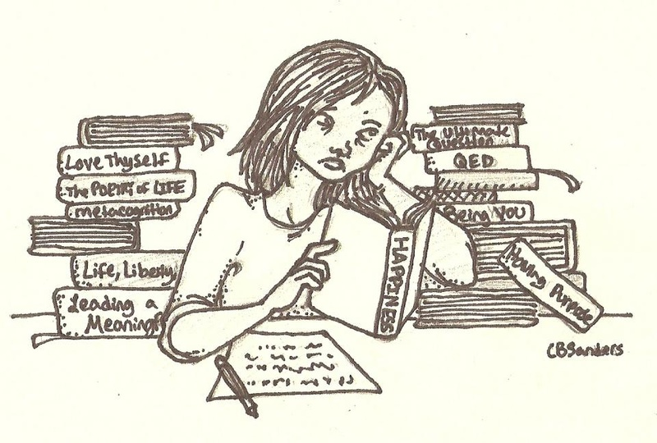
Mental Illness
Definition
Mental Illness is a behavioural or psychological pattern demonstrated by an individual that causes significant distress, impaired functioning , and decreased quality of life.

Slide 5
Factors Contributing Mental Illness
Predisposing Factors
Precipitating Factors

Slide 6
Factors Contributing Mental Illness
Predisposing Factors are risk and protective factors that influence the type and amount of resources the person can use to handle stress
Precipitating Stressor are stimuli that are challenging, threatening, or demanding to the individual.

Slide 7

Predisposing Factors
More than 6 month from Ilness
Literature review
Biological Factors
Psychological Factors
Genetic background
Nutritional Status
History of mental illness
Exposure of toxin: cigarete and narcotics
Biological sensitivities
Intelegence
Verbal or communication skill
Morale
Personality
Past experiences
Self concept and motivation
Psychological defences
Locus of controls

Slide 8
Predisposing Factors
Sociocultural Factors
Age and Gender
Education: had low educational status
Income and Occupation: had a low income and unemploye
Social position: low social possisition
Belief
Social integration or relatedness
Marital Status

Slide 9
Biological Predisposing Factors
Nutrition Status: Baby with history of Malnutrition, Premature, ect
Genetic: family with mental disorder/mental illness
History of Mental Illness: How Long a person got the sign and Symptom of Mental Illness
Exposure of Toxin: Substance Use: cigarete and oir Narcotic addistion
History of Psysich Illness: diabetic, myocardial infarction, Brain cancer/tumor
Biological Sensitivities

Slide 10
Precipitating Factors
Precipitating Factors are stimuli that are challenging, threatening, or demanding to the individual
Nature
Biological, psychological, or Sociocultural
Originate
Persons internal environment
Persons external environment
Timing
Number
Number of stressors an individual experiences within a certain period because stressful events

Slide 11
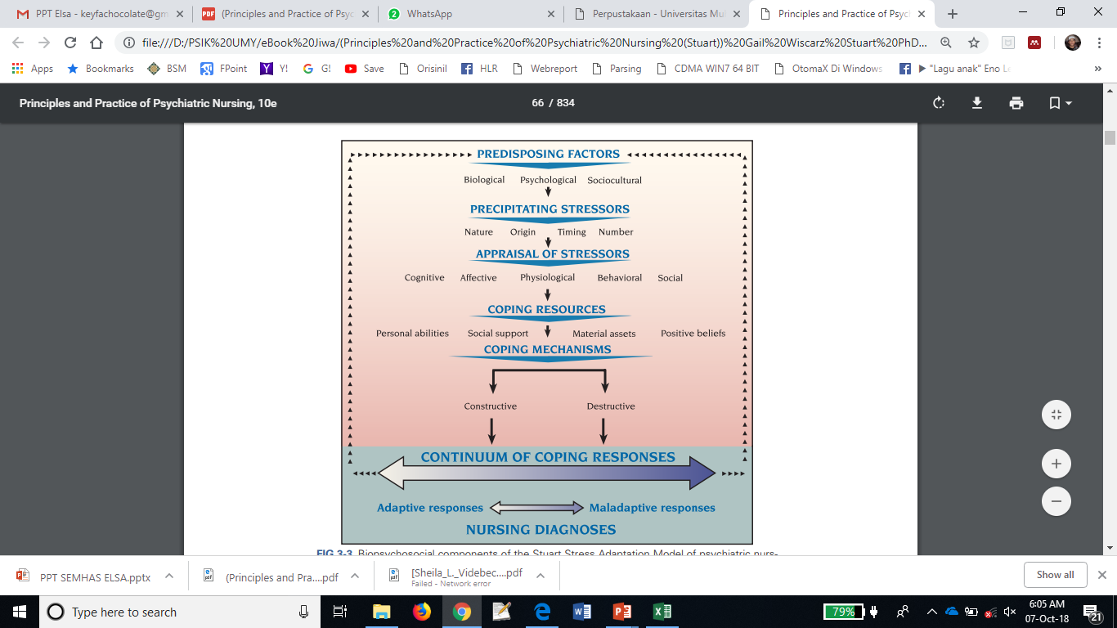
Biopsychosocial Components
Stuart Stress Model Adaptation

Slide 12
Key Fact about Mental Illness
Overall
Half of all lifetime cases of mental and substance use disorder begin by age 14 and three-fourth by age 24
People with seriouse mental illness have shortened life spans, living on average only until 53 years of age.
Almost one-fourth of all adult stays in general hospitals involves mental or substance use disorder

Slide 13
Fact on Mental Health
WHO (2018)
There are indications that for each adult who died of suicide
Over 800.000 people die due to suicide every year and suicide is the second leading cause of death in 15-29-year-olds.
75% of suicide occure in low-and-middle income countries
Mental disorder and harmful use of alcohol

Slide 14
NO HEALTH WITHOUT MENTAL HEALTH

Slide 15
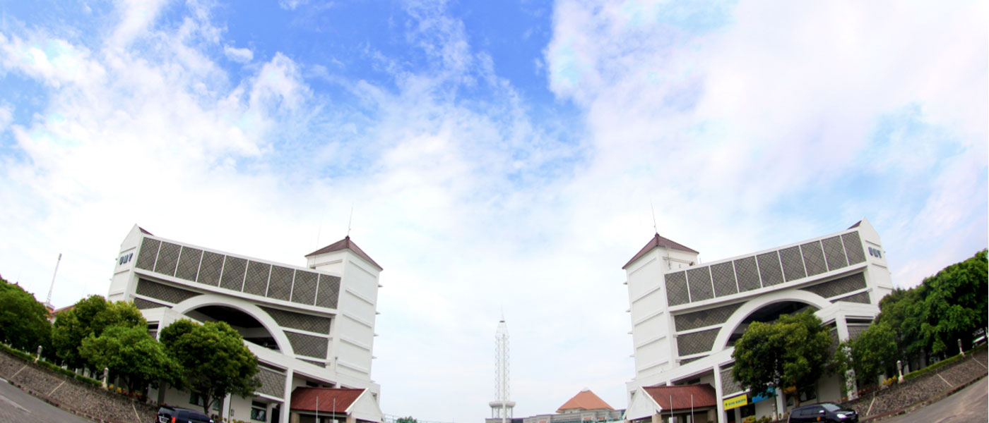
THANK YOU

