Slide 1
Women’s Transnational Advocacy Network
Nur Azizah
Seminar Nasional “Transnasionalisme : Peran Aktor Non Negara dalam Hubungan Internasional”, Yayasan OBOR Indonesia – Prodi Hubungan Internasional, Universitas Muhammadiyah Yogyakarta, 9 April 2019.

Slide 2
Why Women ?
Half of the Population
Gender Impact : Discrimination, Marginalization
International Feminism : top down strategies (Global Norm )
  UNDHR : Man’s right → Human Right
  CEDAW
  UN SC Resolution 1325 : Gender , Peace, Conflict Resolutions

Slide 3
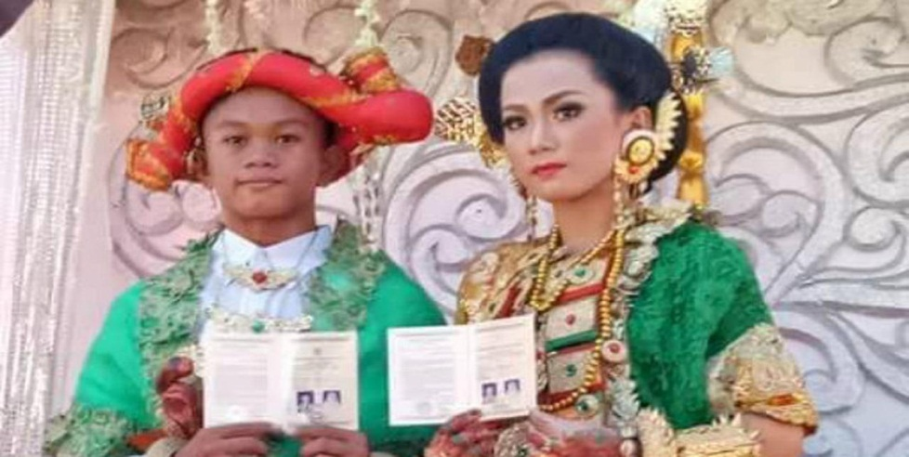
Child Married in Indonesia
The 2012 National Socio-Economic Survey (Susenas)
The Marriage Law in Indonesia :
32.10 % of married children aged 16 to 18 years.
11.13 % of girls marry at the age of 10 to 13 years.
The minimum legal age of marriage for males is 19, but for females is 16 .
  women who marry during their teens are unable to finish high school
Program : Prevention and elimination of child marriage

Slide 4

Violence against Women in Indonesia
(Source : National Commission on Women)
In 2017 : 348,446 cases
In 2016 : 260.000 cases
In 2014 : 293,220 cases
In 2013 : 279,688
In 2012 : 216,156
  Of those figures, around 25 percent were cases of sexual violence.

Slide 5

Joseph Nye
The three-dimensional chess game as a symbolic representation of the distribution of power in the world today :
Military (State)
Economic (Bussiness)
transnational relations (NGO) : composed of various types of non state actors (Nye, 2011)

Slide 6
English School – International Society
Realism : International System is anarchic, since there is no super-state to police the dealings of individual states
English School (international society theory), on the other hand argue that the international sphere is better characterized as a society where in members follow rules and expectations.

Slide 7
Realis vs English School
/ International Society Theory
Realis
English School / international society theory
International System is anarchic, since there is no super-state to police the dealings of individual states
The international sphere is better characterized as a society where in members follow rules and expectations.

Slide 8
Transnational Activities
Positive
Negative
Development issues
Environment
Human Rights
Gender Equality
Transnational Crimes :
  Human Trafficking
  Drug Smuggling
Illegal Migration
Terorrism ( 9/11 WTC -Tragedy)

Slide 9
Distinction between
NGO-INGO-Global NGO
NGOs are ‘‘self-governing, private, not-for-profit organizations that are geared to improving the quality of life for disadvantaged people.’’ Vakil (1997: 2060)
Distinction between NGO-INGO-Global NGO
  NGO is national
  INGO is rooted in two or more countries.
  Global NGOs is NGOs which are inherently directed toward international issues and policy making on a global scale.

Slide 11
1990s : an equality of status between governments and NGOs (social partnership)
The role of NGOs has dramatically changed over the last few decades
Thousands of NGOs attend all UN conferences, they are extremely involved in the drafting of new conventions and their function as observers, agenda setters, and policy implementers
More than 3000 organizations have consultative status in the UN.

Slide 12
The Roles of NGO : implementer, catalyst, and partner
The implementer role is concerned with the mobilization of resources to provide goods and services to people who need them.
  Service delivery : as healthcare, microfinance, agricultural extension, emergency relief, and human rights.
The catalyst role is an NGO’s ability to inspire, facilitate or contribute to improved thinking and action to promote social transformation.
  Gender and empowerment work, lobbying and advocacy work, and attempts to influence wider policy processes through innovation, and policy entrepreneurship.
The partner role (‘‘partnership’’ ) is for NGOs to work with government, donors .
  ‘‘capacity building’’ work which seeks to develop and strengthen capabilities. (Lewis, 2007).

Slide 13
Pengaruh Gerakan Perempuan terhadap Perkembangan Agenda PBB

Slide 14
Peran PBB dalam Mendorong Kesetaraan Gender
Perserikatan Bangsa-bangsa mencanangkan :
  UN Decade for Women (1976-1985)
  Konferensi Dunia tentang Perempuan (World Conference on Women) yang diselenggarakan di :
    Meksiko City (1975), Copenhagen (1980), Nairobi (1985), Beijing (1995) dan New York (MDGs-2000).
MDGs
  1.1 Menanggulangi kemiskinan dan kelaparan
  1.2 Mencapai pendidikan dasar untuk semua
  1.3 Mendorong kesetaraan gender dan pemberdayaan perempuan
  1.4 Menurunkan angka kematian anak
  1.5 Meningkatkan kesehatan ibu
  1.6 Memerangi HIV/AIDS, malaria, dan penyakit menular lainnya
  1.7 Memastikan kelestarian lingkungan hidup
  1.8 Mengembangkan kemitraan global untuk pembangunan

Slide 15
NGO – Uni Eropa
Keberadaan Uni Eropa memberi ruang yang semakin luas bagi NGO, termasuk NGO – NGO yang bergerak dibidang isu perempuan, untuk berpolitik dan menjalin jejaring antar NGO di berbagai negara anggota Uni Eropa.
Uni Eropa mendorong pertumbuhan jejaring transnasional tersebut dengan cara menggelontorkan dana untuk proyek-proyek pembangunan yang dilaksanakan oleh NGO.
Misalnya, melalui The European Fund for Regional Development. Untuk dapat mengakses dana ini, sebuah NGO lokal di sebuah negara

Slide 16
NGO - Eropa
Eropa harus menunjukkan bahwa mereka mempunyai partner sesama NGO di negara lain di Uni Eropa.
Persyaratan semacam ini sengaja dilakukan oleh Uni Eropa untuk mendorong integrasi masyarakat Eropa sehingga siap “take off” pada tahun 1990an.
Para NGO yang bergerak di isu perempuan ini kemudian juga meyakini bahwa kemampuan mereka untuk berjejaring secara transnational akan meningkatkan pengaruh mereka dalam melancarkan advokasi kebijakan.

Slide 17
Salah satu dampak dari keberadaan TANs adalah kemampuannya dalam membangun regime tatakelola pemerintahan yang bersifat supra nasional.

Slide 18
Referensi
NYE, Joseph S. The future of power. New York: Public Affairs, 2011.

