Slide 1


Gender in ASEAN
Nur Azizah
International Relations Department
Universitas Muhammadiyah Yogyakarta
Disampaikan dalam Dialog ASEAN yang diselenggarakan atas kerjasama PSA UGM- PSA UMY
– di Ruang E 6 Lantai 5 UMY, 9 November 2018

Slide 2
SEX AND GENDER
Sex = male and female
Gender = masculine and feminine
Sex refers to biological differences; chromosomes, hormonal profiles, internal and external sex organs.
“Gender” refers to the socially constructed roles, behaviors, activities, and attributes that a given society considers appropriate for men and women.
Gender describes the characteristics that a society or culture delineates as masculine or feminine.
So while your sex as male or female is a biological fact that is the same in any culture, what that sex means in terms of your gender role as a 'man' or a 'woman' in society can be quite different cross culturally.
In sociological terms 'gender role' refers to the characteristics and behaviours that different cultures attribute to the sexes.
  What it means to be a 'real man' in any culture requires male sex plus what our various cultures define as masculine characteristics and behaviours, likewise a 'real woman' needs female sex and feminine characteristics. To summarise:
'man' = male sex+ masculine social role → (a 'real man', 'masculine' or 'manly')
'woman' = female sex + feminine social role →(a 'real woman', 'feminine' or 'womanly')

Slide 3
Constructivist Theory : logic of appropriateness
“Constructivist approaches expand the repertoire of theoretical explanation by arguing that states behave in accordance with a “logic of appropriateness” and a “logic of material consequences” for their actions. By claiming that standards of appropriateness – i.e. “norms” – determine political outcomes.[1]
[1] Finnemore, Martha. 1996. “Norms, Culture, and World Politics: Insights from Sociology’s Institutionalism.” International Organization 50 (2): 325-347; Finnemore, Martha and Kathryn Sikkink. 1998. “International Norm Dynamics and Political Change.” International Organization 52 (4): 887-917; March and Olsen 1989; Wendt 1994; Finnemore 1996.

Slide 4
Mengukur kesenjangan gender - diskriminasi :
ASPEK-ASPEK Keadilan dan kESETARAAN
Akses: Kesempatan yang sama dalam memperoleh hak-hak dasar
Partisipasi: Pelibatan yang seimbang dalam memperoleh sumber daya
Kontrol: Keterlibatan dalam pengambilan keputusan
Manfaat: Keterjangkauan untuk mendapatkan hasil yang sama dari pembangunan

Slide 5
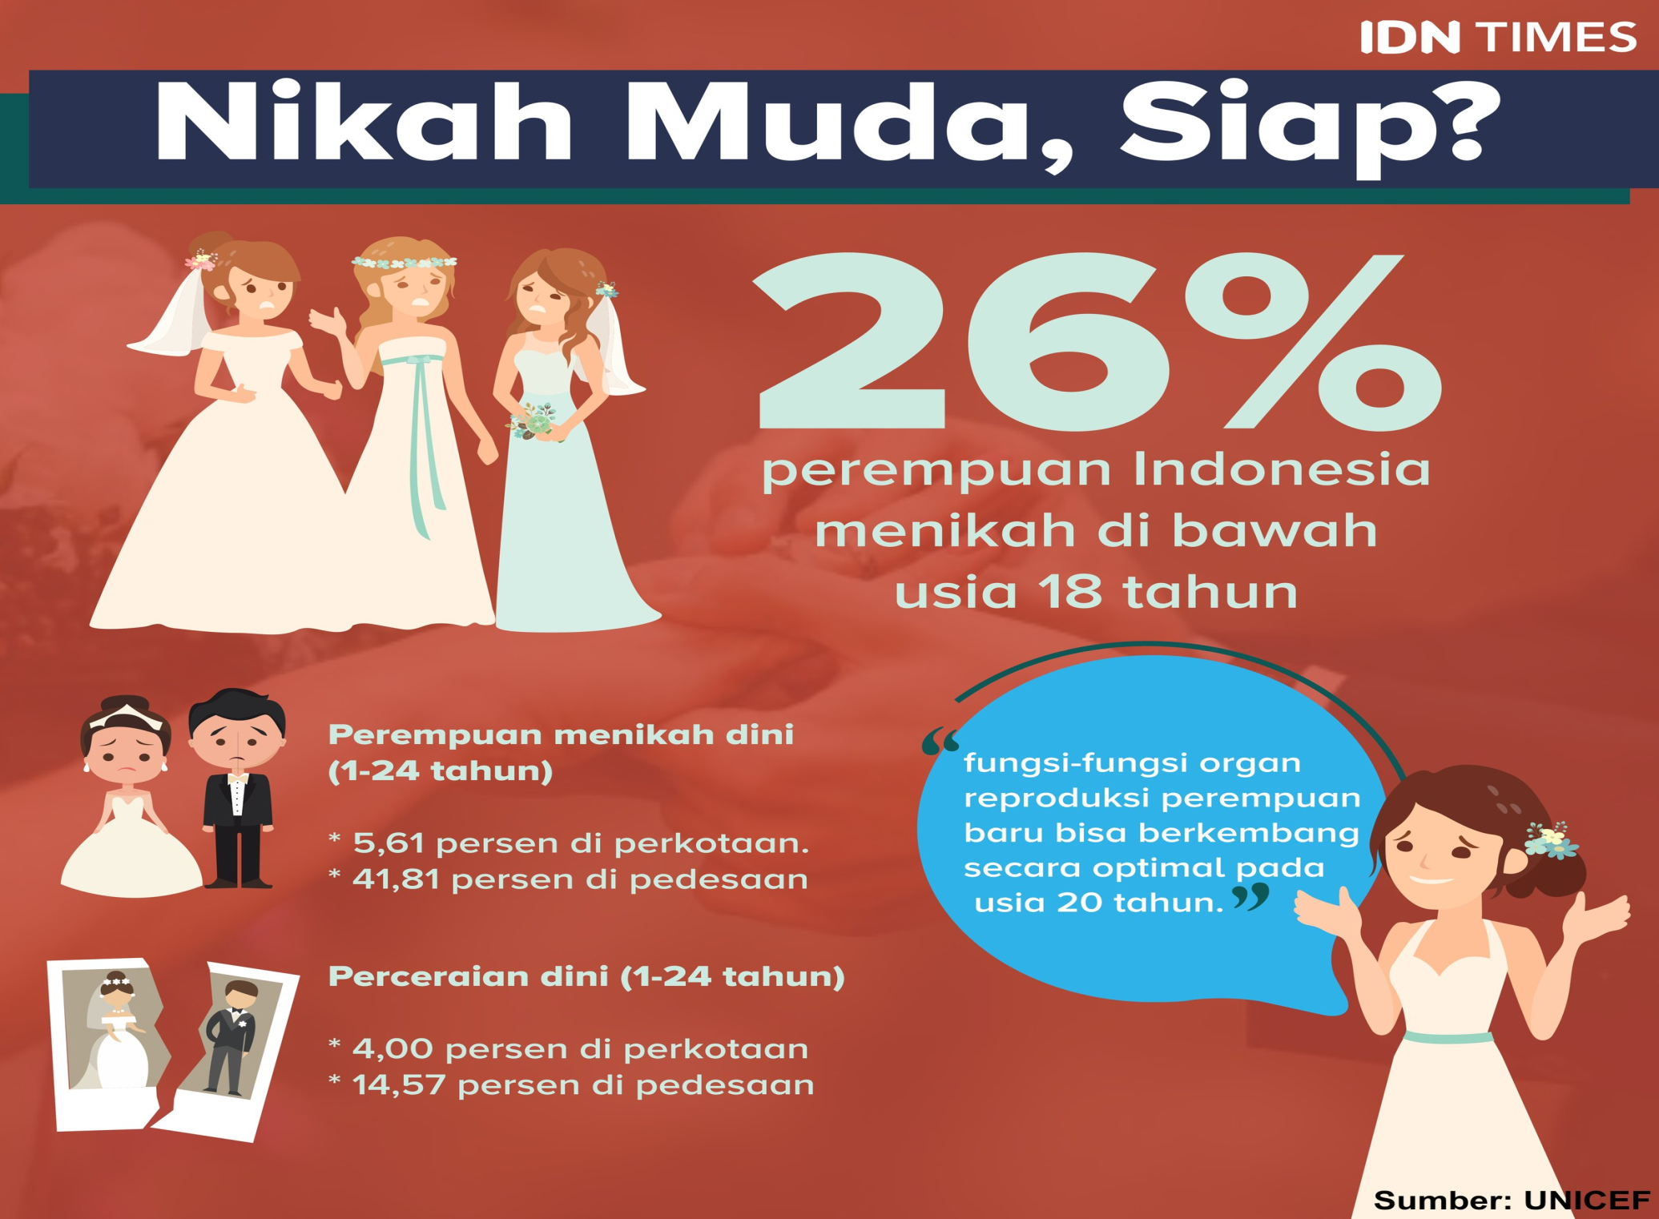

Slide 6
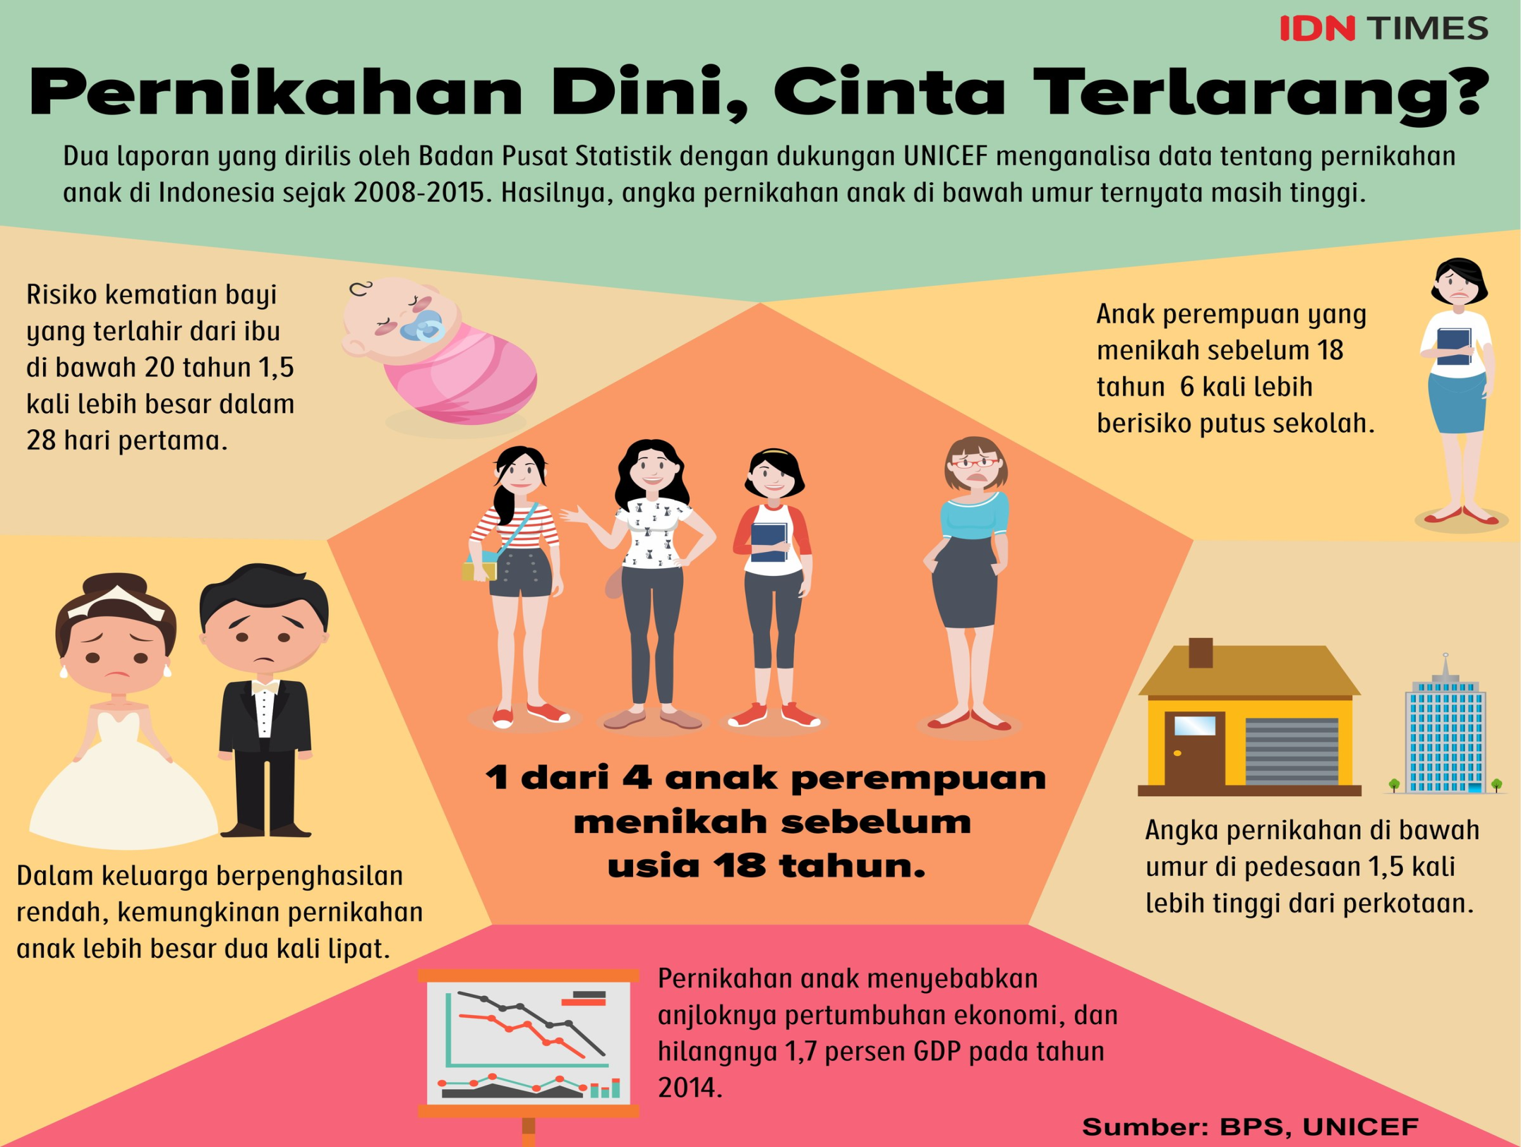

Slide 7
Prosentase Perempuan di Parlemen (Lower House / DDPR) di Negara-negara ASEAN
Sumber, IPU - http://archive.ipu.org/wmn-e/classif.htm , revisi data Indonesia
 | Pemilu Terakhir | Total DPR | Perempuan di DPR | % Perempuan di DPR
Philippines | 2016 | 292 | 86 | 29,5
Laos | 2016 | 149 | 41 | 27,5
Vietnam | 2016 | 494 | 132 | 26,7
Singapore | 2015 | 100 | 23 | 23
Cambodia | 2018 | 125 | 25 | 20
Indonesia | 2014 | 560 | 97 | 17,3
Malaysia | 2018 | 223 | 31 | 13,9
Nyanmar | 2014 | 433 | 44 | 10,2
Thailand | 2014 | 246 | 13 | 5,3

Slide 8
the World Economic Forum’s Global Gender Gap Index
(The Global Gender Gap Report 2017)
1 | Philippines
2 | Bangladesh
3 | Mongolia
4 | Laos
5 | Singapore
6 | Vietnam
7 | Thailand
8 | Myanmar
9 | Indonesia
10 | Cambodia

Slide 9
Peran PBB dalam Mendorong Kesetaraan Gender
Perserikatan Bangsa-bangsa mencanangkan :
  UN Decade for Women (1976-1985)
  Konferensi Dunia tentang Perempuan (World Conference on Women) yang diselenggarakan di :
    Meksiko City (1975), Copenhagen (1980), Nairobi (1985), Beijing (1995) dan New York (MDGs-2000).

Slide 10


Ekonomi naik ≠ Gender Equality naik
Gender Equality naik = Ekonomi naik
Pembangunan harus bertujuan untuk mengurangi Kesenjangan Gender
MDGs
SDGs

Slide 11
The UN Women’s vision of Planet 50-50 by 2030
The He For She initiative invites men and boys as partners for women’s rights, and also recognises how the entire society can benefit from gender equality.
“Gender equality is not a matter concerning women only, but all of us including men and boys.
By encouraging men and boys to be agents of change, we would like to inculcate a culture of respect for women and girls.
Gender equality is pivotal for the ASEAN Community.

Slide 12
ASEAN initiative on Women’s Issues
1975
established the ASEAN Sub-Committee on Women (ASW)
1976, Pertemuan di Makati Philippine untuk menentukan strategi ASEAN dalam merespon the United Nations International Decade for Women (1975-1985).
1981
2001
1981 :ASW → diubah menjadi AWP (the ASEAN Women’s Programme)
2001 : AWP → diubah menjadi the ASEAN Committee on Women (ACW).
2012, 2015, 201 : ASEAN Ministerial Meeting on Women
2000 : Indonesia : Instruksi Presiden No. 9 tahun 2000 tentang Pengarusutamaan Gender (PUG)

Slide 13
Bantuan Pembangunan
Bantuan untuk Kesetaraan Gender
1958 : United Nations Delegations a statement introducing the idea of the 1 per cent target, i.e. that grants and concessional loans to developing countries should be at least 1 per cent of the national income of the rich countries.
  Development Assistance > 1 % GNP
Donor untuk Kesetaraan Gender :
  Tahun 2015-2016 rata-rata USD 41.7 billion / tahun, setara dengan 37% bantuan bilateral , mentargetkan gender equality sebagai tujuan.

Slide 14
Donor Funding untuk Kesetaraan Gender
INGO
Pemerintah
AusAids
USAID
Norwegia
Swedia
Netherland
Canada
UNDP
UN Women

Slide 15

Women’s Fund Asia
126, Polhengoda Road, Colombo 5, Sri Lanka
Tel. No: +94 11 4324541,E-mail: info@wf-asia.org
We are a feminist donor organisation that supports the realisation of the human rights of women and trans* people in Asia
WOMEN’S FUND ASIA
Our Vision
Realising the human rights of women and trans* people in Asia.
Our Mission
Women’s Fund Asia works to nurture and lead feminist philanthropy in the region; to effectively mobilise resources to support individuals, groups and networks enabling their sustainability; and to strengthen partner capacities, leadership, advocacy and networks in the field.
Strengthening Feminist Voices
Movement and Labour
Autonomy, Decisions and Sexual Rights
Access to Justice
Environment Justice

Slide 16

https://www.globalfundforwomen.org/
2018 : $21 million
Global Fund for Women’s primary goal is to get resources to organizations led by women, girls, and trans people.
GFW support organizations led by historically marginalized groups who are working to build strong, connected movements for gender equality and human rights. We trust women, girls, and trans people to know how best to solve the problems in their communities.
Vision
  Every woman and girl is strong, safe, powerful, and heard. No exceptions.
Mission
  We are a global champion for the human rights of women and girls. We use our powerful networks to find, fund, and amplify the courageous work of women who are building social movements and challenging the status quo. By shining a spotlight on critical issues, we rally communities of advocates who take action and invest money to empower women.

Slide 17
Gender Mainstreaming
Gender mainstreaming adalah konsep kebijakan publik yang didasarkan pada fakta akan adanya dampak yang berbeda antara perempuan dan laki-laki jika terkena kebijakan tersebut.
Gender mainstreaming meyakini akan adanya perbedaan kebutuhan dan kepentingan antara laki-laki dan perempuan karena adanya pembagian peran gender didalam masyarakat.
Konsep GenderMainstreaming pertamakalinya dikemukakan pada tahun 1985 dalam Third World Conference on Women in Nairobi, Kenya, → Diadopsi oleh PBB
1995 : The idea was formally featured in 1995 at the Fourth World Conference on Women in Beijing, China, and was cited in the document that resulted from the conference, the Beijing Platform for Action.

Slide 18
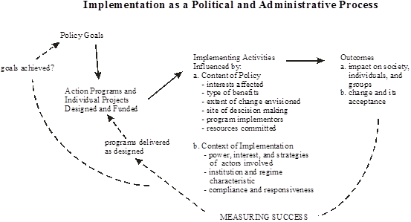
Implementation as a Political and Administrative Process

Slide 19
Content of policy dipengaruhi oleh :
Contexs of implementation dipengaruhi oleh :
kepentingan yang dipengaruhi atau kepentingan siapa saja yang terlibat (interests affected)
type manfaat yang diperoleh (type of benefits)
derajad perubahan yang diharapkan (extent of change envisioned)
letak pengambilan keputusan (side of decision making)
siapa saja yang menjadi pelaksana program (program implementator)
sumberdaya yang dilibatkan (resources commited).
kekuasaan, kepentingan dan strategi aktor yang terlibat (power, interest and strategies of actors)
karakter lembaga dan regime yang berlaku (institution and regime characteristic)
kepatuhan dan daya ketanggapan (compliance and responsiveness),

