Slide 1
Presentation Title:
“Research Based Education in the Universities of Bangladesh and Competencies of Faculty Members”
-an overview
Presented by :
Md. Abu Jahid, MBA (Acc), University of Rajshahi.
Fellow, Doctoral Management
Universitas Muhammadiyah Yogyakarta(UMY)

Slide 2
Introduction:
University faculty members are the most talented person and the architect of a nation.
Searching new things in their expertise field and teaching to the students are the main duties of a faculty member.
Bangladesh young national literacy rate is 72.9%
High educating literacy rate is (12%) significantly lower in Bangladesh. (BANBEIS: 2017).
Higher education system is still traditional and research based study is not focused in the syllabus.
Entry requirements for universities faculty members vary for the absence of unified service rules.

Slide 3
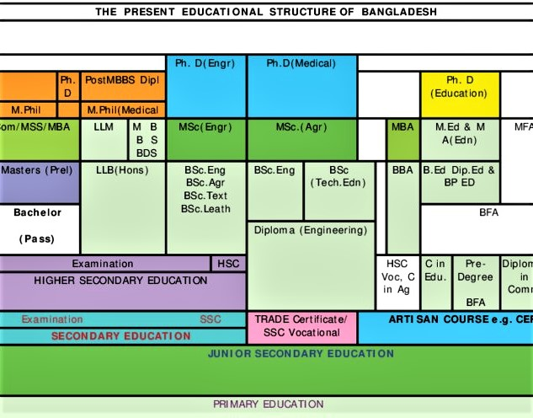
Offered Research Based Degrees Only in Public Universities and output
Degree/year | 2014 | 2016 | 2017
MS/MPH/FCPS/MD | 442 | 320 | 566
MPhil | 274 | 229 | 222
MPhil(Medical) | 156 | 170 | 211
PhD | 488 | 474 | 441
Total | 1360 | 1193 | 1440

Slide 4
The Higher Education System in Bangladesh is Highly Complex
There are four types of higher education institutions:
1.Competitive public and private universities;
2. A vast number of govt. and non-govt. colleges
affiliated with the National University;
3. Islamic educational institutions affiliated with
the Islamic University of which only three are
public institutions;
4. Various types of professional colleges,
institutions and madrasas.

Slide 5
Present Scenario of University Education in Bangladesh
There are 148 Universities in Bangladesh, 45 (30%) are Public and 103 (70%) are private.
All Public Universities are autonomous and run by their own Ordinance/Act but all the Private Universities are run by Private University Act 2010.
University Grant Commission (UGC) is the guardian of all higher educational institutions.
Type of University | No. of University | Teacher Total | Student Total | Ratio
Public | 45 (30%) | 13799 | 676623 | 1:48
Private | 103 (70%) | 15333 | 351691 | 1:22
Total | 148 | 29132 | 1028314 | 1:35
(BANBEIS: 2018)

Slide 6
Indicators of Research level
Bangladeshi University research contributions are minor by international standards, public or private, are not well represented in regional or global rankings.
There aren’t any Bangladeshi Universities are included in the Times Higher Education or Shanghai rankings.
The oldest “Dhaka University” and the most reputable “BUET” are ranked in the 801 to 1000 range in the current QS ranking.

Slide 7
Faculty members by designation employed
Sl.No | Type of University | Teacher by designation
 |  | Professor | Associate Professor | Assistant Professor | Lecturer | Total
1 | Public | 3906 | 2175 | 4738 | 3232 | 14051
2 | Private | 2384 | 1431 | 3373 | 8145 | 15333
3 | Total | 6,290‬ | 3,606‬ | 8111 | 11377 | ‭29384
Data: BANBEIS 2018
Lecturer teaching in public universities 23%
Lecturer teaching in private universities 53%
1(one)educational and research institute for higher training and research under Dhaka University. (National Education policy 2010)

Slide 8
Causes of Scarcity of Research
Public university seat capacity is very limited in Bangladesh, especially at quality institutions—every year potential students who passed the HSC exams, but fewer available seats in the top level of competitive public universities.
Only public universities offer research based degrees, The Doctor of Philosophy (Ph.D) is the highest academic credential in Bangladesh and the Master of Philosophy (M.Phil) is an advanced research degree, both of them awarded only by public universities (WENR August 1, 2019).
Research based courses are very few in the syllabus of undergraduate and graduate degree programs.
Allocation of national budget in education and research limited( GDP 2.1% only).
Recruitment policy and syllabus, most of the public and private universities do not require research experience to entry in the job as lecturer because research is mostly not included in their teaching syllabus.

Slide 9
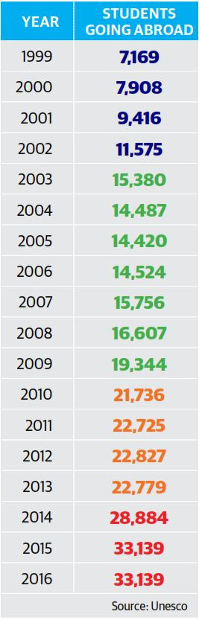
Causes of Scarcity of Research
The number of Bangladeshi students enrolled in degree (research)programs abroad almost increased within 18 years, from 7000 in 1999 to 33,000 (UNESCO Institute for Statistics 2017).
Many Bangladeshi students and University faculty members do not return from abroad after completing their studies. As one Bangladeshi professor told the Dhaka Tribune newspaper, “jobs and investments are not generating nearly the amount of money needed … for a standard of living, the young do not see a future for themselves in Bangladesh.
Many are frustrated over the criminal situation created by poverty along with political unrest and no industrial and agricultural development, which has worsened their perception of the country.”

Slide 10
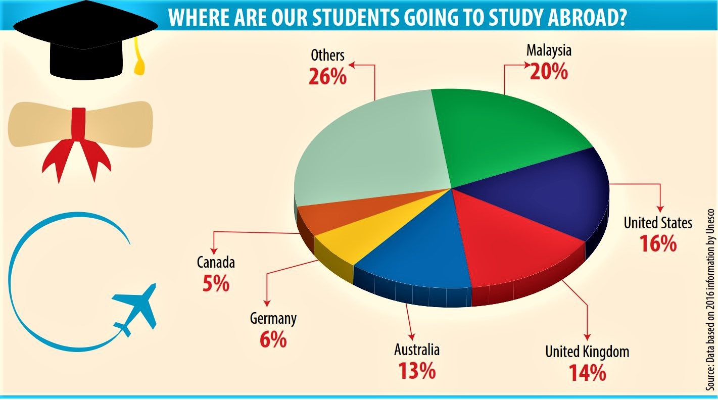

Slide 11
Recommendations for more involvement in research
Bangladeshi 70% universities are from private sector so they should offer research based degrees.
Seat capacity should be increased specially for present research based programs in public universities.
Research based courses should be included in the undergraduate and post graduate degree syllabuses.
Unified service rules and recruitment policies should be adopted for ensuring the quality faculty members service in the universities.
Favorable environment, standard remuneration and other facilities should be insured by the authorities for stabilizing the job.

Slide 12
Conclusion
According to education minister “unified policy soon for university teacher recruitment and promotion”. The policy will be implemented through a gazette notification- (June16, 2019 Focus Bangla).
Research in universities can generate enormous social capital and rich economic dividends.
It must, therefore, begin to receive serious attention and will require integrating intention, imagination, innovativeness, investment, and involvement of government and various stakeholders.

Slide 13



THANK YOU

