Slide 1
Becoming Excellent University Student
Presented By: Anisa Dwi Makrufi
Disampaikan pada Bridging Mahasiswa Baru PAI FAI UMY
Sabtu, 12 Oktober 2019

Slide 2
What`s on Your Mind?
Excellent University Student
Agama
Teknologi
Bisnis
Academic

Slide 3
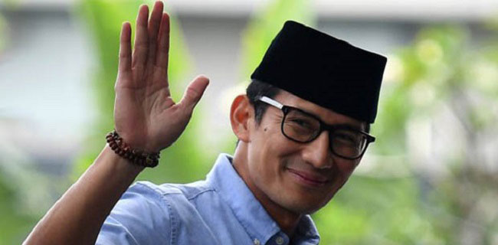
Who Are They??

Slide 4
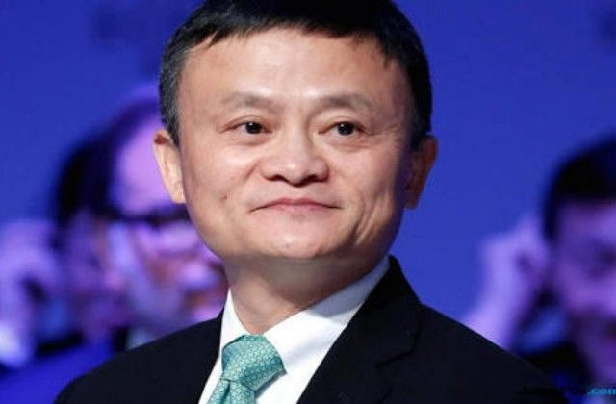

Who Are They??

Slide 5
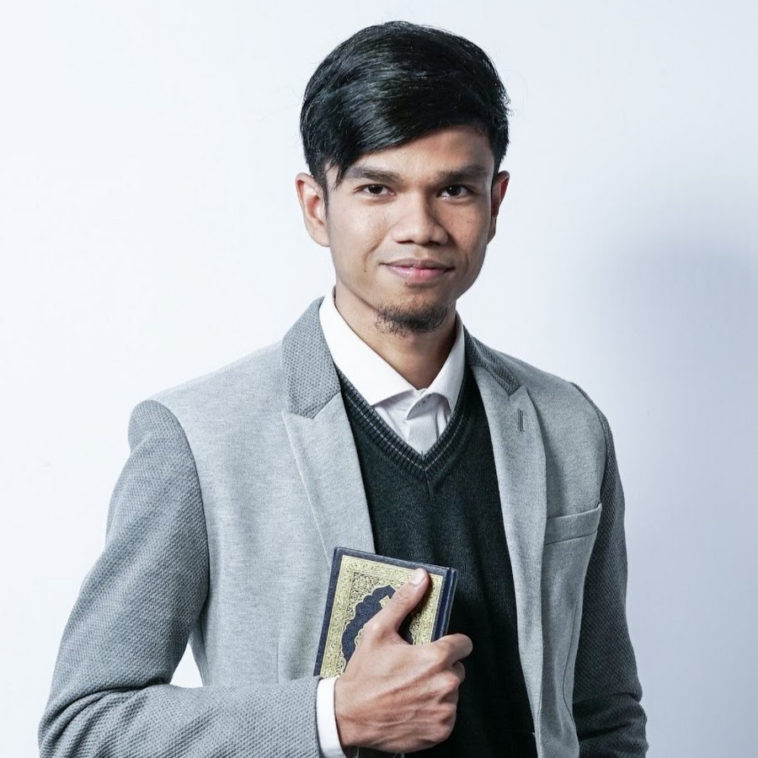
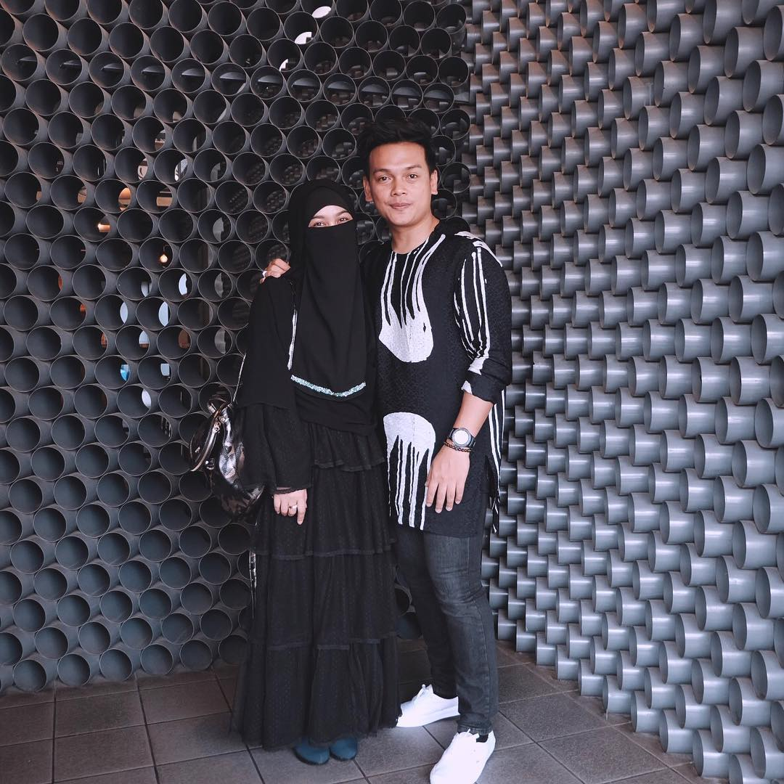
Who Are They??

Slide 6
Amati video berikut:

Slide 7
“Aku dan Mimpiku”
Silahkan menulis (waktu 10 menit)

Slide 8
Mahasiswa PAI “Luar Biasa”
NIAT
Commitment - Integrity – Success
Afirmasi diri menurut nama
Roadmap/ Mindmap (perjalanan empat tahun ke depan)
Role model (biografi orang—orang sukses)→Nabi Muhammad
Isi waktu luang dengan membaca (Muhammad Super Leader Super Manager)

Slide 9
Steps to be Excellent University Student
Create a calendar of dates (Download a weekly planner from the Tutoring Services/Study Skills website).
Make a “To do” list.
Make sure to schedule relaxation, exercise and recreation time.
Allow time to review before class.
DO NOT over commit.
Avoid Procrastination

Slide 10
The Basics of Being a Good Student
Prioritize your life: Doing well in school should be your top priority.
Study: There is no substitute.
Always attend class.
Do all of the homework and assigned reading.
Develop self-discipline.
Manage your time.

Slide 11
Amunisi
Kenali potensi diri (ada yang sudah punya bisnis? Keahlian tertentu?)
Bergaul dengan orang yang satu visi (gaul dengan tukang minyak wangi atau pandai besi?)
Memupuk mimpi (dreams come true, its really! Who wants to share?)

Slide 12

Bermimpilah setinggi langit. Jika engkau jatuh, engkau akan jatuh di antara bintang-bintang.
– Soekarno

