Slide 1

MSC APPLICATION
LOCAL AND SYSTEMIC APPLICATION
AGUS WIDIYATMOKO
FKIK UNIVERSITAS MUHAMMADIYAH YOGYAKARTA

Slide 2

MESENCHYMAL STEM CELL
Self-renewing, multipotent progenitor cells with multilineage potential to differentiate into cell types of mesodermal origin
MSCs can migrate to sites of inflammation and exert potent immunosuppressive and anti-inflammatory effects through interactions between lymphocytes associated with both the innate and adaptive immune system

Slide 3
SOURCES OF MSC
bone marrow,
adipose tissue,
placenta,
amniotic fluid, and
umbilical cord blood

Slide 4
THERAPEUTIC PROPERTIES OF MSCs
Differentiation and regenerative potential
Ability to self-renew and to differentiate into cells of the mesenchymal lineage
Immune modulation
They exert potent immunosuppressive and anti-inflammatory effects
Migratory capacity
MSCs have the capacity to migrate to sites of inflammation and tumor microenvironments

Slide 5
Human umbilical cord blood‐derived MSCs (hUCB‐MSCs)
They have distinct advantages, including accessibility, a higher proliferation capacity, and a lower immunogenicity

Slide 6

LESSON FROM THE CASES

Slide 7
DIABETES MELLITUS
MSC-related research has demonstrated exciting therapeutic efects in glycemic control both in vivo and in vitro, and these results now have been translated into clinical practice (Zang et al. 2017)
Umbilical cord-derived MSCs (UC-MSCs) express embryonic markers and endodermal lineage markers (Pessina A et al. 2004)

Slide 8

CASE 1
Man, 56 years old, with DM type 2
  Given stem cell infusions from the umbilical cord
  HbA1C before therapy 8,4%
  HbA1C after therapy 7,2% (one month later)
  The patient received metformin and glimepiride therapy
  After 3 months, HbA1C becomes 8.0

Slide 9
DISCUSSION
Stem cells are infused through the arm
The first 1 month stem cell successfully homing and serves to reduce blood sugar levels
After 1 month, a diabetic or hyperglycemic environment reduces the proliferative potential of MSCs (Cheng et al., 2016)
A better protocol is needed for the dosage and method of administering stem cells in diabetes

Slide 10
Case 2
Women, 72 years old, DM2NO with microangiopathy and macroangiopathy complication
  Stem cells are given directly to the pancreas
  HbA1C before treatment 8,9%
  HbA1C 1 month after treatment 6,2%
  HbA1C 6 month after treatment 6,6 %
  Patients get basal insulin therapy (before therapy 14 unit per day, after therapy 6 unit per day)

Slide 11
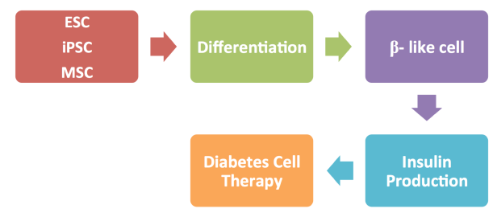
DISCUSSION
Giving stem cells directly to the pancreas gives better results than stem cell infusions

Slide 12
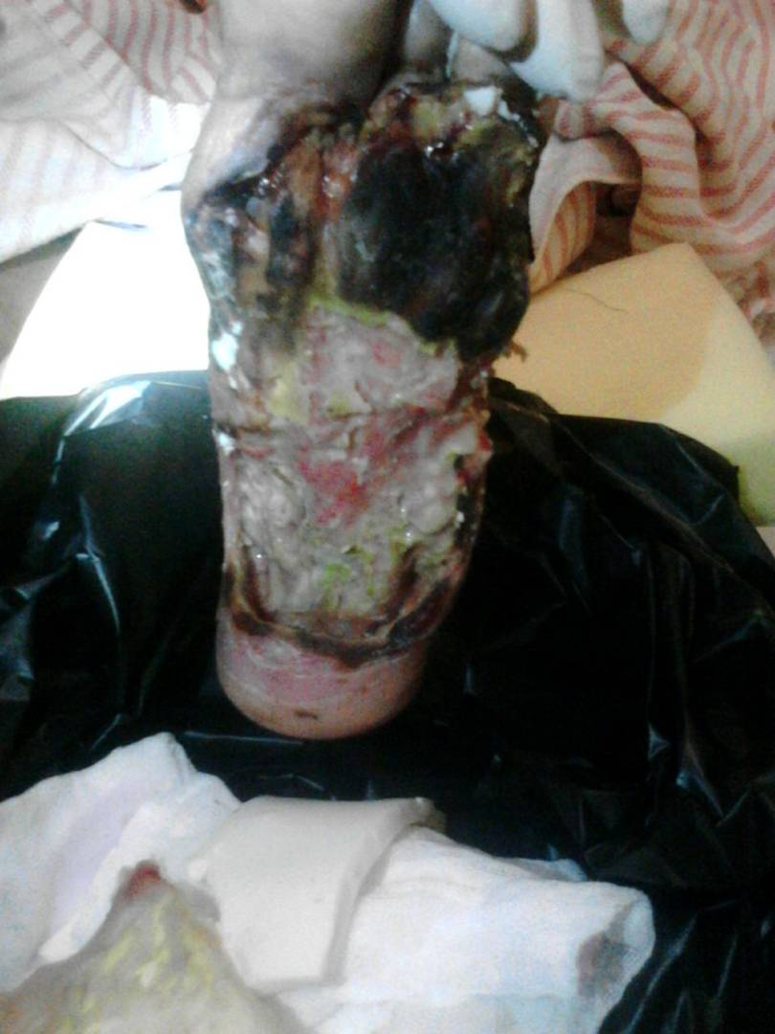
Case 3
Women 73 years old with diabetic foot
MSC was injected Intramuscular and subcutaneous with growth factor

Slide 13
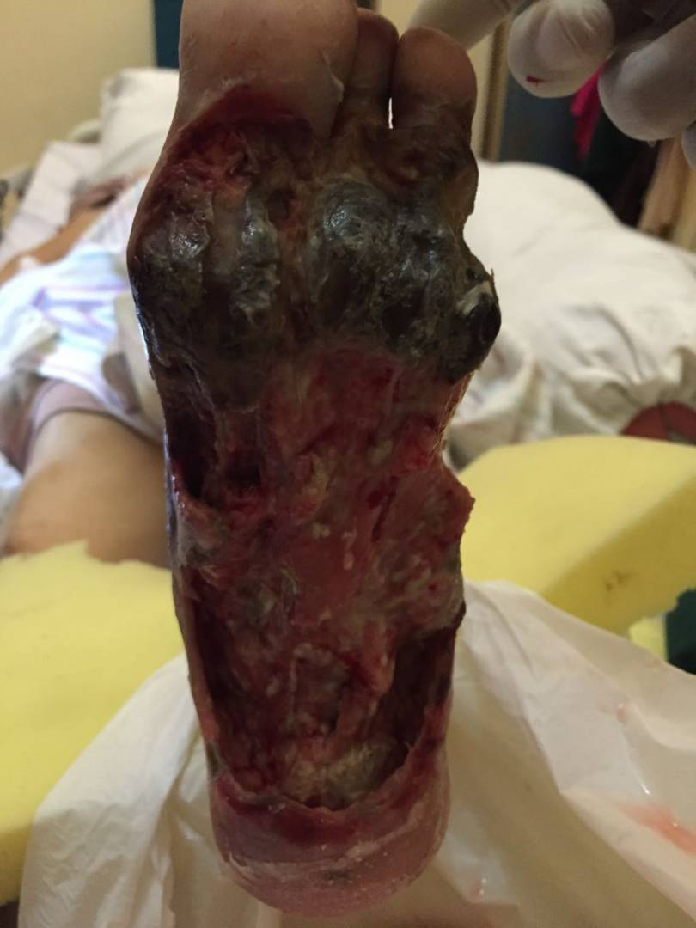
After 1 month, with stem cell application (local) + growth factor

Slide 14
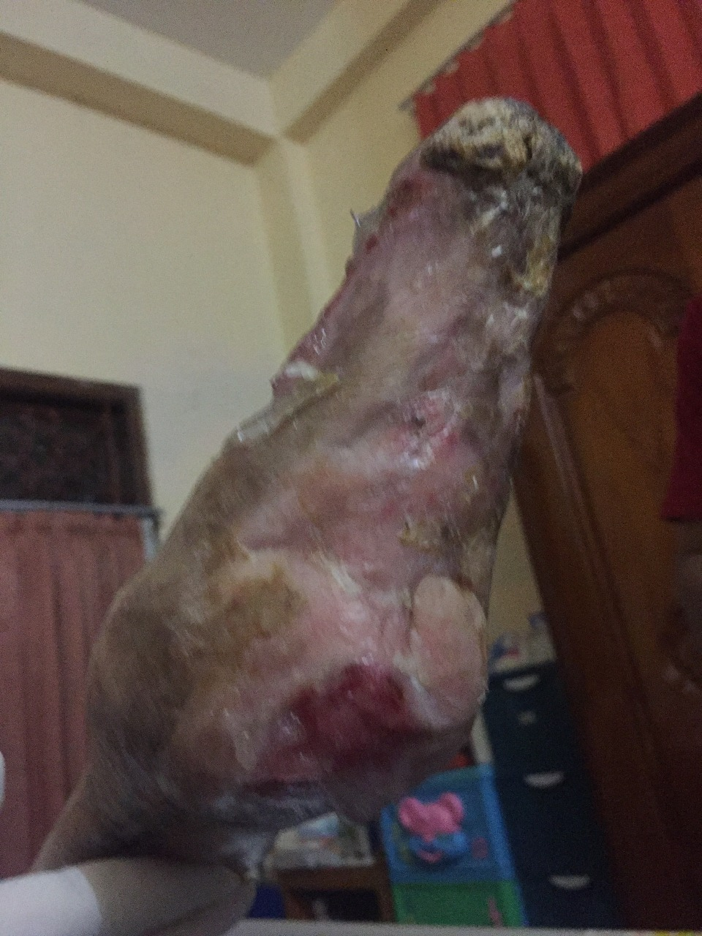
After 1 years

Slide 15
DISCUSSION
MSCs can enhance the migration, angiogenesis, and reepithelialization via paracrine to accelerate wound repair.
Diabetic microenvironment including hyperglycemia and persistence of inflammation may have an influence on population and function of endogenous stem cell

Slide 16
Case 4
Women, 27 years old with Rheumatoid Artritis
  Treat with infusion of UC-MSC
  hsCRP before treatment 3,7 mg/L
  ESR before therapy 54mm
  hsCRP after 1 month therapy was 0,7 mg/L
  ESR after 1 month therapy 12 mm
  Routine therapy with metotrexate 12,5mg per weeks

Slide 17
DISCUSSION
MSCs have significant clinical implications as they exert potent immunosuppressive and anti-inflammatory effects through the interactions between the lymphocytes associated with both the innate and adaptive immune systems. (Kim and Cho, 2013)
MSCs have the capacity to migrate to sites of inflammation

Slide 18
CONCLUSION
Stem cell therapy provides hope for the treatment of several diseases
There are several mechanisms for stem cell therapy to repair damage in the body
Further research is needed to make stem cell therapy even better
Further research to determine stem cell therapy protocols for various disease conditions

Slide 19

ALHAMDULILLAH

