Slide 1

CLINICAL EXPERIENCE
STEM CELL THERAPY FOR DIABETIC FOOT ULCER
AGUS WIDIYATMOKO
FKIK
UNIVERSITAS MUHAMMADIYAH YOGYAKARTA

Slide 2
DIABETES
FACTS OF INDONESIA
The prevalence of diabetes according to the 2015 PERKENI consensus in the population aged ≥ 15 years is 10.9%

Slide 3
DIABETIC FOOT ULCERS
MACRO AND MICROVASCULAR COMPLICATION
DFU is one of the most common complications
Data from the RSCM Jakarta, found 8.7% of patients experiencing complications of diabetic ulcers (RSCM, 2011)

Slide 4
Phases of Normal Wound Healing
Inflammatory phase,
Proliferative phase and
Remodelling phase

Slide 5
DIABETIC FOOT ULCER
proteolysis cytokine receptor deficiencies
impaired angiogenesis
CHRONIC WOUND
Impaired progenitor cell recruitment
delayed re-epithelialisation

Slide 6
MESENCHYMAL STEM CELL
Self-renewing, multipotent progenitor cells with multilineage potential to differentiate into cell types of mesodermal origin
MSCs can migrate to sites of inflammation and exert potent immunosuppressive and anti-inflammatory effects through interactions between lymphocytes associated with both the innate and adaptive immune system

Slide 7
SOURCES OF MSC
bone marrow,
adipose tissue,
placenta,
amniotic fluid,
umbilical cord blood

Slide 8
THERAPEUTIC PROPERTIES OF MSCs
Differentiation and regenerative potential
Ability to self-renew and to differentiate into cells of the mesenchymal lineage
Immune modulation
They exert potent immunosuppressive and anti-inflammatory effects
Migratory capacity
MSCs have the capacity to migrate to sites of inflammation and tumor microenvironments

Slide 9
Human umbilical cord blood‐derived MSCs (hUCB‐MSCs)
They have distinct advantages, including accessibility, a higher proliferation capacity, and a lower immunogenicity

Slide 10

OUR CLINICAL EXPERIENCE

Slide 11
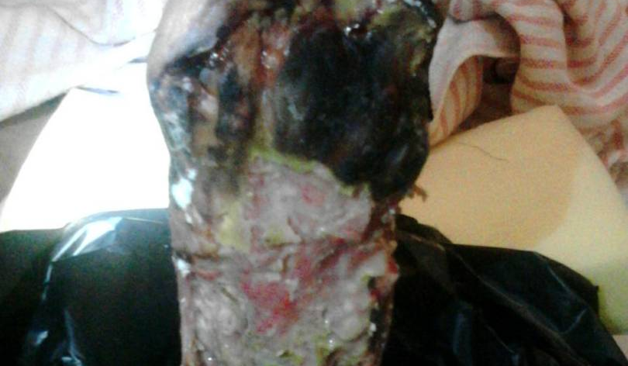
Case 1
73-year-old woman with diabetes since 40 years ago
Complications of diabetic foot ulcer since 4 months ago
Umbilical Cord Stem Cell was injected Intramuscular and subcutaneous with growth factor

Slide 12
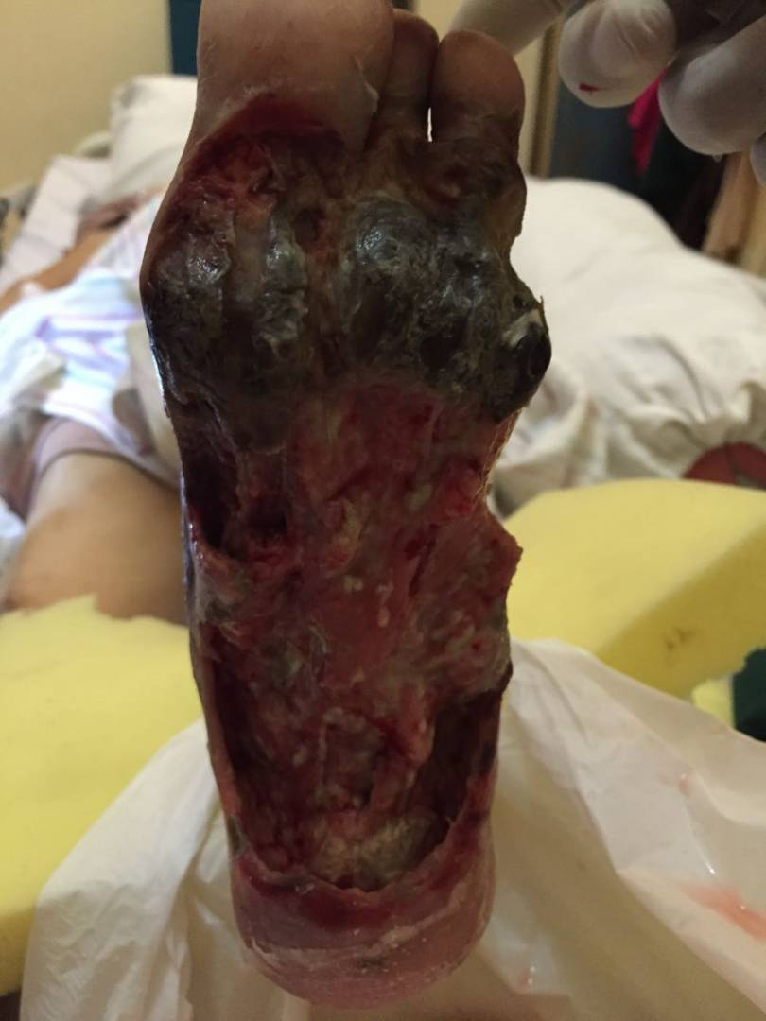
After 1 month, with umbilical cord stem cell application (local) + growth factor

Slide 13
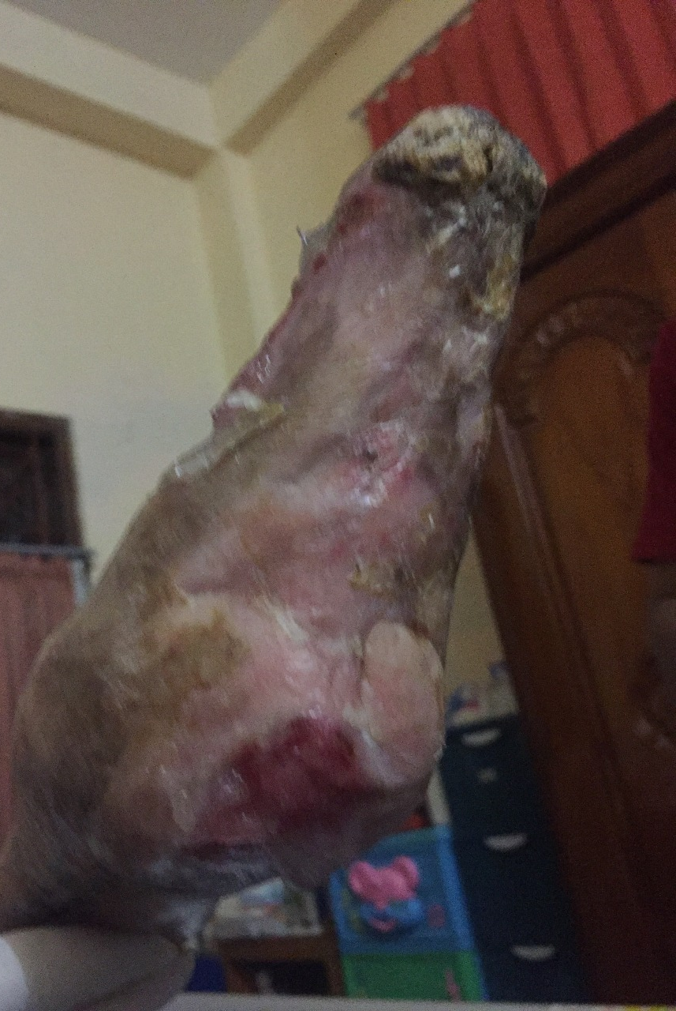
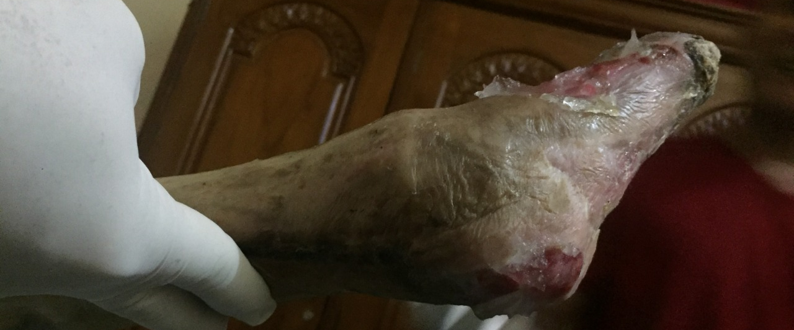
After 1 year with wound care and topical stem cell administration every 3 months

Slide 14
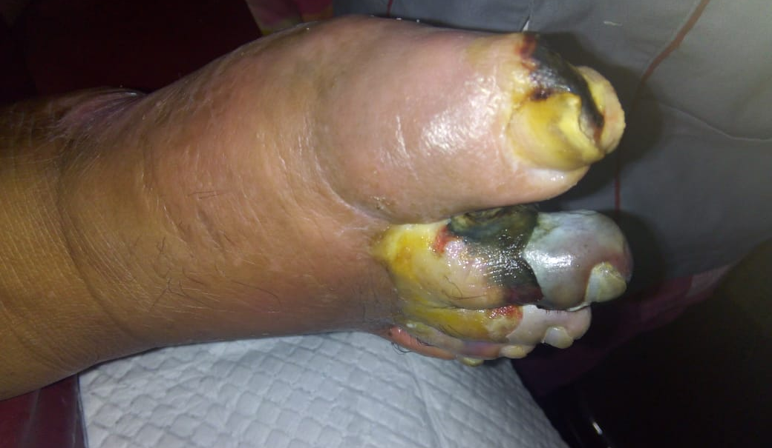
Case 2
54 years old man with diabetes since 10 years ago
Complications of diabetic foot ulcer since 3 months ago
Umbilical cord stem cells are infused and given topically every 3 months

Slide 15
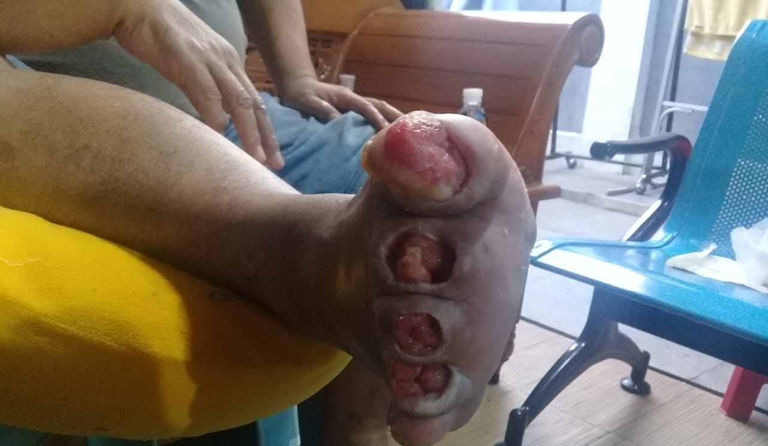
After 1 month
limited amputations of the 2nd, 3rd, and 4th fingers

Slide 16
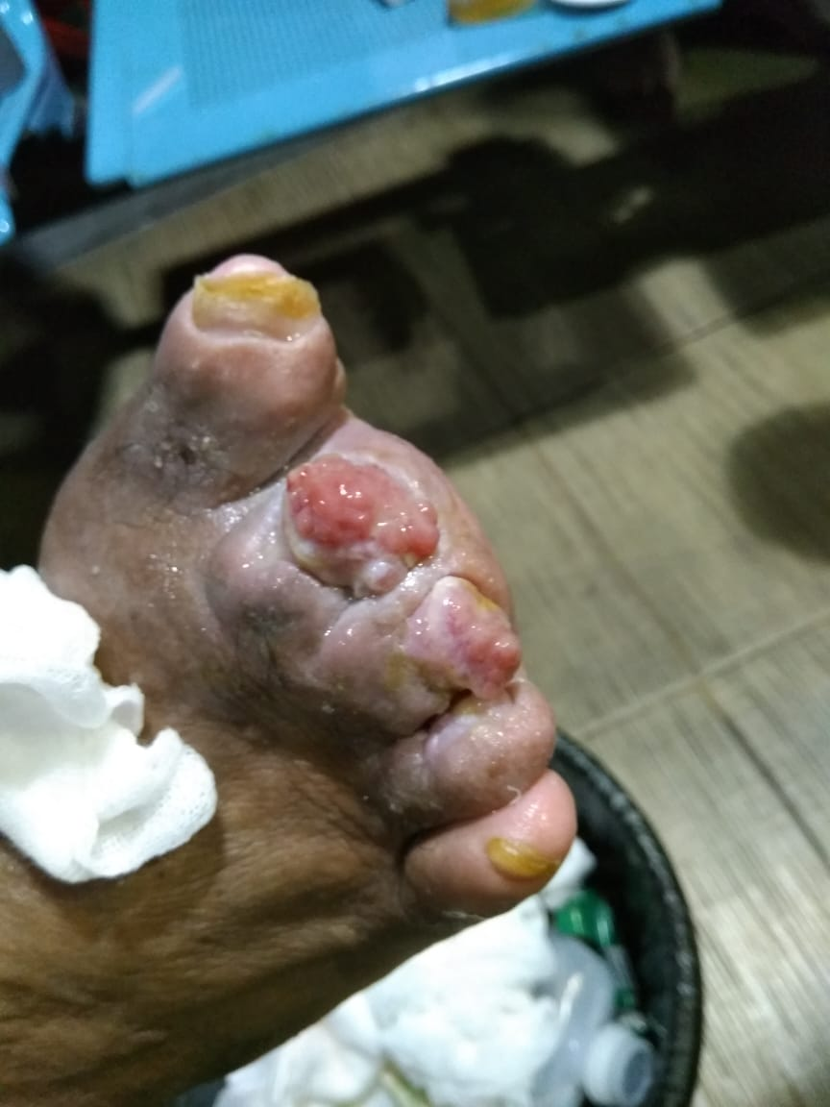
After 4 month

Slide 17
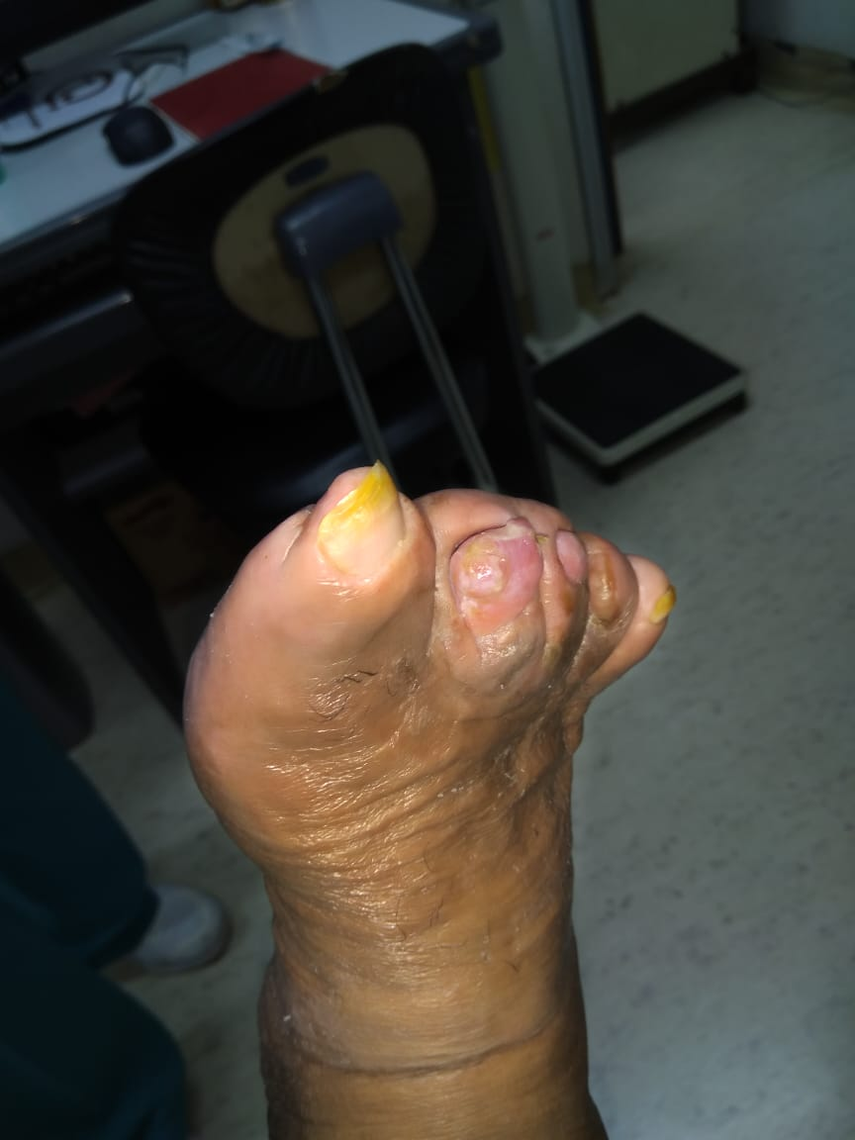
After 7 month
The wound closes and new tissue grows in the toe

Slide 18
DISCUSSION
MSCs can enhance the migration, angiogenesis, and reepithelialization via paracrine to accelerate wound repair.
Diabetic microenvironment including hyperglycemia and persistence of inflammation may have an influence on population and function of endogenous stem cell

Slide 19
STEM CELL AND HEALING PROCESS
Normal wound healing requires the coordinated communication among cells, growth factors and extracellular matrix proteins within the extracellular matrix.
Stem cells are central in this process as they allow for a coordinated repair response.
They also recruit other cells and signal the release of growth factors and the appropriate MMPs into the extracellular matrix.

Slide 20
CONCLUSION
Stem cell therapy provides hope for the treatment of Diabetic Foot Ulcers
There are several mechanisms for stem cell therapy to repair damage in chronic wound
Further research is needed to make stem cell therapy even better
Further research to determine stem cell therapy protocols for Diabetic Foot Ulcers

Slide 21

ALHAMDULILLAH
THANK YOU............
WEDI OMBO BEACH
GUNUNG KIDUL YOGYAKARTA

