Slide 1


Determinants of Foreign Tourism Demand to Indonesia: Gravity Model Approach
Dyah Titis Kusuma Wardani
Nuvimbar Susy Anindita Handayani
Universitas Muhammadiyah Yogyakarta

Slide 2
FOREIGN TOURISM TOTAL NUMBER OF VISIT TO INDONESIA, 2009-2016

Slide 3

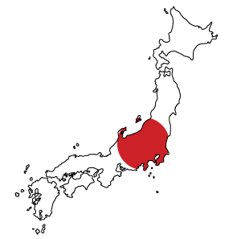








8%
4%
15%
6%
4%
22%
Observation: Eight (8) of Countries as the Most Visitors
Data of Total Number of Foreign Tourists is obtained from Statistics Indonesia (BPS)
24%
17%

Slide 4



Research Scope
Act
Period
8 Countries as the most visitors
Law of Republic Indonesia Number 10 Year 2009: Tourism
2009 - 2016
Singapore, Malaysia, Australia, United States, United Nation, Republic of China, Jepang, dan Republic of Korea

Slide 5


RESEARCH QUESTIONS
To what extent the effect of Indonesia’s GDP per capita on the total number of foreign tourist visit to Indonesia?
1
To what extent the effect of foreigners’ GDP per capita on the total number of foreign tourist visit to Indonesia?
2
To what extent the effect of distance on the total number of foreign tourist visit to Indonesia?
3
To what extent the effect of domestic (Indonesia) exchange rate on the total number of foreign tourist visit to Indonesia?
4
To what extent the effect of foreign countries’ population on the total number of foreign tourist visit to Indonesia?
5

Slide 6

RESEARCH OBJECTIVES
To examine the effect of Indonesia’s GDP per capita on the total number of foreign tourist visit to Indonesia
To examine the effect of foreigners’ GDP per capita on the total number of foreign tourist visit to Indonesia
To examine the effect of distance on the total number of foreign tourist visit to Indonesia
To examine the effect of domestic (Indonesia) exchange rate on the total number of foreign tourist visit to Indonesia
To examine the effect of foreign countries’ population on the total number of foreign tourist visit to Indonesia

Slide 7


GRAVITY THEORY
The gravity model has been widely used in explaining the volume of trade, capital flows, regional science economic geography as well as migration of people among countries in the world (Kosnan, Ismail & Kaliappan, 2013).
$$F=G\frac{m_{1}m_{2}}{r^{2}}$$
F : Attraction forces between two objects (N)
𝒎_𝟏 : Mass of object 1 (kg)
𝒎_𝟐 : Massa object 2 (kg)
r : Distance (m)
G : Gravity constant
This research applied Gravity model approach, as research conducted by Sheldon and Var (1985) explains that initially the gravity model predicts that the flow of tourism from region i to region j is the same as from country j to country i. Kimura and Lee (2009) show that service trade is better predicted by gravity equations than service trade. Distance between the two countries is also important in measuring interactions between two countries.

Slide 8
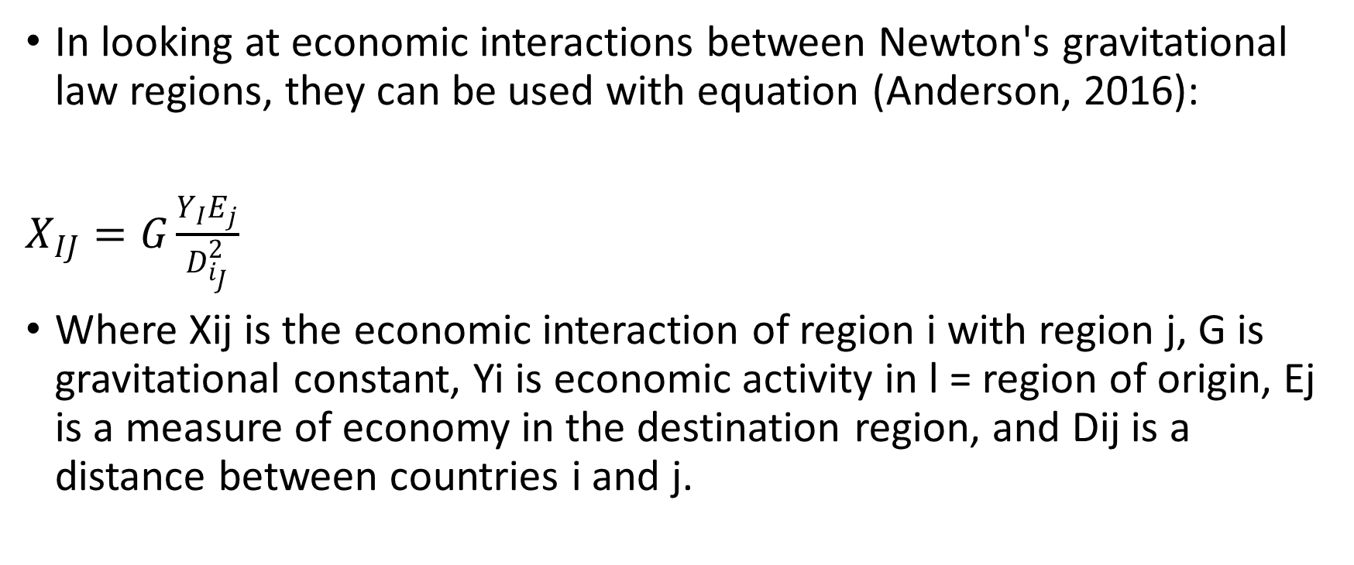
GRAVITY THEORY
In looking at economic interactions between Newton's gravitational law regions, they can be used with equation (Anderson, 2016):
$X_{IJ}=G\frac{Y_{I}E_{j}}{D_{i_{J}}^{2}}$
Where Xij is the economic interaction of region i with region j, G is gravitational constant, Yi is economic activity in l = region of origin, Ej is a measure of economy in the destination region, and Dij is a distance between countries i and j.

Slide 9


Some adjustments are made by the Rodrigue (2004) therefore, it become more convinient with the tourism model. The model that has been proposed by Rodrigue (2004) as follows:
$${TD}_{ij}=K\frac{m_{i}.m_{j}}{D_{ij}^{t}}$$
where:
TDij : represents tourist arrivals from country i to destination country j
K : is a constant
mi : is a factor that generate the movement of international tourism
mj : is a factor that attracts the movement of international tourism
Dij : is the distance between origin country, i and destination country, j
Gravity Model Theory in the Number of Tourism Visits

Slide 10

HYPOTHESIS
RESEARCH FRAMEWORK
(+)
  Indonesia GDP per capita
(+)
  Foreigner countries’ GDP per capita
(–)
  Total Number of Foreign Tourists
  Distance
(–)
  Domestic Exchange Rate
(+)
  Foreigner Countries’ Population

Slide 11
REGRESSION RESULT
lnTotForeigner_{it}= a + b₁ ln GDP (Foreigner)_{it} + b₂ ln GDP(Indo)_{jt} + b₃ ln Distance_{ijt} + b₄ ln Exrate(domestic)_{it} + b₅ ln Population (foreigner)_{jt} +eit
Y = Total Number of Foreign Tourists (People)
α = Constant
GDP per cap Indo = Indonesia GDP per capita (Million $US)
GDP per cap Foreign= Foreign Countries GDP (Million $US)
Jarak = Distance (Km)
Pop foreign = Population of Foreign Countries (People)
Exrate = Domestic (Indonesia) Exchange Rate (IDR/$US)
e = Error Term
t = Time
i,j = Country

Slide 12
CLASSICAL ASSUMPTIONS
Multicollinearity Test
Heteroscedasticity Test
VARIABEL | VIF
ln Pop Foreigner | 5,08
ln Distance | 4,62
ln GDP cap Foreigner | 4,07
ln Exrate Indonesia | 1,18
ln GDP cap Indonesia | 1,03
Mean VIF | 3.20
Chi²(1) | 1.36
Pro > chi² | 0,2441
                Based on heteroscedasticity test probability of Chi2 at about 0,2441 or more than 0.05 (> 0.05), therefore this model is free from heteroscedasticity
                There is no multicollinearity problem, since the value of Mean VIF and VIF value of variable respectively is under 10

Slide 13
MODEL PREFERENCE
Hausman Test
Chi² (4) | 8.96
Prob > chi² | 0,0622
We only use fixed effect and random effect model
Hausman test result :
Probability value of Chi² at about 0,0622 or > 0,05 so we choose random effect

Slide 14

Estimation Result: Random Effect Model
Ln totforeign = -1,126 + 1,217 ln(GDPcap Indo)
Robust s.e 2,866 0,231
p-value 0,694 0,000
+0,939ln(GDPcap Foreign)– 1,622ln(Dist)
Robust s.e 0,245 0,355
p-value 0,000 0,000
– 0.141 log(Exrate Indo) + 0,469 log(PopForeign)
Robust s.e 0,073 0,181
p-value 0,053 0,010
R² = 0,5901 F-stat = 215,87 Prob(F-stat) = 0,0000

Slide 15

Conclusion

Slide 16
Determinants of the number of foreign tourists to Indonesia from 2009 to 2016, can be concluded as follows, Both Gross Domestic Product per capita (GDP per capita) of Indonesia and foreign countries have positive and significant effect on the number of foreign tourists demand to visit Indonesia. This explains that the greater the GDP per capita of Indonesia, the greater the number of foreign tourists to Indonesia and in the same time, the greater the GDP per capita of foreign countries, the greater the number of foreign tourists to Indonesia. This situation indicates that, the larger market of tourism sector in foreign countries. Therefore, this a large potential for foreigners to travel to Indonesia.
Distance between Indonesia and foreign countries has a negative and significant effect on the demand for foreign tourism. This means that, the further the distance a country will be, the fewer the number of foreign tourists visiting Indonesia, this is because transportation cost will also become more expensive with the further distance.
Domestic exchange rates of Indonesia has a negative and significant effect on the number of foreign tourists to Indonesia, this means that, when the exchange rate of the Indonesia currency weakens, the higher the number of foreign tourists to Indonesia and vice versa.
Population of foreign countries have positive and significant effect on demand for foreign tourism. This reveals that, the more population of foreign countries, the greater chance the number of foreign tourists are visiting Indonesia.

Slide 17


Based on the conclusions, we can provide some policy recommendation:
This research is expected to be a material improvement and consideration for the government in improving and maintaining the stability of Indonesia's income to maintain the number of foreign tourists to visit Indonesia.
RECOMMENDATION
The government is expected to increase cooperation in the expansion of international airline routes to reduce distance constraints in order to increase the number of tourists from various countries.

Slide 18
References
Anderson, J.E., 2016. The Gravity Model of Economic Interaction. Boston College and NBER.
Baltagi, B., 2008. Econometric Analysis of Panel Data. John Wiley & Sons.
Blake, A. and Cortes-Jiménez, I., 2007. The Drivers of Tourism Demand in the UK. A Report Prepared by Christel DeHaan Tourism and Travel Research Institute-University of Nottingham for the Department of Culture, Media and Sport. London: UK Parliament.
Deluna Jr, R. and Jeon, N., 2014. Determinants of International Tourism Demand for The Philippines: an Augmented Gravity Model Approach.
den Butter, F.A.G., Chasapopoulos, P. and Mihaylov, E.S., 2014. Demand for Tourism in Greece: A Panel Data Analysis Using the Gravity Model.
Eilat, Y. and Einav*, L., 2004. Determinants of International Tourism: A Three Dimensional Panel Data Analysis. Applied Economics, 36(12), pp.1315-1327.
Fang Bao, Y. and Mckercher, B., 2008. The Effect of Distance on Tourism in Hong Kong: A Comparison of Short Haul and Long Haul Visitors. Asia Pacific Journal of Tourism Research, 13(2), pp.101-111.

Slide 19
Garin-Munoz, T. and Amaral, T.P., 2000. An Econometric Model for International Tourism Flows to Spain. Applied Economics Letters, 7(8), pp.525-529.
Ghani, G.M., 2016. Tourist Arrivals to Malaysia From Muslim Countries. Tourism Management Perspectives, 20, pp.1-9.
Gil-Pareja, S., Llorca-Vivero, R. and Martínez-Serrano, J.A., 2007. The Impact of Embassies and Consulates on Tourism. Tourism Management, 28(2), pp.355-360.
Hanafiah, M.H.M. and Harun, M.F.M., 2010. Tourism Demand in Malaysia: A Cross-Sectional Pool Time-Series Analysis. International Journal of Trade, Economics and Finance, 1(1), pp.80-83.
Hansen, W.G., 1959. How Accessibility Shapes Land use. Journal of The American Institute of planners, 25(2), pp.73-76.
Kimura, F., & Lee, H. H. (2006). The Gravity Equation in International Trade in Services. Review of World Economics, 142(1), 92-121.

Slide 20
Kosnan, S.S.A., Ismail, N.W. and Kaliappan, S.R., 2013. Determinants of International Tourism in Malaysia: Evidence From Gravity Model. Jurnal Ekonomi Malaysia, 47(1), pp.131-138.
Leitão, N.C., 2015. Portuguese Tourism Demand: a Dynamic Panel Data Analysis. International Journal of Economics and Financial Issues, 5(3), pp.673-677.
Mariyono, J., 2017. Determinants of Demand for Foreign Tourism in Indonesia. Jurnal Ekonomi Pembangunan: Kajian Masalah Ekonomi dan Pembangunan, 18(1), pp.82-92.
Mohebi, M. and Khalid, A.R., 2010. Revenue Determinants in Tourism Market. American Journal of Applied Sciences, 7(12), pp.1593-1598.
Montgomery, D.C., Peck, E.A. and Vining, G.G., 2012. Introduction to Linear Regression Analysis (Vol. 821). John Wiley & Sons.
Othman, M.H., Mohamad, N., Ghani, G.M. and Ariffin, M.I., Malaysia’s Tourism Demand: A Gravity Model Approach. Journal of Bussines and Social Develpoment, 6(1), pp.39-50.
Pratomo, D.S., 2012. Permintaan Pariwisata Indonesia: Studi Kasus Wisatawan Malaysia. Journal of Indonesian Applied Economics, 3(2).

Slide 21
Salman, A.K., 2003. Estimating Tourist Demand Through Cointegration Analysis: Swedish Data. Current Issues in Tourism, 6(4), pp.323-339.
Santeramo, F.G. and Morelli, M., 2015. Enhancing the Foreign Demand for Agritourism (No. 171-2016-2090, p. 33).
Selimi, N., Sadiku, M. and Sadiku, L., 2017. The Impact of Tourism on Economic Growth in the Western Balkan Countries: An Empirical Analysis. International Journal of Business and Economic Sciences Applied Research, 10(2), pp. 19-25.
Sharpley, R., 2003. Tourism, Modernisation and Development on The Island of Cyprus: Challenges and Policy Responses. Journal of Sustainable Tourism, 11(2-3), pp.246-265.
Sheldon, P.J. and Var, T., 1985. Tourism Forecasting: a Review of Empirical Research. Journal of Forecasting, 4(2), pp.183-195.
Tinbergen, J.J., 1962. Shaping the World Economy; Suggestions For an International Economic Policy.

Slide 22

Thank You
nuvimbar@gmail.com

