Slide 1

Teaching Learning during COVID-19 Pandemic
International Webinar Nurse’s Talk
Yogyakarta, Mei 4 2020
Lisa Musharyanti
Master of Nursing Program
Universitas Muhammadiyah Yogyakarta

Slide 2
COVID-19 pandemic
Social/physical distancing changed how nursing students are learning around the globe
Learning process must be continue : undergraduate, clinical education, post graduate
Replacement of conventional learning to online learning & distance learning

Slide 3
OUR RESPONDS
Thinking of the learning objective for the students
What methods can be used to help students learnt at a distance?
What are online platform can be used?
How we do feedback to the students ?
What kind of assessment can be implemented ?

Slide 4
Synchronize meeting:
MS Teams
Zoom
Webex
Hangouts
etc
Asynchronize meeting:
-MyKlass UMY
WhatsApp
Email

Slide 5

Main Platform
MyKlass UMY

Slide 6
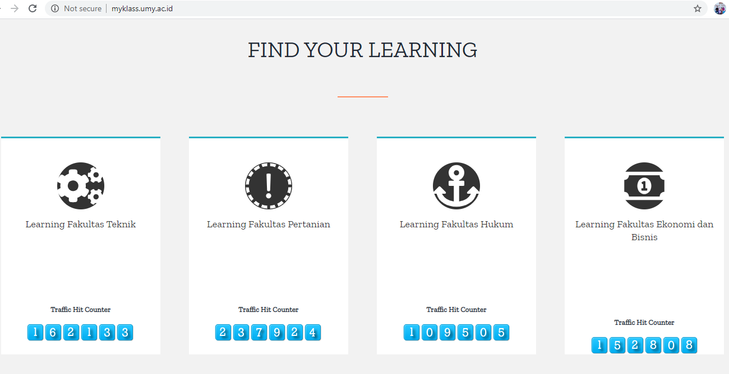

Slide 7
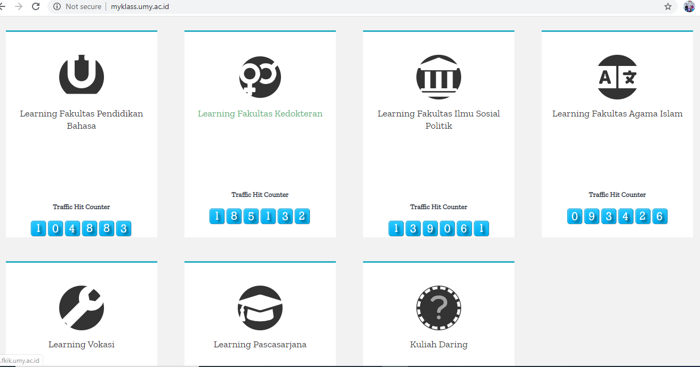

Slide 8
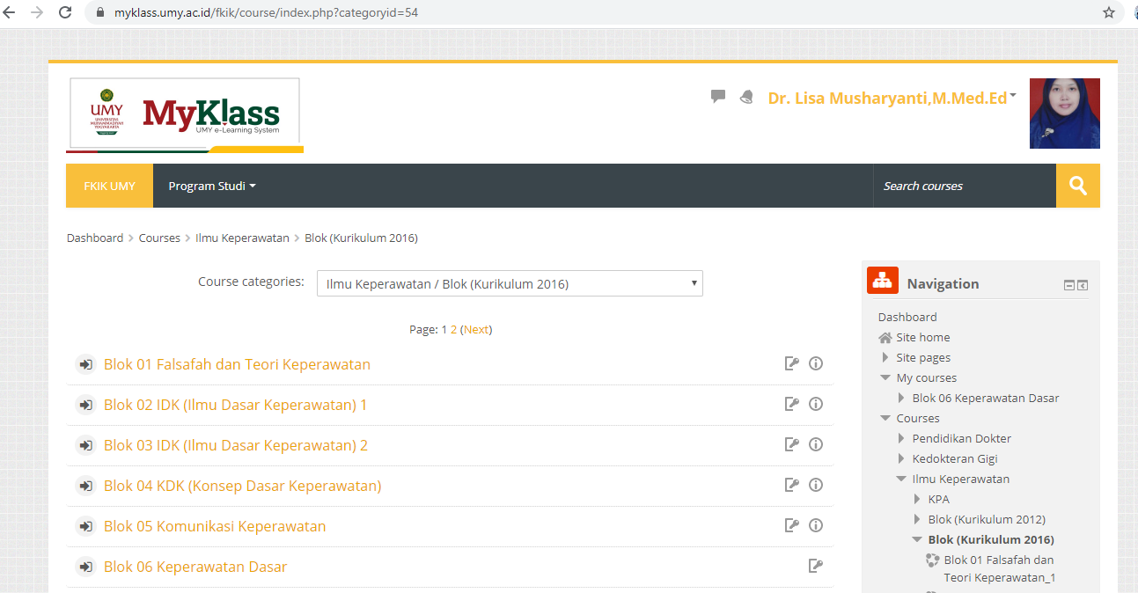
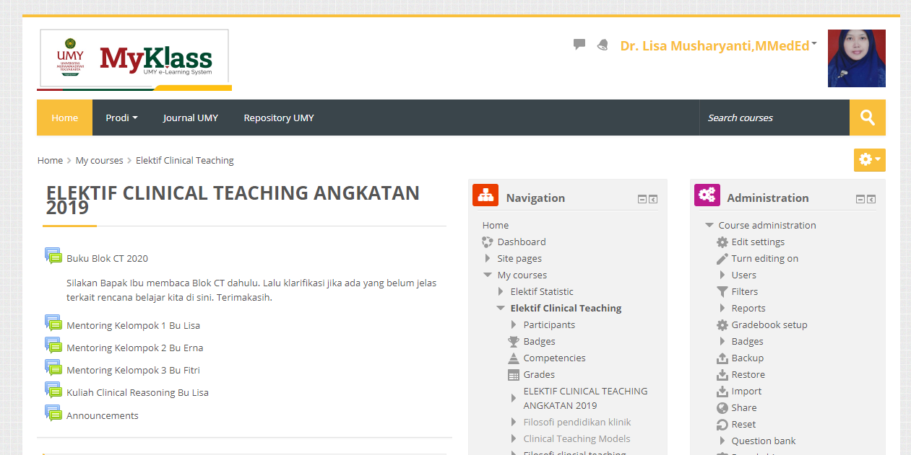

Slide 9
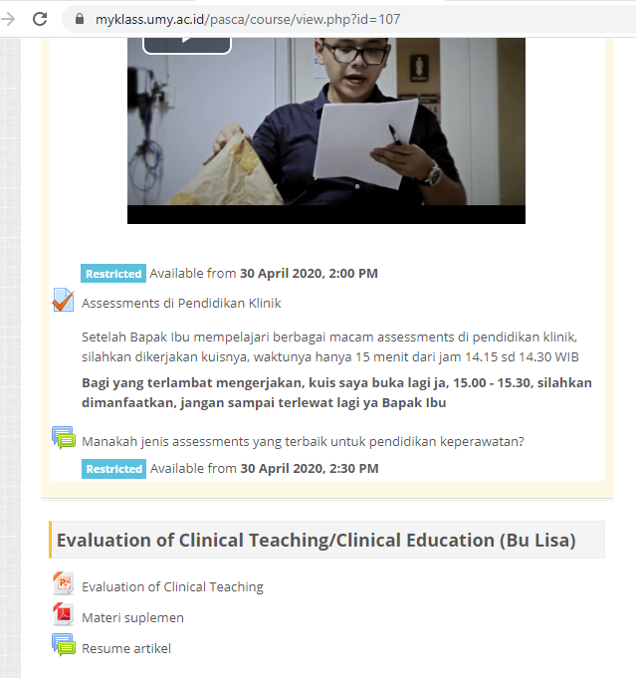
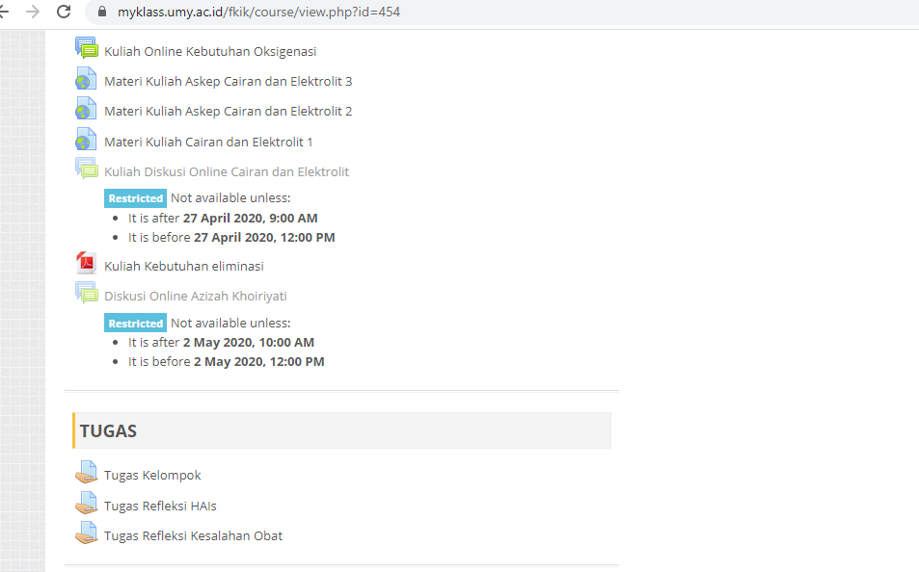
Lecture In MYKLASS UMY

Slide 11

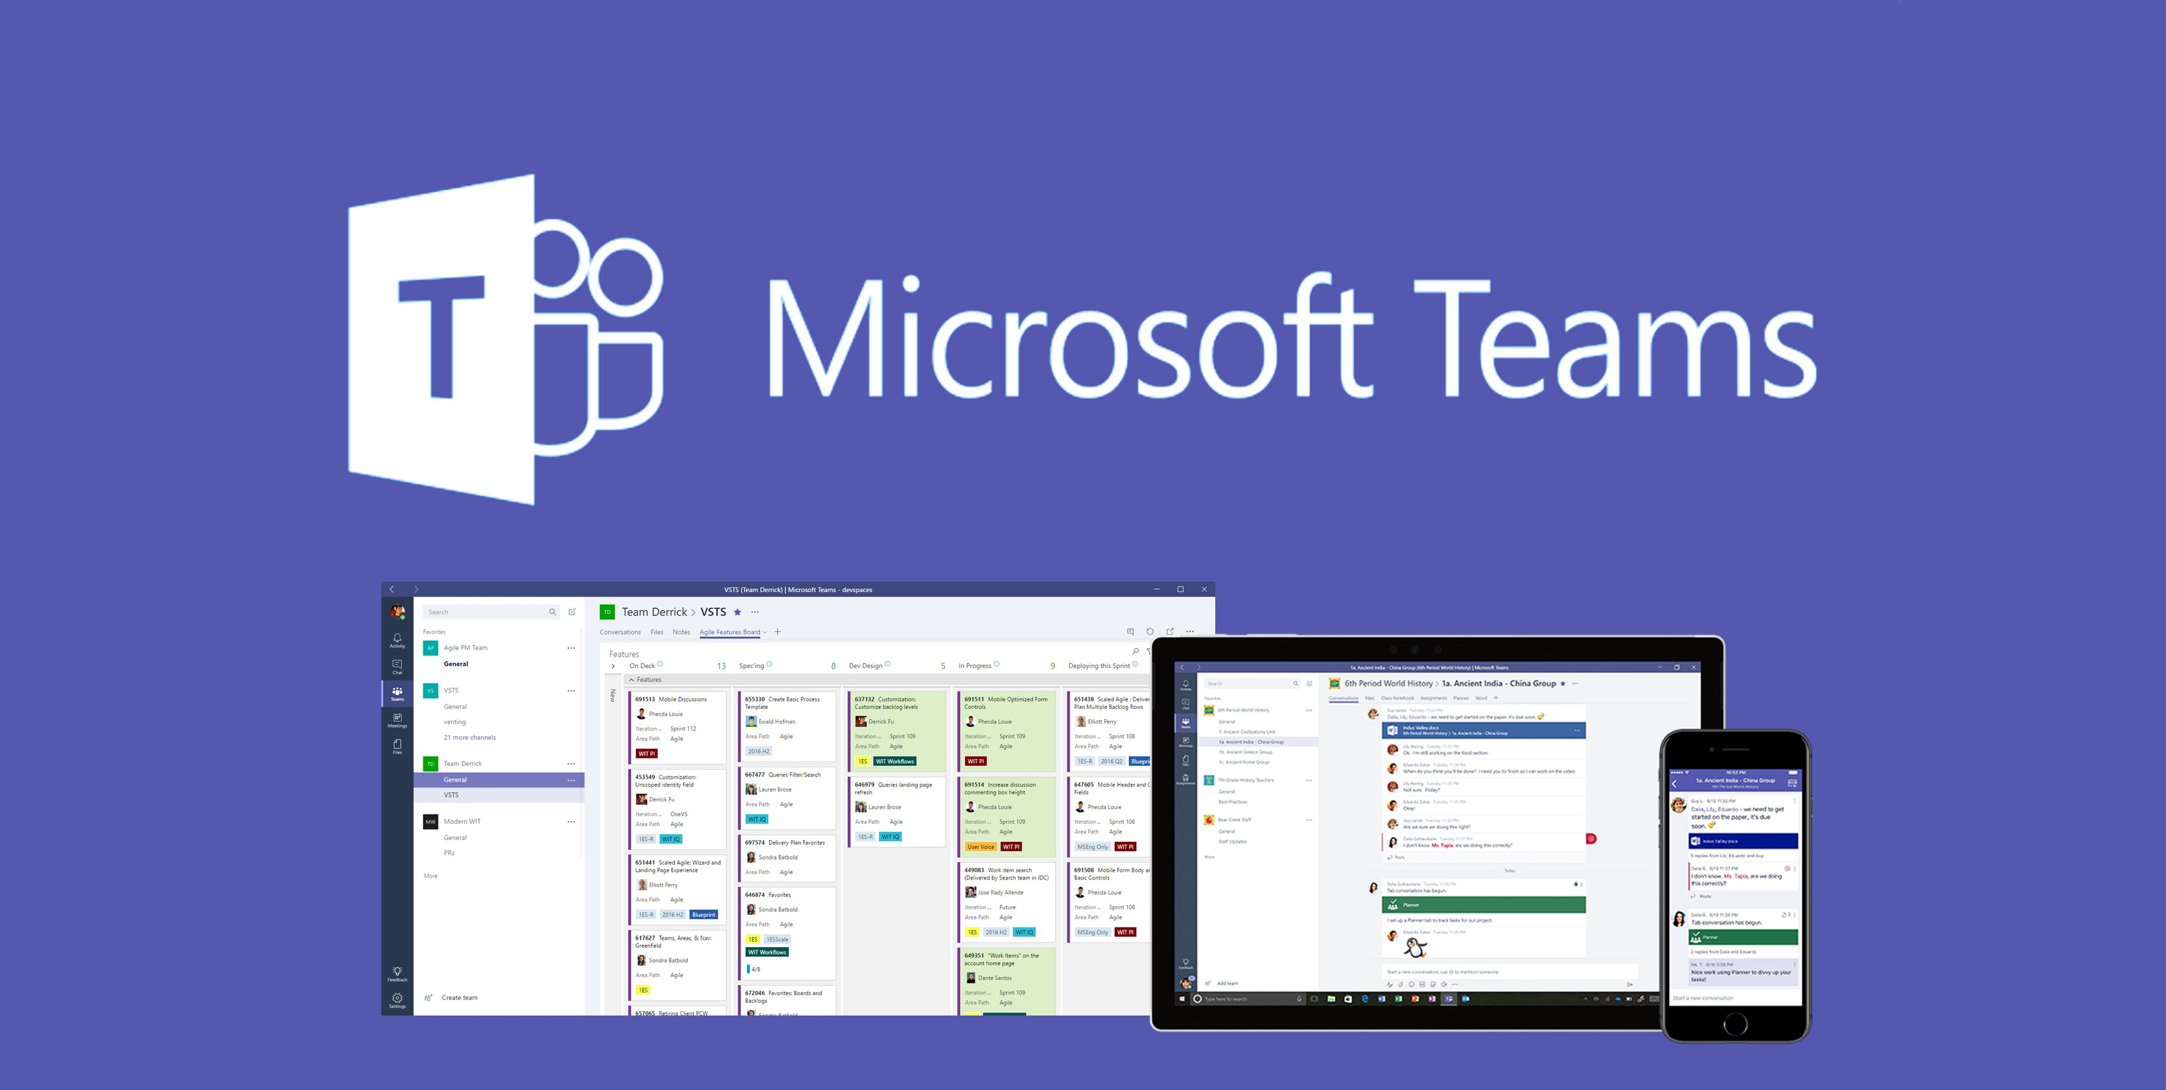



ANOTHER PLATFORMS/LMS

Slide 12

ACADEMIC PHASE
Tutorial
Mentoring
Project Consultation
Thesis consultation
Lectures
Thesis defence

Slide 13
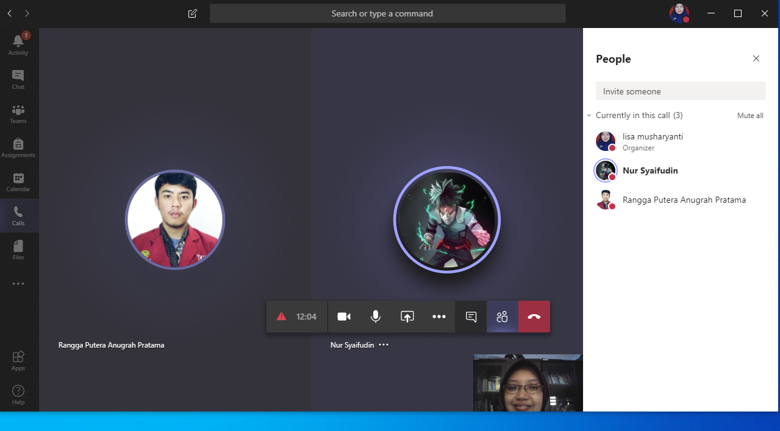
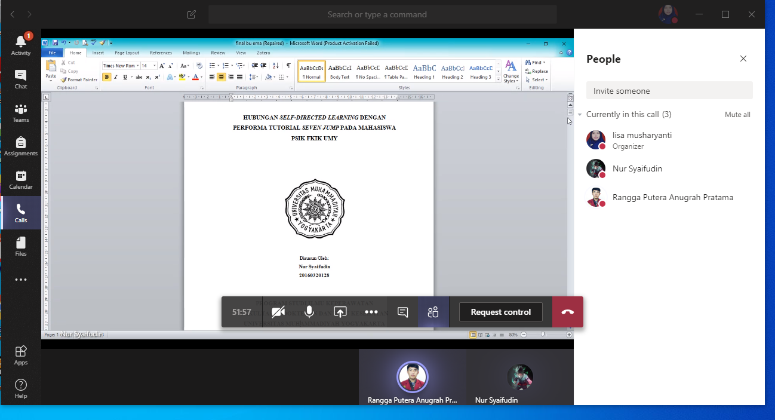
Thesis/ Skripsi Consultation

Slide 14

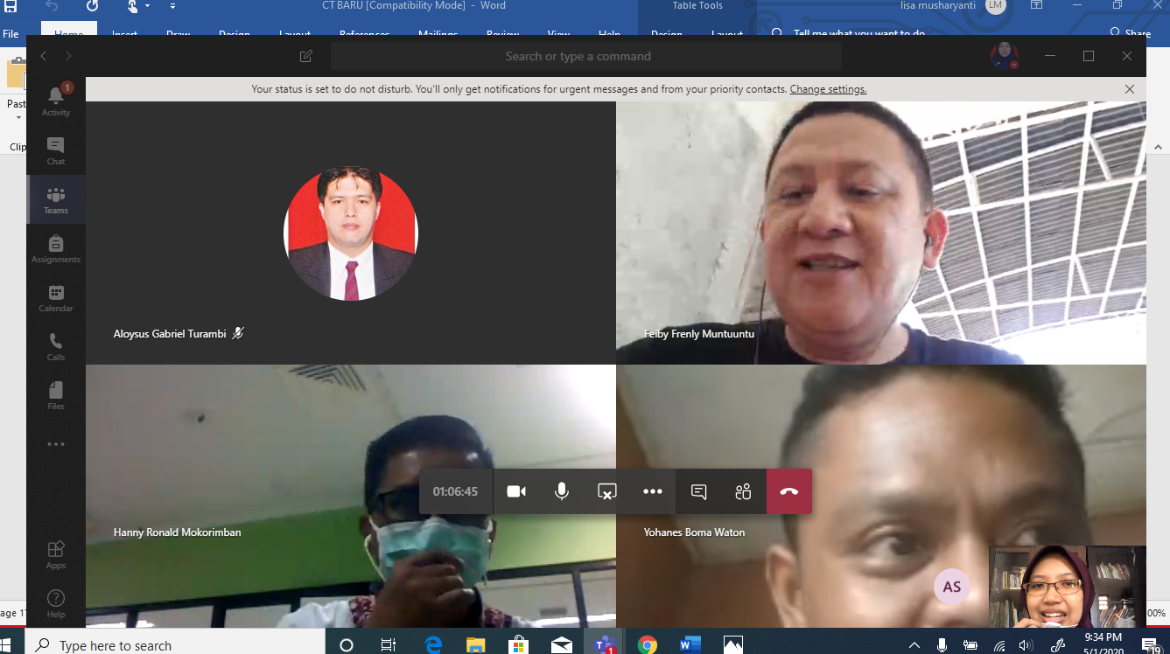
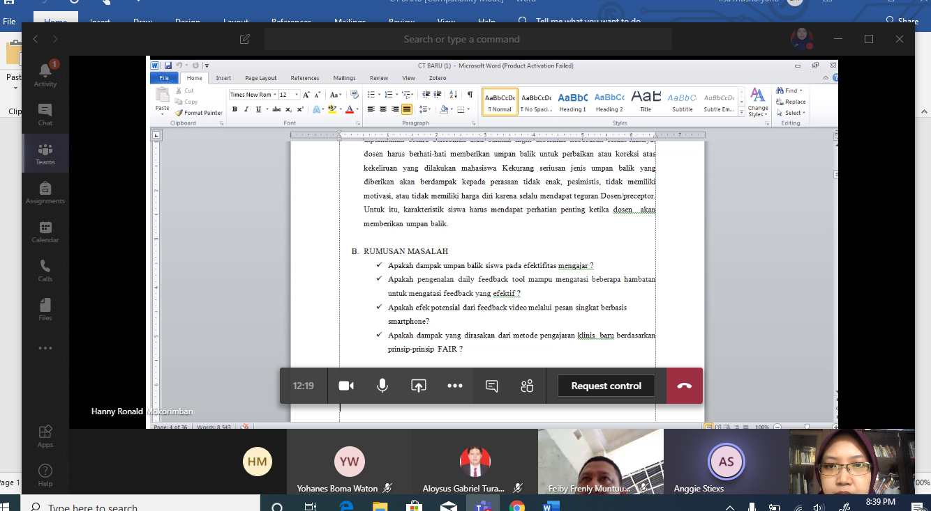
Mentoring, Project Consultation

Slide 15


Clinical Education/ Clinical Rotation
Clinical Rotation in hospital’s departement
E- Learning ?

Slide 16

We have to decide
What activity that can be done using online
platform ?
What activities that can’t be done using online platform ?

Slide 17


Learning Activity
Tutorial
Case reflection
Mentoring
Case Presentation
etc
Article presentation

Slide 18
Challenges of distance learning
STUDENT/ LECTURER
How to prepare the lecturer and students ?
Learning objective
What instructionals that are optimal for students’ learning experience?
Feasibility
What platforms that are efficien and effective for the learning proccess?

Slide 19
PREPARATION OF LECTURE & STUDENTS
Lecture/Tutor
Course content and structure
Students’ assessment
Students
Course structure
How to access and use course element and resources
Giving written and verbal feedback
Project guidance
E-mentoring
Organization of time
Responsibility as a learner
Communication with tutor and other students
The assessment system

Slide 20
Challenges Of Distance Learning
MAJORITY : FOCUS ON COGNITIF DOMAIN
What instructional that are optimal for students’ learning experience ?
CONSTRUCTIVE FEEDBACK

Slide 21
Challenges Of Distance Learning
BANDWITH
What platforms that are efficien and effective for the learning process ?
CONNECTION
FINANCIAL ASPECT

Slide 22
Challenges Of Distance Learning
Avoid one single test as a summative assessment
Assessment Methods
Combine the summative assessment and formative assessment
Feedback and various assessment during the course program

Slide 23
alhamdulillah
Semoga bermanfaat

