Slide 1
Komunikasi Kreatif di Masa Pandemi
Dr. Fajar Junaedi
Dosen Ilmu Komunikasi Universitas Muhammadiyah Yogyakarta
Kreasi Talkative Dalam Perkembangan Komunikasi di Masa Pandemi
Universitas Mercu Buana Yogyakarta
Selasa 20 Oktober 2020

Slide 2
Being creative
Being creative means solving a problem in a new way. It means changing your perspective.
Being creative means taking risks and ignoring doubt and facing fears. It means breaking with routine and doing something different for the sake of doing something different.

Slide 3
Being creative
It means mapping out a thousand different routes to reach one destination. It means challenging yourself every day. Being creative means searching for inspiration in even the most mundane places. It means you’re asking stupid questions.

Slide 4
Being creative
It means creating without critiquing. Being creative means you know how to find the similarities and differences between two completely random ideas.

Slide 5
Being creative
Being creative means you’re thinking.

Slide 6
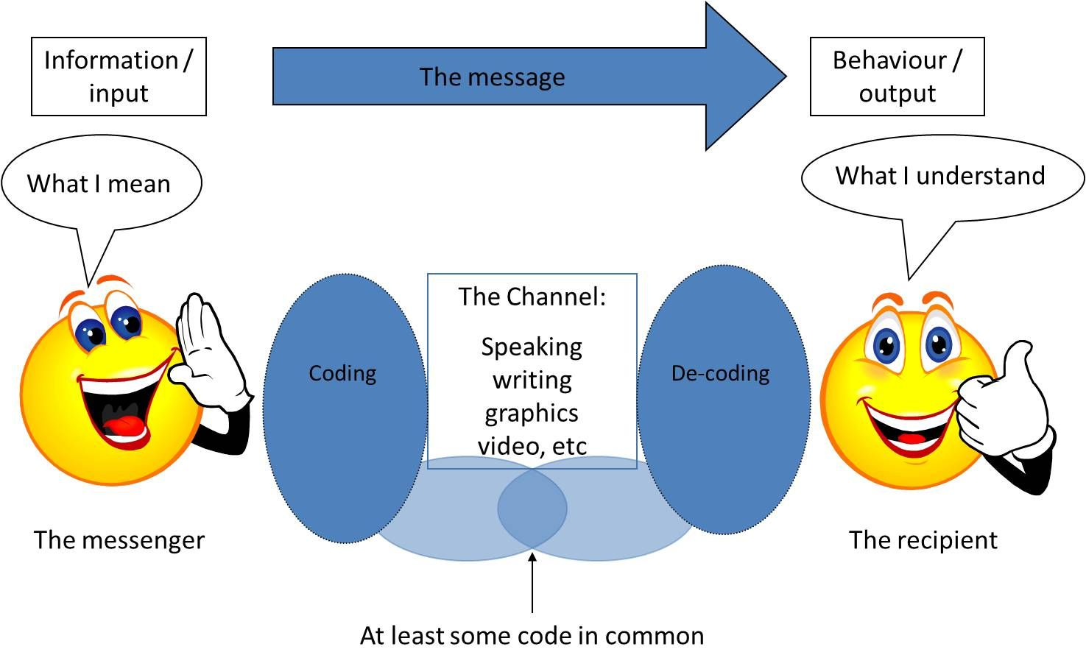

Slide 7


Slide 8
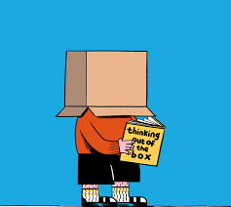

Slide 9


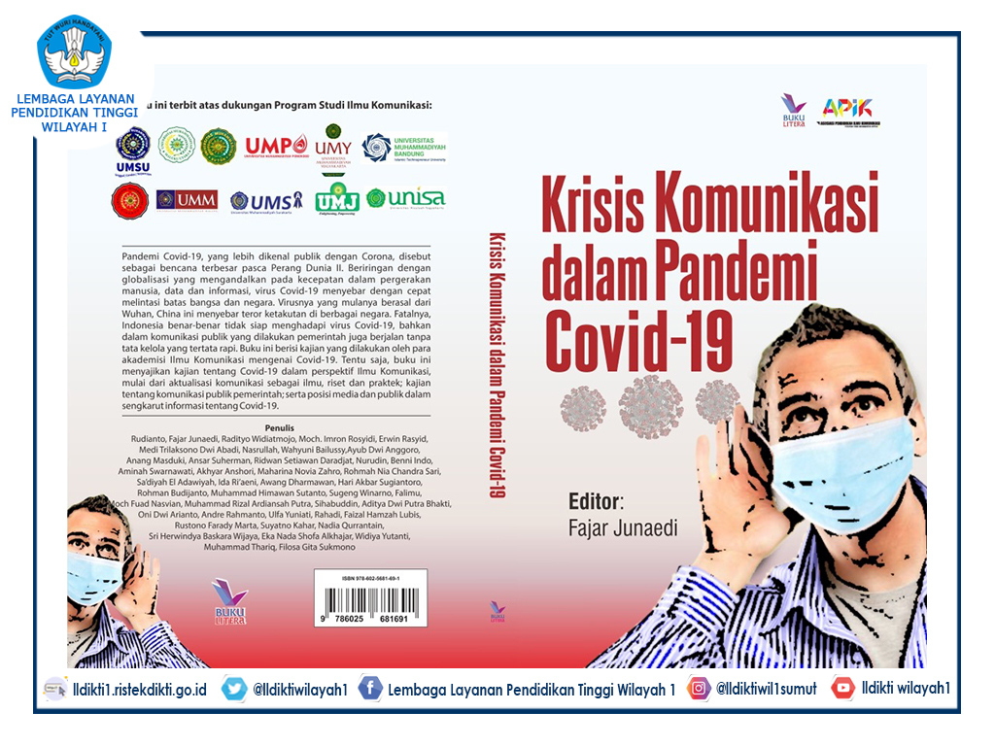

Slide 10
Terima kasih
Fajar Junaedi
Twitter/IG @fajarjun

