Slide 1

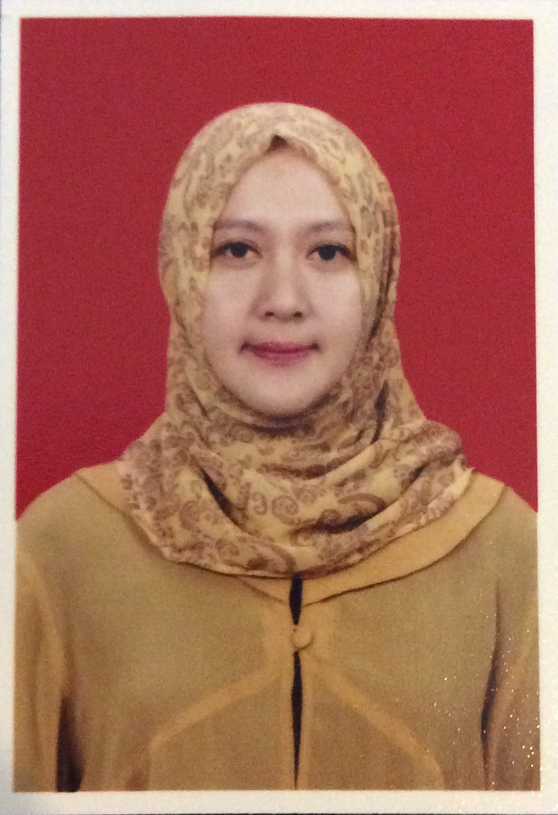
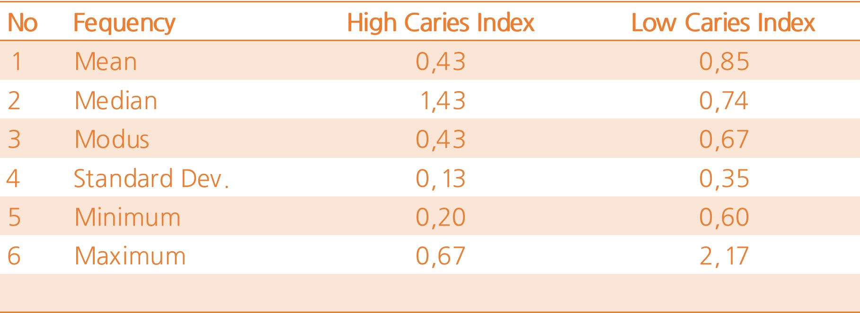

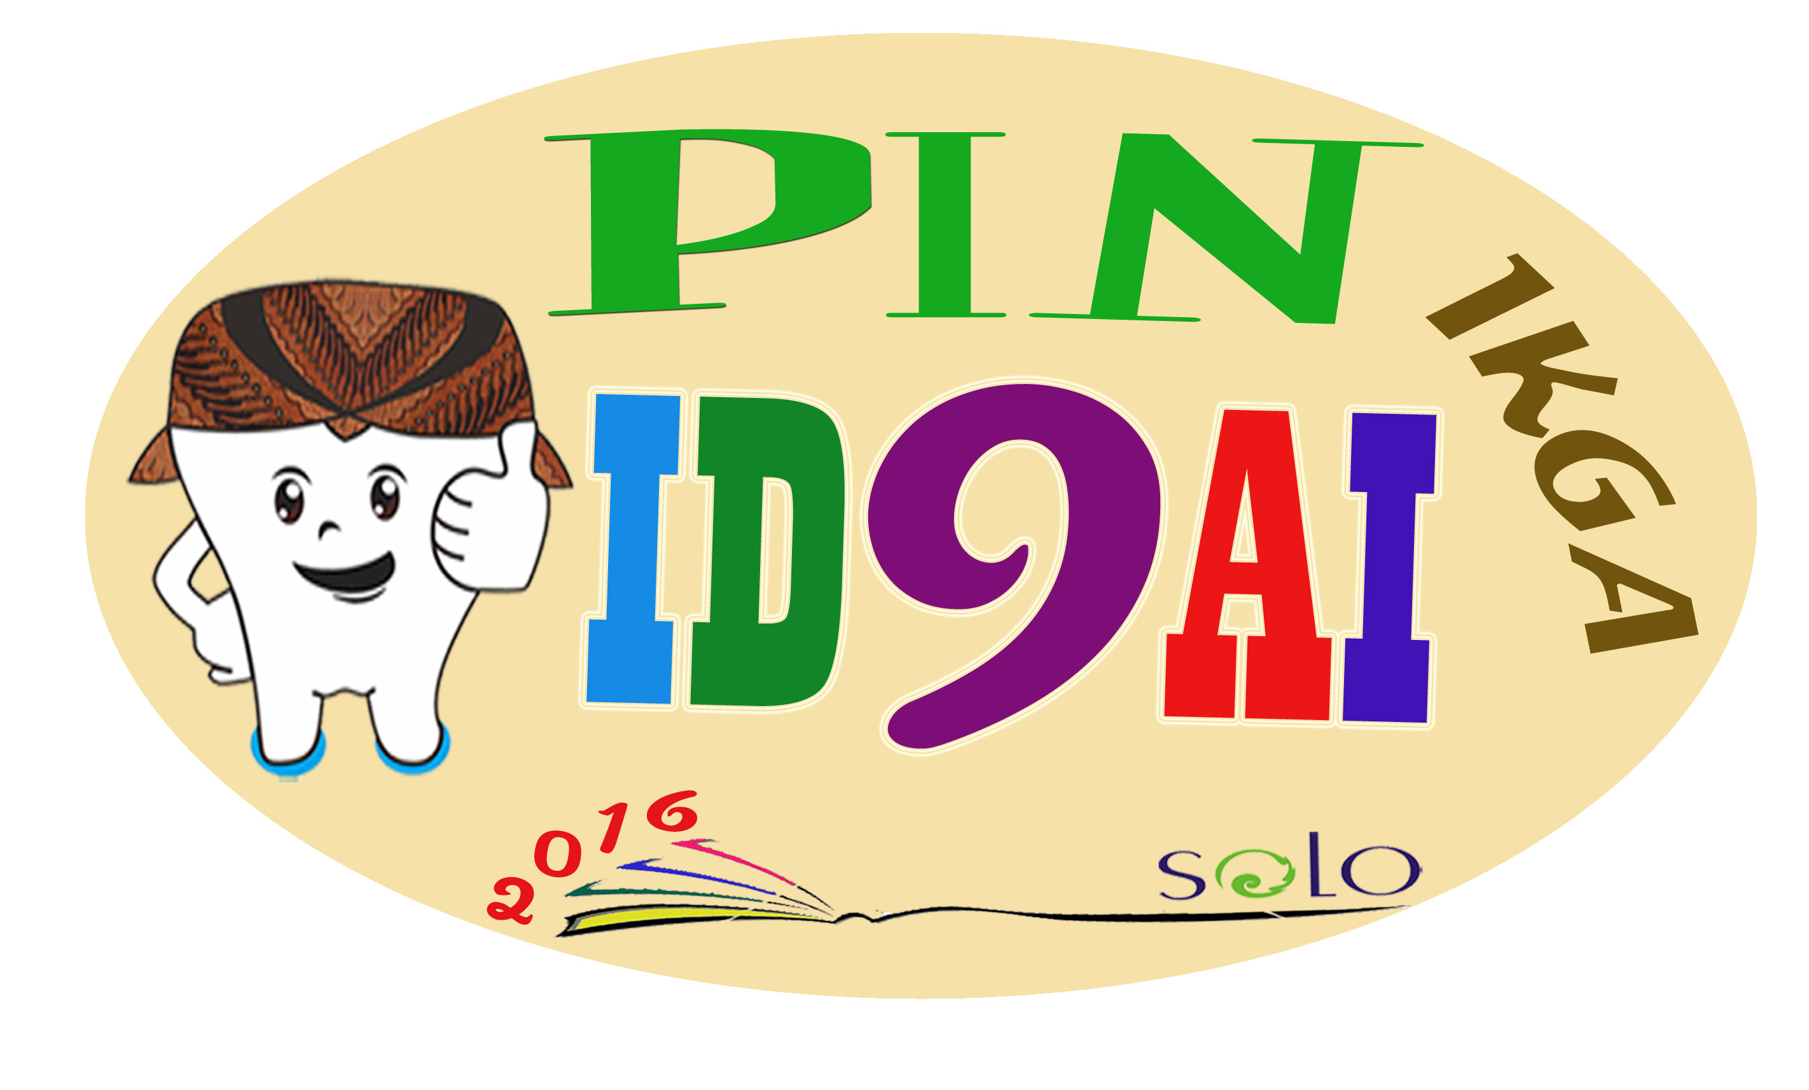
PERBEDAAN LAJU ALIRAN SALIVA ANTARA ANAK DENGAN INDEKS KARIES RENDAH DAN INDEKS KARIES TINGGI
Helen Novika Ferandini*, drg. Likky Tiara Alphianti, MDSc., Sp.KGA**
*Mahasiswa Program Studi Pendidikan Dokter Gigi, FKIK Universitas Muhammadiyah Yogyakarta
** Departemen KGA Program Studi Pendidikan Dokter Gigi, FKIK Universitas Muhammadiyah Yogyakarta
Tabel 1 Frequency Distribution Data
Introduction
Mixed dentition age is a stage when there were both primary and permanent teeth in mouth, on children between 6-12 years old. There are 80-95% of children under 18 years old who have caries. Caries lesion may become worse if salivary flow is low. Saliva has important roles on tooth remineralization to prevent caries.
Purpose
The aim of this research was to determine the differences of salivary flow rate between children with low caries index and high caries index.
Materials and Method
This was an analytic observational research that used cross sectional design. Subjects are children between 6-8 years old in Padokan 2 elementary school which selected by purposive sampling technique. Salivary flow rate was measured from unstimulated saliva that collected in pot sample and divide it by total time (3 minutes) and the result is calculated in millimeters per minute.
Result
The results showed that the mean value of salivary flow rate in children with high caries index is 0.429 ± 0.126; and children with low caries index is 0.847 ± 0.349. Statistical analysis used Independent t-test showed that there was significant result (p<0,05).
Conclusion
In conclusion, there was significantly difference in salivary flow rate between children with low caries index and children with high caries index.Children with low caries index have higher salivary flow rates than children with high caries index.
Key words: children 6-8 years old, high caries index, low caries indeks and salivary flow rate.
Table 2. Mean and Standard Deviation
 | Group | N | Mean | Std. Deviation | Std. Error Mean
Salivary flow rate | Hi-Caries | 30 | 0,8470 | 0,34930 | 0,06377
 | Low-Caries | 30 | 0,4293 | 0,12567 | 0,02294
Table 3. Result of Independent t-test
 |  | Levene's Test for Equality of Var. | t-test for equality of means
 |  | F | Sig | t | df | Sig.2 tailed
Equal variences assumed |  | 2,81 | 99 | 6,163 | 58 | 0,0000
Equal variances not assumed |  |  |  | 6,163 | 36,384 | 0,0000
References:
1. Badan Penelitian dan Pengembangan Kesehatan, 2007, Riset Kesehatan Dasar (Riskesdas 2007), Kementerian Kesehatan Republik Indonesia, Jakarta
2. Angela A , 2005, Pencegahan Primer pada Anak yang Beresiko Karies Tinggi, Maj ked Gi (Dent J) ; 38(2): 130-4.
3. Kidd, E.A.M. and Joyston-Bechal, S., 2012, Dasar-dasar Karies; Penyakit dan Penanggulangannya (terj.), Penerbit EGC, Indonesia.
4. Darwita R. R., Novindra H., Budiharto, Pratiwi P. D., et al., 2011, Efektivitas Program Sikat Gigi Bersama terhadap Risiko Karies Gigi pada Murid Sekolah Dasar, J Indon Med Assoc, Volume: 61, Nomor: 5.
5. Wu K. P., Ke J. Y., Chung C. Y., Chen C. L., Hwang T. L., et al., 2008, Relationship between Unstimulated Salivary Flow Rate and Saliva Composition of Healthy Children in Taiwan,Chang Gung Med J ;31 : 281-6
6. Chawda J. G., Chaduvula N., Patel H. R., Jain S. S., and Lala A. K., 2011, Salivary SigA and Dental Caries Activity, Journal Indian Pediatrics, 48.
7. Gopinath V. K., and Arzreanne A. R., 2006, Saliva as a Diagnostic Tool for Assesment of Dental Caries, Archives of Orofacial Sciences; 1: 57-59.
8. Surjadi, N. And Amtha, R. 2012. Radiotheraphy Reduced Salivary Flow Rate and Might Induced C. Albicans Infection. Journal of Dentistry Indonesia. Vol. 19. No. 1. 14-19
9. Koch, G. & Poulsen,S. 2001. Pediatric Dentistry a clinical approach. Munksgaard. Copenhagen.
10, Whelton, H. 1996. Introduction : the anatomy and phisiology of the salivary glandula. Dalam Saliva and oral health. Thanet Press Ltd, Margate
11. Davis., W.L.1986. Oral histology, cell structure and function. W.B. Saunders Co., Philadelphia
12. Marsh, P. & Martin, M.V.2000. Oral Microbiology. 4th.ed. Wright.Oxford.
13. Rolla, G., Waller, S.M.& Kjaerheim. 1998. Concept in dental plaque formation. Dalam Oral biofilms and plaque control (Busscher, H.J. & Evans, L.V. eds). Harwood academic publ., switzerland)

