Slide 1

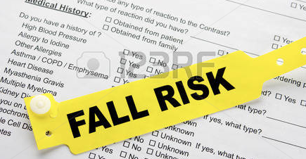
ASSESMENT RISK FALLS
Dr. Elsye Maria Rosa, MKep

Slide 2

Fall Risk Assessment
It Starts with You…
Preventing Falls
Improving Lives

Slide 3
Falls are not a normal part of aging and most falls can be prevented.

Slide 4
Definisi
“ Jatuh adalah kejadian tiba-tiba, tidak disengaja yang menyebabkan perubahan posisi seseorang berada di area yang lebih rendah, pada suatu objek, di lantai atau di rumput atau di tanah, selain akibat dari serangan paralisis, epilepsi atau kekuatan di luar batas”. Tinetti, et al. (1997, dalam Feder, 2000)
“Jatuh sebagai suatu kejadian yang dilaporkan oleh penderita atau saksi mata yang melihat kejadian dan mengakibatkan seseorang mendadak terbaring atau terduduk di lantai dengan atau tanpa kehilangan kesadaran atau luka” , Reuben (1996, dalam Darmojo, 2004) .
“Jatuh adalah kejadian yang tidak disengaja yang mengakibatkan lansia terbaring di lantai atau berada pada tingkat yang lebih rendah” (Kellogg International Work Group, 1987 dalam Newton, 2003).
Disimpulkan bahwa jatuh adalah kejadian tiba-tiba dan tidak disengaja yang mengakibatkan seseorang terbaring atau terduduk di lantai.

Slide 5
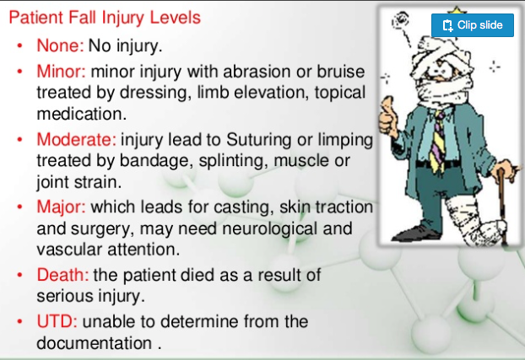

Slide 6
ETIOLOGY
Intrinsik / fisik / berhubungan dengan kondisi pasien !
Riiwayat jatuh sebelumnya
Inkontinensia
Gangguan kognitif / psikologis
Usia > 65 tahun
Osteoporosis
Status kesehatan buruk
Gangguan muskuloskletal
Ekstrinsik / lingkungan !
Lantai basah / silau, ruang berantakan, pencahayaan kurang, handrail tidak
adekuat, kabel lepas.
Alas kaki tidak pas
Dudukan toilet rendah
Kursi dan tempat tidur beroda
Rawat inap berkepanjangan
Peralatan yang tidak aman
Peralatan rusak
Tempat tidur ditinggalkan dalam posisi tinggi

Slide 7
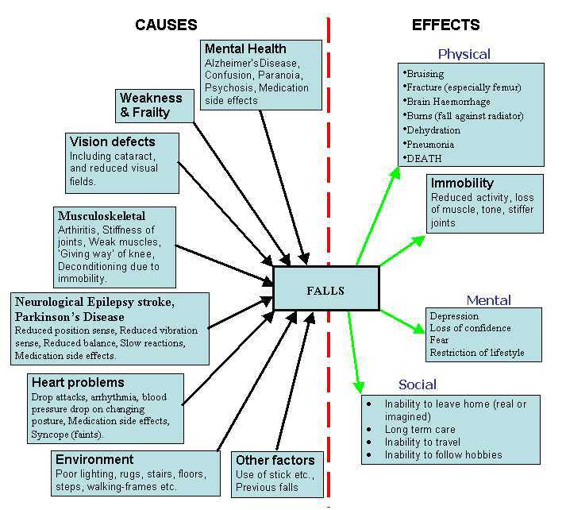

Slide 8
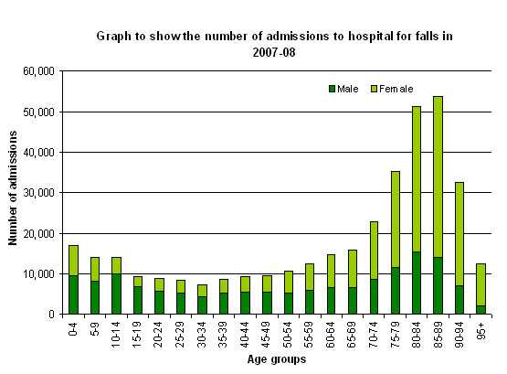

Slide 9
mencegah kejadian pasien jatuh American Nursing Association (2009),
Melakukan pengkajian resiko jatuh
Pengkajian resiko jatuh harus dilakukan dan harus sudah dilakukan sejak di bagian penerimaan dan dilakukan ulang setiap 24 jam.
Jika hasil pengkajian menunjukkan pasien mempunyai nilai atau skor risiko jatuh,
maka perawat bisa menentukan intervensi yang akan dilakukan dan disesuaikan dengan kondisi pasien

Slide 10
Intervensi
Memasang stiker tanda risiko jatuh di depan pintu kamar pasien untuk pasien dengan skor MORSE >25
Memasang stiker tambahan risiko jatuh di depan pintu kamar pasien dengan riwayat jatuh sebelumnya
Memasang gelang kuning sebagai identifikasi pasien dengan risiko jatuh
Menempatkan pasien risiko jatuh di ruangan yang berdekatan satu sama lain agar memudahkan proses observasi rutin
Menempatkan pasien risiko jatuh di ruangan yang dekat dengan nurse station
Melibatkan keluarga sebagai caregivers dan menyarankan keluarga untuk selalu menemani 24 jam penuh setiap hari
Menggunakan metode “one-on-one sitters” jika diperlukan
Perawat berkeliling setiap jam, menawarkan bantuan ke kamar mandi sesuai yang dijadwalkan dan membantu memenuhi kebutuhan hidrasi
Memastikan penerangan kamar dan kamar mandi sudah adekuat

Slide 11
langkah-langkah pencegahan kejadian pasien jatuh menurut
Hempel, et al., (2013) :
Melakukan pengkajian risiko jatuh
Memberikan penanda bagi pasien dengan risiko jatuh
Memberikan edukasi kepada pasien dan keluarga terkait risiko jatuh
Pemantauan keliling
Memasang alarm di bed-exit
Melakukan evaluasi post-fall

Slide 12
RS PKU Gamping Menggunakan tiga jenis pengkajian risiko jatuh
Sydney Scoring untuk pasien lansia,
Morse Fall Score untuk pasien dewasa,
The Humpty Dumpty Scale untuk pasien anak.
Pelaksanannya???
Pelaksanaannya????
Pelaksanaannya???

Slide 13
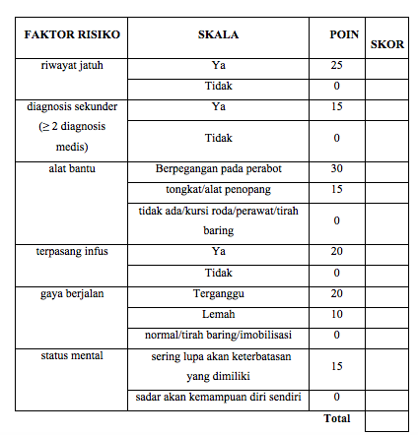
MORSE FALLS SCALE (MFS)

Slide 14
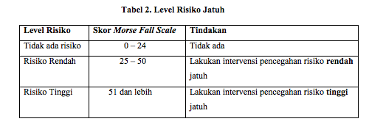

Slide 15
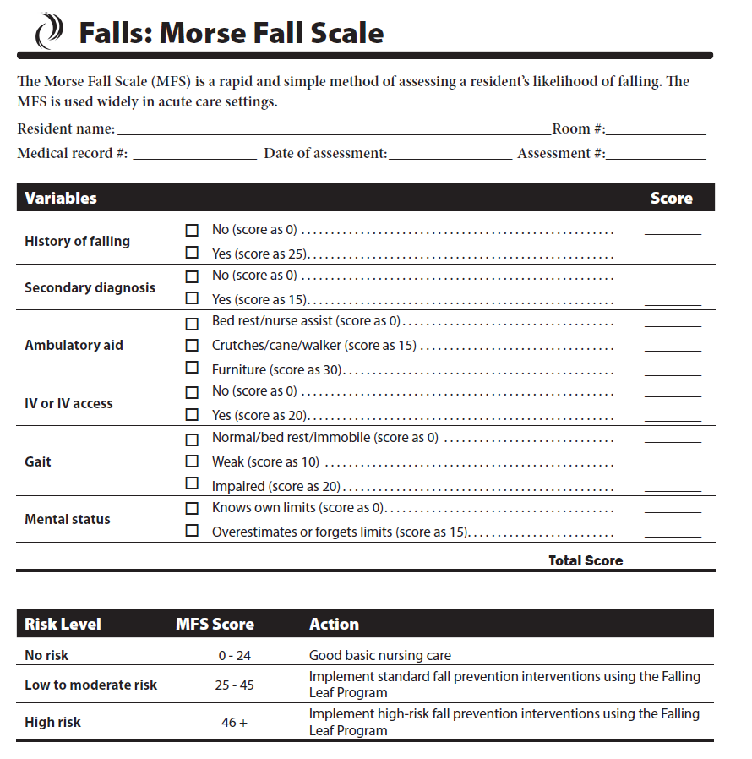

Example: Morse Fall Scale
Notes:
Some fall risk assessment tools that may or may not be used at your hospital are:
- The Morse Fall Scale

Slide 16
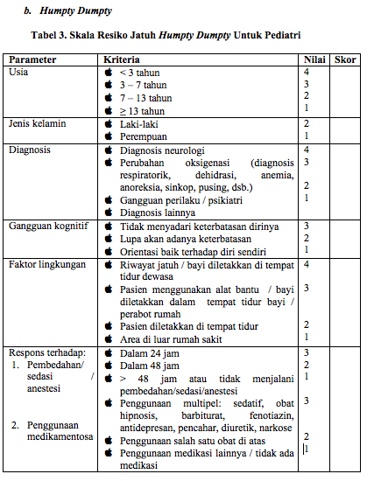
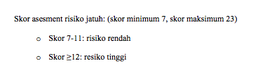

Slide 17
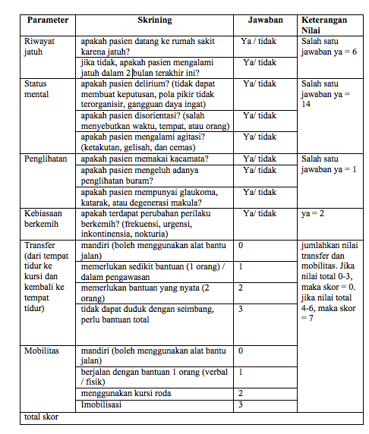
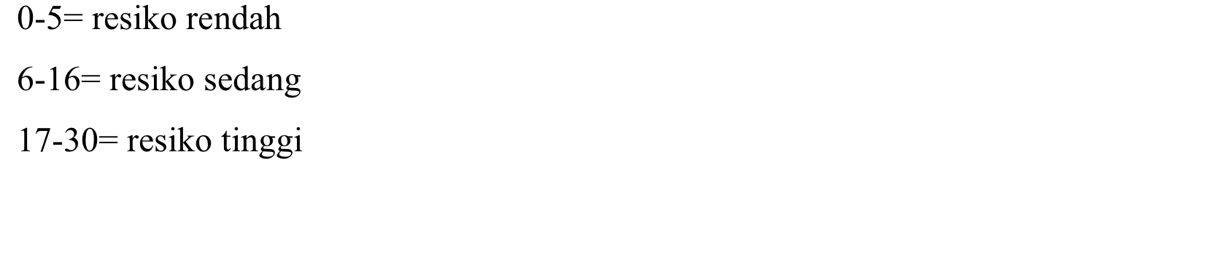
Tabel :Ontario Modified Stratify - Sydney Scoring

Slide 18
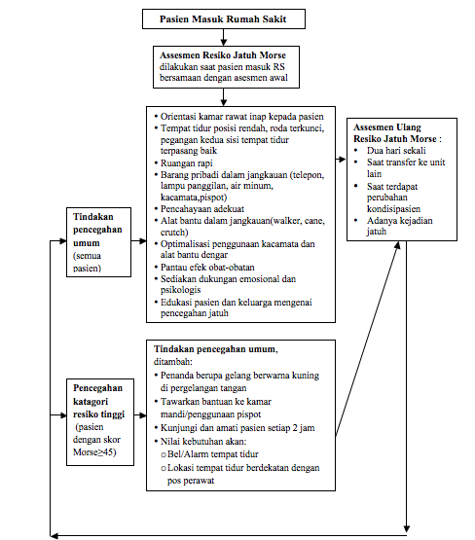

Slide 19
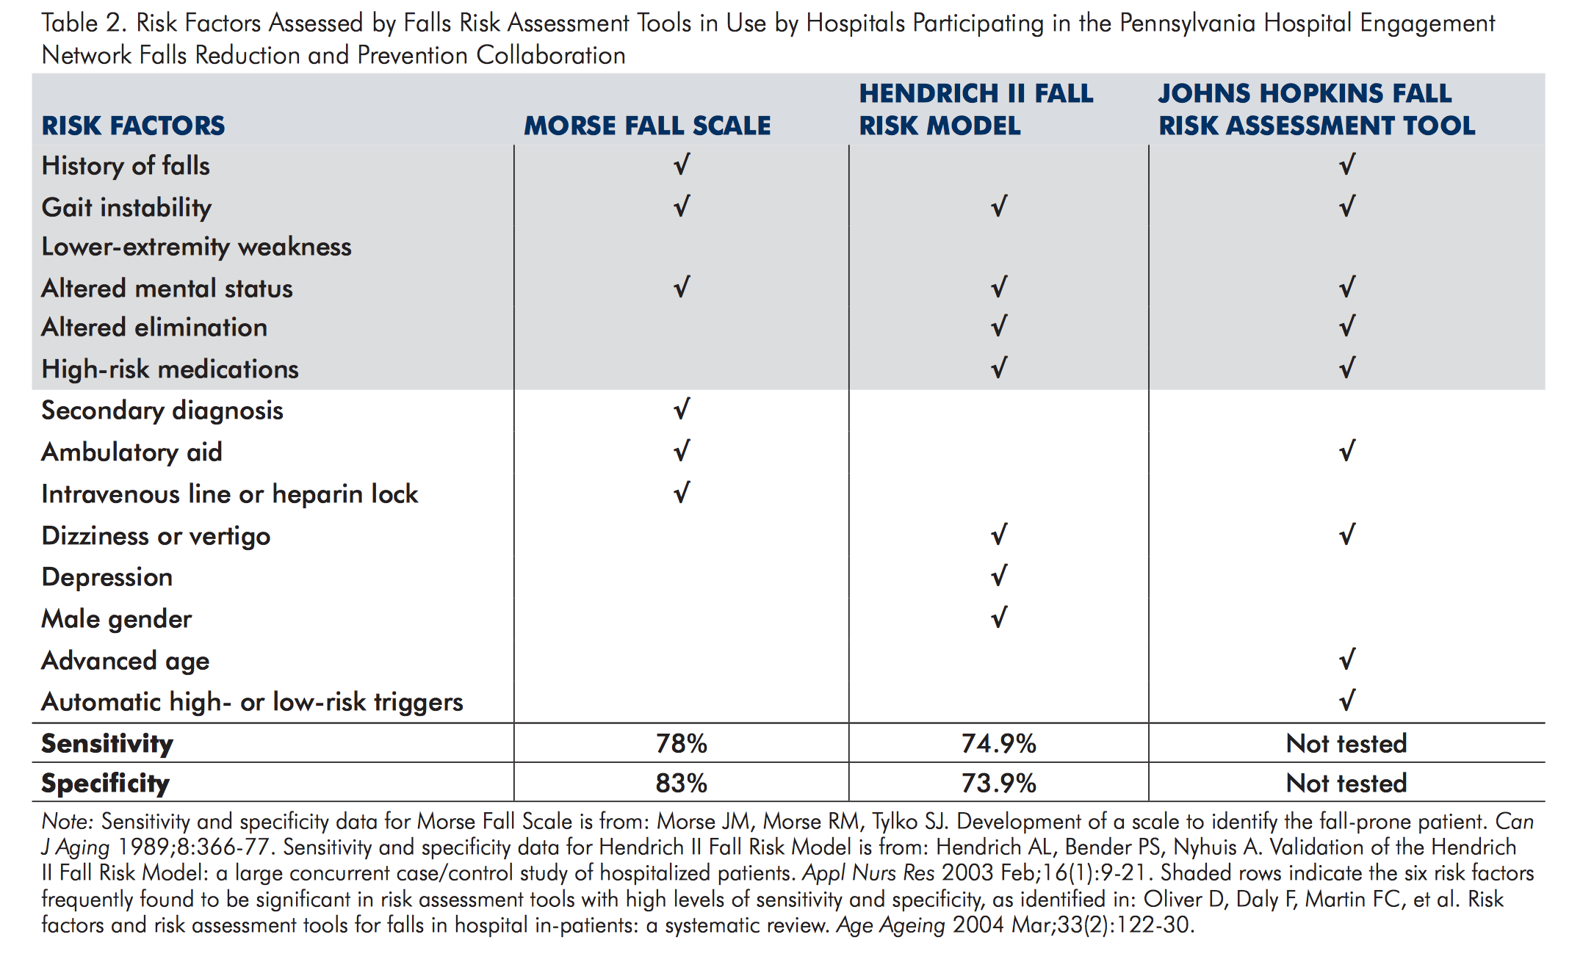

Slide 20
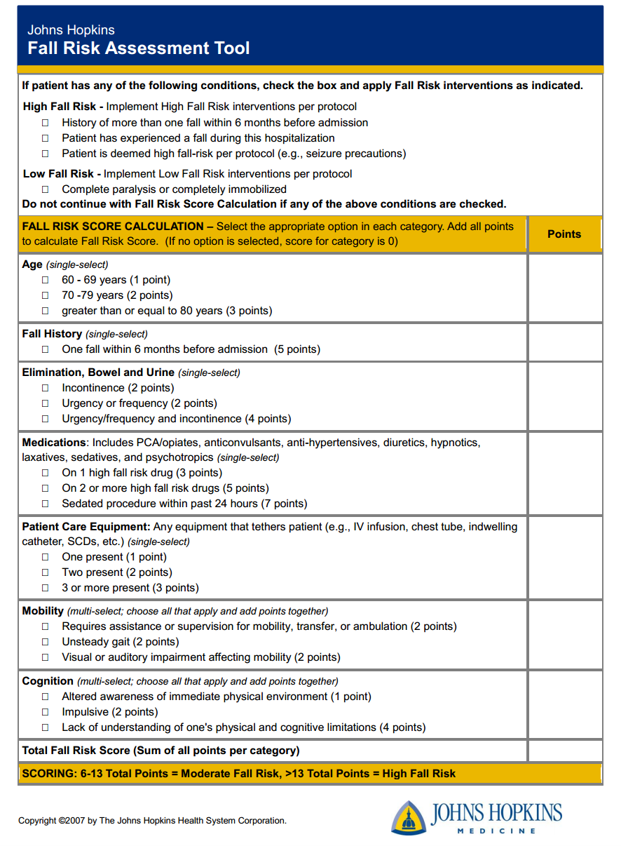

Slide 21
Why focus on preventing falls?
30% of Inpatient Falls Result in Serious Injury
Preventing falls:
Meningkatkan Kepercayaan Pasien
Memperbaiki Pelayanan
Memperbaiki Kepuasan pasien
Menurunkan biaya yang tidak diperlukan baik untuk pasien dan RS
Reduces Risk of Injury to the Caregiver
Notes:
Why should we focus on preventing falls?
According to evidence-based research, out of all inpatient incidents, such as medication errors, pressure ulcers, hospital-acquired pneumonia or surgical site infections, 84% are patient falls. An estimated 30% of inpatient falls results in serious injury, such as a fracture, subdural hematoma, injury requiring surgery, or death. A serious injury due to a fall increases the average length of stay by 6.27 days – increasing the risk of other potential complications, such as pressure ulcers, infections or medication errors. Preventing a patient from falling increases patient comfort, patient & family satisfaction, and confidence in the care they are being provided.
How does preventing falls keep health care workers safe?
According to the Bureau of Labor Statistics, six of the top ten professions with greatest risk of back injuries are: Nurse’s Aides, LPNs, RNs, Health Aides, Radiology Techs, and Physiotherapists. 38% of RNs and 42% of all Direct Caregivers suffer injuries as a result of patient handling activities.
Preventing additional patient handling that will be required after a patient falls is definitely in your best interest. Ensuring you have a fall prevention plan with every patient actually improves your safety and work satisfaction. Identifying and reducing the risk for patient falls often reduces staff workload.
How do patient falls impact the health care system as a whole?
Falls are considered preventable in most cases. The morbidity, mortality and financial burdens attributed to patient falls in hospitals and other healthcare settings are among the most serious risk management issues facing the healthcare industry today.
Preventing falls:
Increases patient trust.
Improves quality of care and patient and family satisfaction
and decreases unnecessary costs for both the patient and the hospital.

Slide 22
What can I do to prevent falls?
Leadership & Frontline Staff Involvement
Identify Fall & Injury Risk Patients
Fall Prevention Interventions
Patient/Family Engagement & Culture
Safety Attitude Culture
Monitor Performance
Notes:
The Washington State Hospital Association Fall Prevention Safety Action Bundle is an evidenced-based document outlining five core strategies necessary for preventing falls. This presentation is focused on the importance of screening patients and identifying those who are at risk for fall and injury.

Slide 23
What is a Fall Risk Assessment?
Screening tool to help determine
patient’s level of fall risk
Notes:
How do we identify patients who are at a high risk for falling and injuring themselves in the hospital?
Evidence has proven that using a fall risk assessment tool to screen all patients, we can identify those patients who may be at a higher risk for falling.
Some fall risk assessment tools that may or may not be used at your hospital are shown on the following slides
The Morse Fall Scale
The STRATIFY assessment
- The Hendrich II Fall Model
You also may have a risk assessment tool developed specifically for your hospital

Slide 24
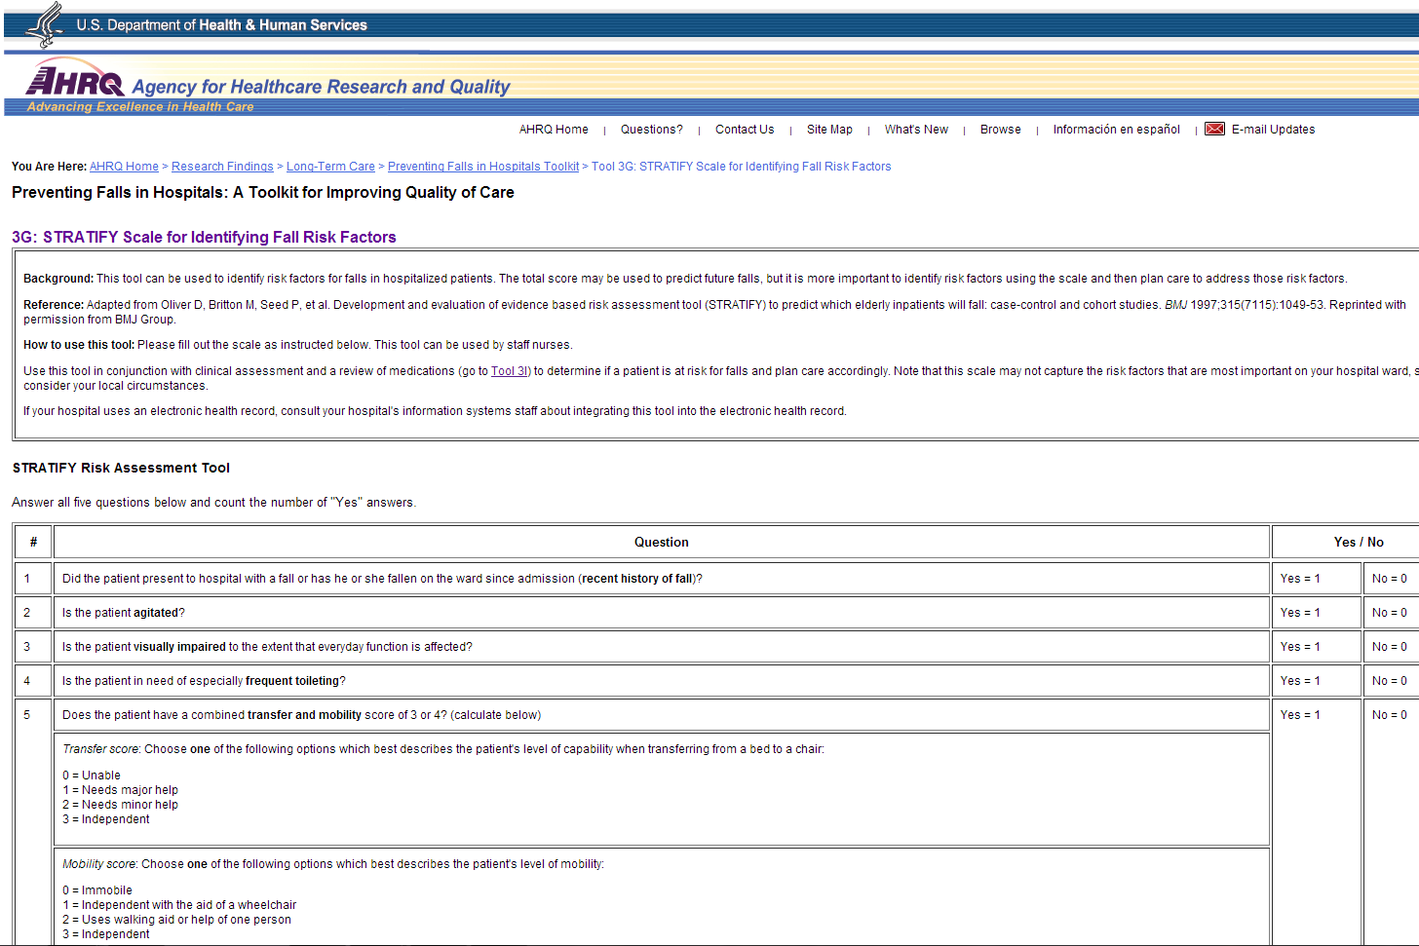
Example: STRATIFY Assessment
Notes:
The STRATIFY assessment

Slide 25
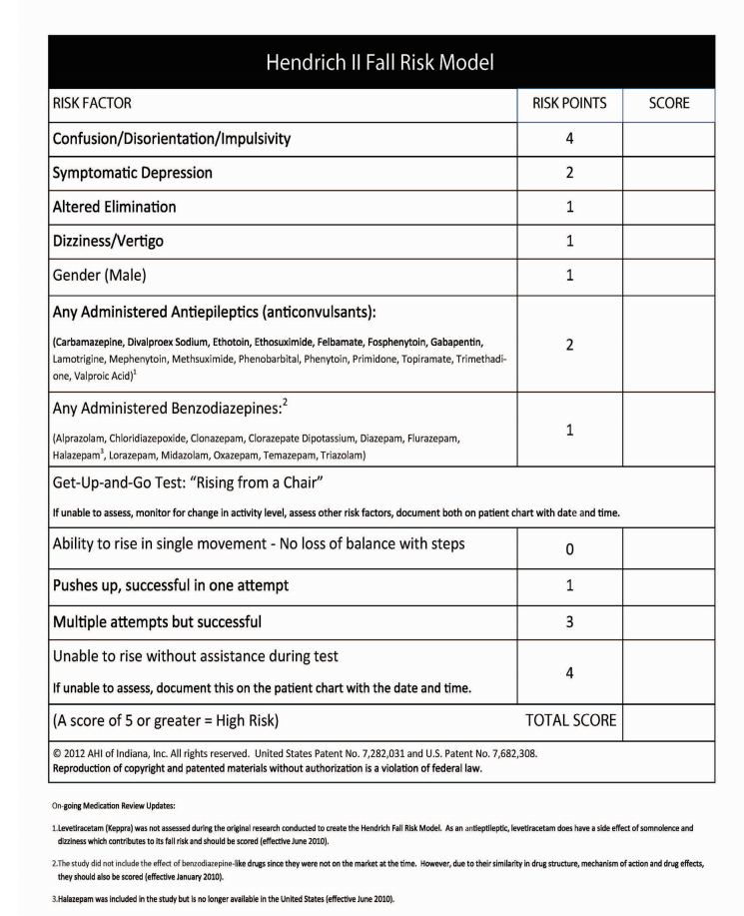
Example: Hendrich II Fall Model
Notes:
- The Hendrich II Fall Model

Slide 26

Is it really that important?
YES
Pasien “Tidak Tahu” kalau Mereka Berisiko Tinggi untuk terjadinya Jatuh
Menggambarkan informasi tentang kondisi pasien
Standar pendekatan untuk “Semua pasien”
Notes:
Is it really that important to do a fall risk assessment on every patient?
Patients usually don’t know that they are at a high risk for falls.
They also may not realize that it is important to tell you that they have fallen 3 times in the past month or that they are making frequent trips to the bathroom.
Patients and families may not understand why medications make them a risk for falls.
Using a risk assessment tool can help draw this information out of patients, and, well - help prevent a fall.
Using a standardized approach for all patients reminds us to consider each patient’s fall risk level.

Slide 27

Which patients are at highest risk for falling?
Punya riwayat “Jatuh”
Penurunan kemampuan : mobilisasi
Gangguan Kognitif
Kebutuhan untuk Toilet
Berumur
Faktor lingkungan
Notes:
Which patients are at the highest risk for falling? What factors are putting them at this higher risk?
Research shows previous falls predict future falls.
Patients who have issues with balance or walking are at a higher risk for falls. Remember to incorporate a mobility assessment such as the Timed Get up and Go test to help determine the patient’s independence with mobility.
Patients who have delirium or dementia may not be able to remember instructions or realize they are a risk or in danger. Those patients are also more likely to wander or be agitated, increasing their risk for falls.
Research has shown, if the patient is taking 2 or more medications, they are at higher risk for falls. Many medications cause balance issues, cognitive and memory impairment, dizziness, and an increased need to void – which can all increase the risk for a fall.
Research shows half the falls in hospitals are associated with toileting-related issues. Patients who are incontinent, need to urinate frequently or have diarrhea are two times more likely to fall.
Advanced age, makes the patient more likely to have all these risk factors, thereby increasing the risk of falls.
Other things to consider are environmental factors:
- Is the patient in a semi-private room or in a private room? – semi private rooms are usually more cluttered.
- Does the patient have IVs or other tubes and wires that can easily get tangled and cause the patient to fall?
- Where is the nurse call button located? – if patient isn’t able to reach the call bell to ask you for help, they are more likely to try and get to whatever they need themselves.
- That is the same with Mobility Aids, they need to be within reach of the patient.- If the patient is not able to reach their walker, cane or wheelchair, they may try to mobilize without them– increasing their risk for a fall.

Slide 28

When and how often to do a
Fall Risk Assessment?
Penentuan resiko jatuh pada saat pasien diterima. (Initial fall risk on admission)
Pengkajian ulang pada pasien yang mengalami perubahan kondisi dan pengobatan. (Re-assess with patient condition or medication change)
Saat perubahan shift dan ronde pasien (At shift change and patient rounds)
Notes:
When and how often should you do a fall risk assessment?
Initial and ongoing fall risk assessments are both important.
Why? Because one of the only constants in healthcare… is that things are going to change, including your patients.
It is important to complete an initial fall risk assessment within two hours of admission.
Numerous evidence-based research indicates the earlier you assess a high risk fall, the less likely there will be an incident.
Reassess fall risk when there is a change in a patient’s condition, when there is an addition or change in medication, immediately following a fall, and each day or with each shift change for high-risk patients.
Any change in the patient’s condition could result in increased risk for falls, such as if the patient becomes sedated with medications or confused after surgery. This includes new medications, or changing medications and any new symptoms, such as vomiting or diarrhea.

Slide 29

I have completed a
Fall Risk Assessment on my patient. What next?
Buat perencanaan pencegahan jatuh pada setiap pasien. (Develop individualized fall prevention plans for each patient)
Ikuti kebijakan RS (Follow the policy in your hospital)
Pelajari Program pencegahan jatuh di RS (Learn about your hospitals Fall Prevention program)
Ikut sertakan pasien dan keluarga untuk mengembangkan perencanaan (Engage patients and families in developing the plan)
Notes:
You have completed a fall risk assessment on your patient. Now what?
Based on the finding of your assessment, you will develop a specific care plan for each patient.
Even though we have standards of care to reduce falls, each patient is unique and has different needs and situations. Make sure to include what is most appropriate for each one of your patients in their care plan.
Remember, Follow the policy in your hospital.
Learn about your hospital’s fall prevention program. Chances are …there are numerous, well-thought out protocols already in place to assist you with preventing your patient from falling.
Ask to be a part of a fall prevention team if you have identified a need for improvement on your unit.
Also remember, engage patients and families in developing the care plan.
Patients and families need to know there is a risk for falling. Encourage them to participate in the care plan so they understand their risks. Armed with education, patients and family members will likely be more compliant with the instructions they are given.

Slide 30
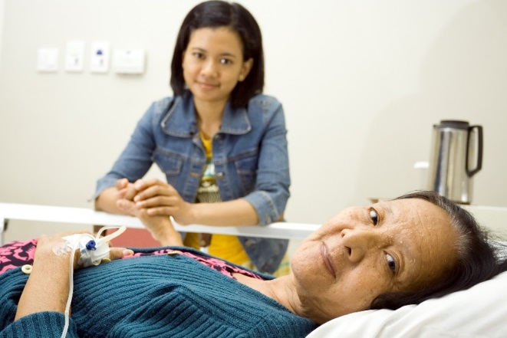


Mrs. Saul
Demographic Information: 73 years old female
Admitted with: Confusion, fever, and a UTI
Social Situation: Lives at home alone
Her granddaughter, Skyler, checks-in every 3-4 days
Medications: High blood pressure and cholesterol, low dose aspirin, and a multi-vitamin.
Fall History: Once, 2 months ago, with no serious injuries
Additional Observations: Mrs. Saul is weak, dehydrated, and is unable to follow simple commands or answer basic questions
Notes:
Let’s work through a case study together.
Mrs. Saul is a 73 year old female admitted to a private room in your hospital directly from her doctor’s office with confusion, fever, and a urinary tract infection.
She lives at home alone, however, her granddaughter, Skyler, checks-in every 3-4 days and is here with Mrs. Saul during your assessment.
Mrs. Saul takes daily medications for high blood pressure and cholesterol, a low dose aspirin, and a multi-vitamin.
According to Skyler, there was a previous fall at home, with no serious injuries, about 2 months ago.
She appears weak, dehydrated, and is unable to follow simple commands or answer basic questions.

Slide 31

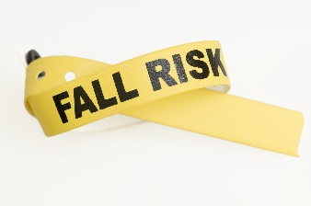
Mrs. Saul
Aspek apa saja yang mempengaruhi resiko jatuh pada Pasien Mrs. Saul?
History of falls
Cognitive impairment
Age consideration
Current medications
Family situation
Diagnosis and Symptoms
Notes:
Based on what you know about Mrs Saul, take a moment to think about which factors may be contributing to her risk for a fall:
Her history of falls
Her cognitive impairment
Her age Her current Medications
Her family situation
The diagnosis/Symptoms
are all fall risk factors for Mrs. Saul.

Slide 32
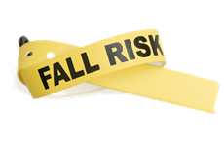
Mrs. Saul
Informasi apa yang hilang?
Data apa yang diperlukan tinggi jatuh?
Mobility issues
Elimination
Medications
Environmental factors
Notes:
What information is missing? What else would you need to assess in order to determine if Mrs. Saul is a high fall risk?
To gain a comprehensive picture of fall risk you will also want to ask…
Does Mrs. Saul use a mobility aid? Does she have any current or potential balance issues?
Is she having any incontinence issues?
Have any new meds been started at admission? Or, have any medications or doses changed?
Is Mrs. Saul connected to any IVs or monitoring equipment? Is she in a semi-private or private room?

Slide 33
Mrs. Saul
Faktor apa yang harus dipertimbangkan untuk membuat perencanaan pada pasien tersebut?
Impaired cognition
Dehydration and Medication
Weakness
Previous fall
Increased need for toileting
Notes:
What risk factors are you noticing that would need to be considered when developing your intervention plan or care plan for Mrs Saul?
Mrs. Saul inability to follow simple commands or answer questions may demonstrate delirium or potential longstanding cognitive impairment. This will likely affect her ability to understand her fall risk and remember instructions she is given.
Mrs. Saul is dehydrated and on blood pressure medication, so could have dizziness, especially when trying to stand.
Weakness may also cause balance/mobility issues.
The granddaughter mentioned a recent previous fall at home, so that places Mrs. Saul at higher risk for another fall.
Mrs. Saul lives alone and may have fallen more than the one reported incident.
Since Mrs. Saul was diagnosed with a urinary tract infection, she may be experiencing frequent urination or urgency requiring her to feel the need to toilet more often.

Slide 34
Mrs. Saul
How often should you review the falls risk and update interventions on this patient?
Change in patient condition
Change in medications
Shift change or Staff change
Post-fall
Notes:
How often should you review the falls risk and update interventions on this patient?
Reassess fall risk when there is a change in the patient’s condition,
when there is an addition or change in medication,
each day or with each shift change or when handing-off a patient
as well as immediately following a fall.

Slide 35

What have we learned?
Complete fall risk assessment
Know risk factors
Initiate a care plan for each patient
Reassess patient’s fall risk when indicated
Engage patients and families in assessment and prevention
Include patient risk and care plan
with your colleagues
Notes:
Recap. What have we learned?
Complete a fall risk assessment, including a mobility assessment, on all patients. It allows you to customize your intervention plan for each patient.
Certain factors place some patients at a higher risk than others. Know those factors, know why they may cause a fall, and keep a look out for those factors when assessing your patients.
Initiate a care plan for each patient based on what you discover through a fall risk assessment.
Reassess patient’s fall risk when there is a change in a patient’s condition, when there is an addition or change in medication, each day or with each shift change and immediately following a fall.
Engage patients and families in the assessment and prevention plan and make sure to include patient risk and care plan with your colleagues .

Slide 36
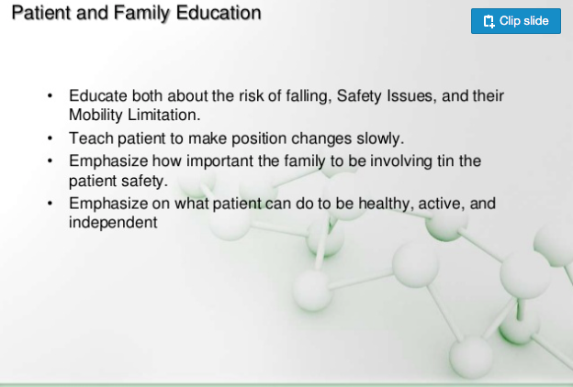

Slide 37
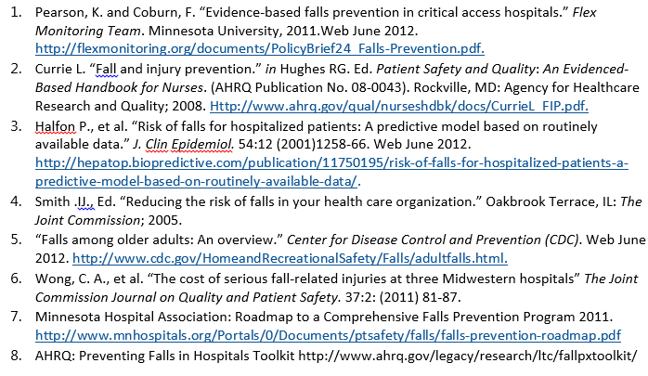
Resources
Notes:
List of resources used to develop the content for this presentation

